Slide 1
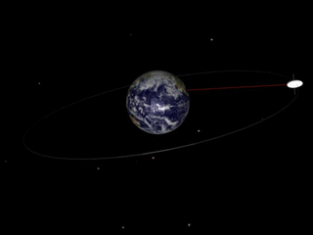



SATELLITES 1.0

Slide 2
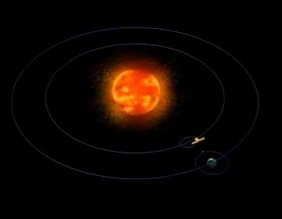
What is a satellite?
SPACEMATTERS.CA
Notes:
Can anyone tell me what a satellite is?

Slide 3
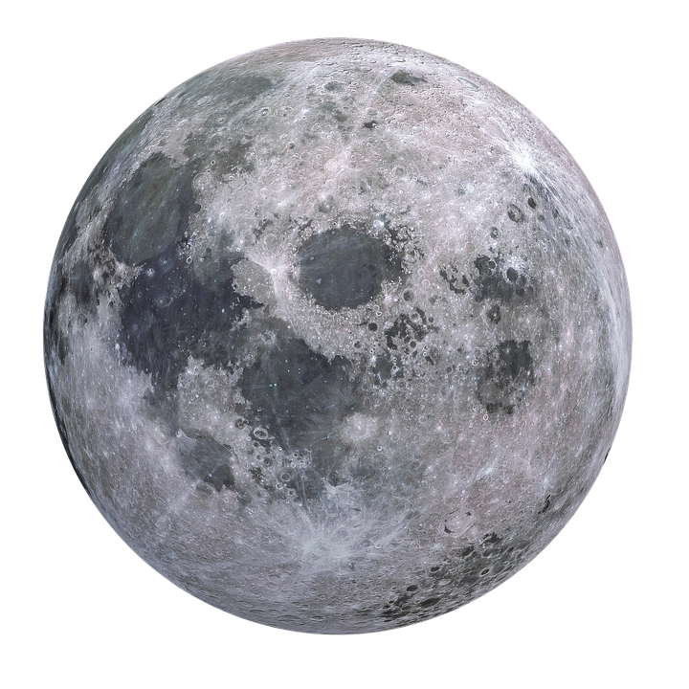

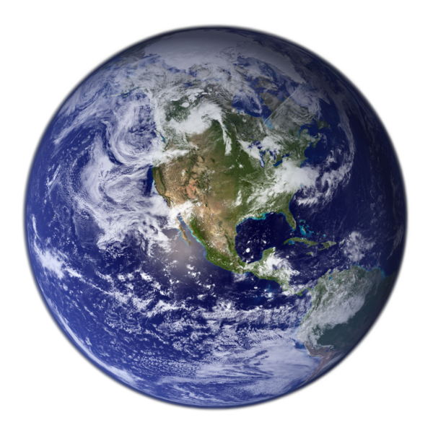
Satellite:
An object, moon, or planet that orbits a sun or planet.
SPACEMATTERS.CA
Notes:
A satellite is an object, moon, or planet that orbits a sun or planet. E.g., the Earth is a satellite because it orbits the Sun. Likewise, the moon is a satellite because it orbits the Earth. When we say ‘satellite’, we’re usually referring to the machines that are orbiting Earth. Basically, anything that is orbiting another thing.

Slide 4
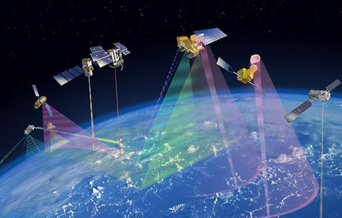
Why do we need satellites?
SPACEMATTERS.CA
Notes:
Above you now, there are thousands of human-made satellites orbiting Earth (over 1000 are still active)
**Pair the students and let them brainstorm for 5 minutes on different uses of satellites, then take up with the students.

Slide 5

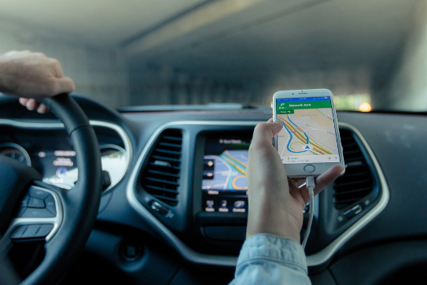
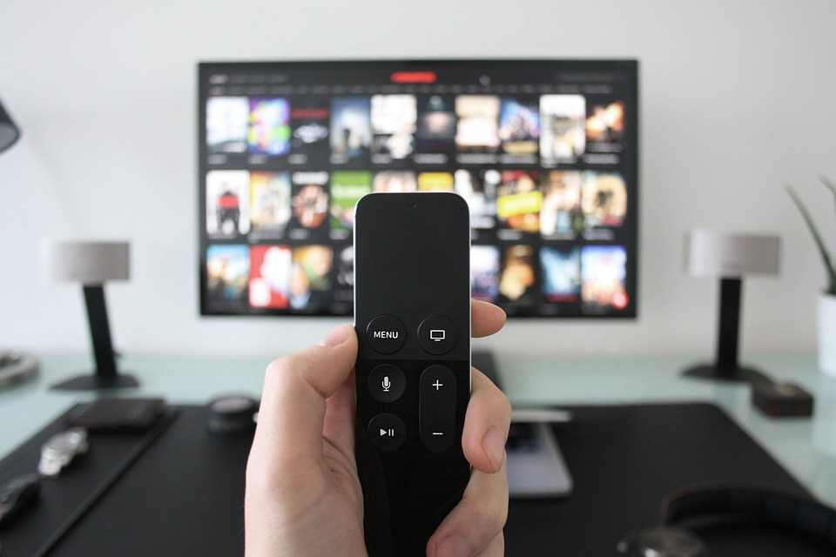

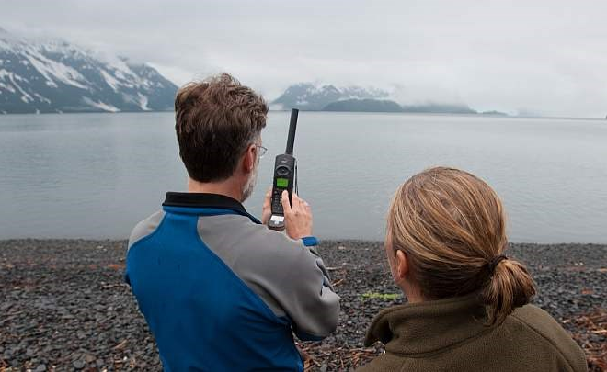
Communication
and navigation
SPACEMATTERS.CA
Notes:
Satellites carry instruments used for many applications:
-Sending communication signals (radio, TV, internet, telephone)
-Connecting Automatic Teller Machines (ATMs) to your bank so you can make those quick withdrawals or deposits
-Sending Global Positioning System (GPS) information to your phone, computer, or other GPS device so you can know where you are, and where you’re going.
*Did you know Canada was the first to have a domestic communication satellite in geostationary orbit (orbit matches Earth’s rotations so it stays above Canada all the time)? This allowed communications signals to be broadcast across the

Slide 6
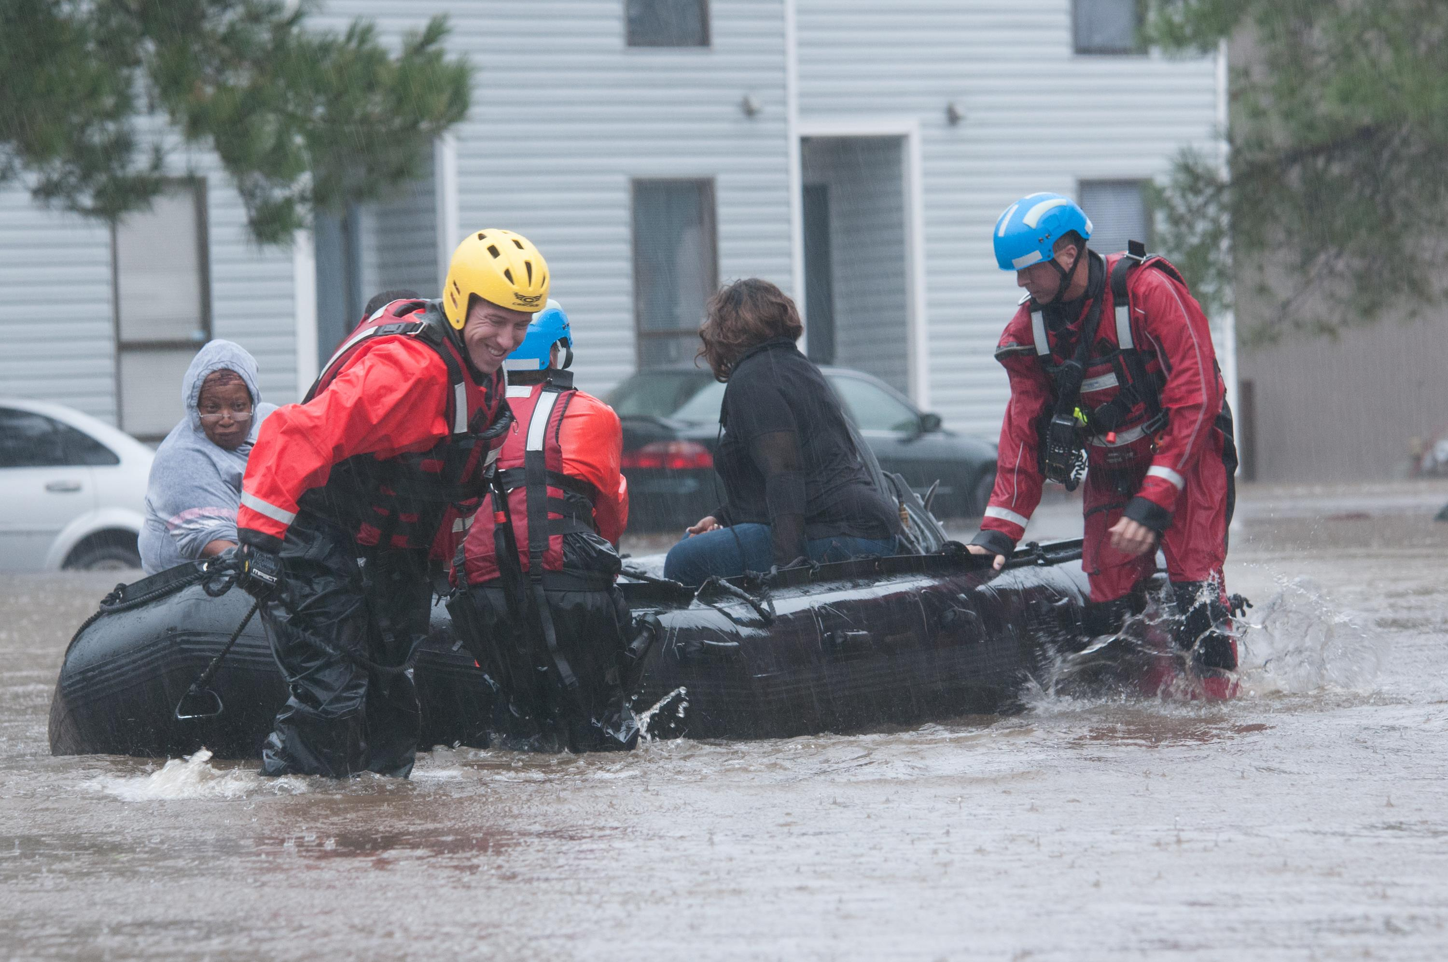
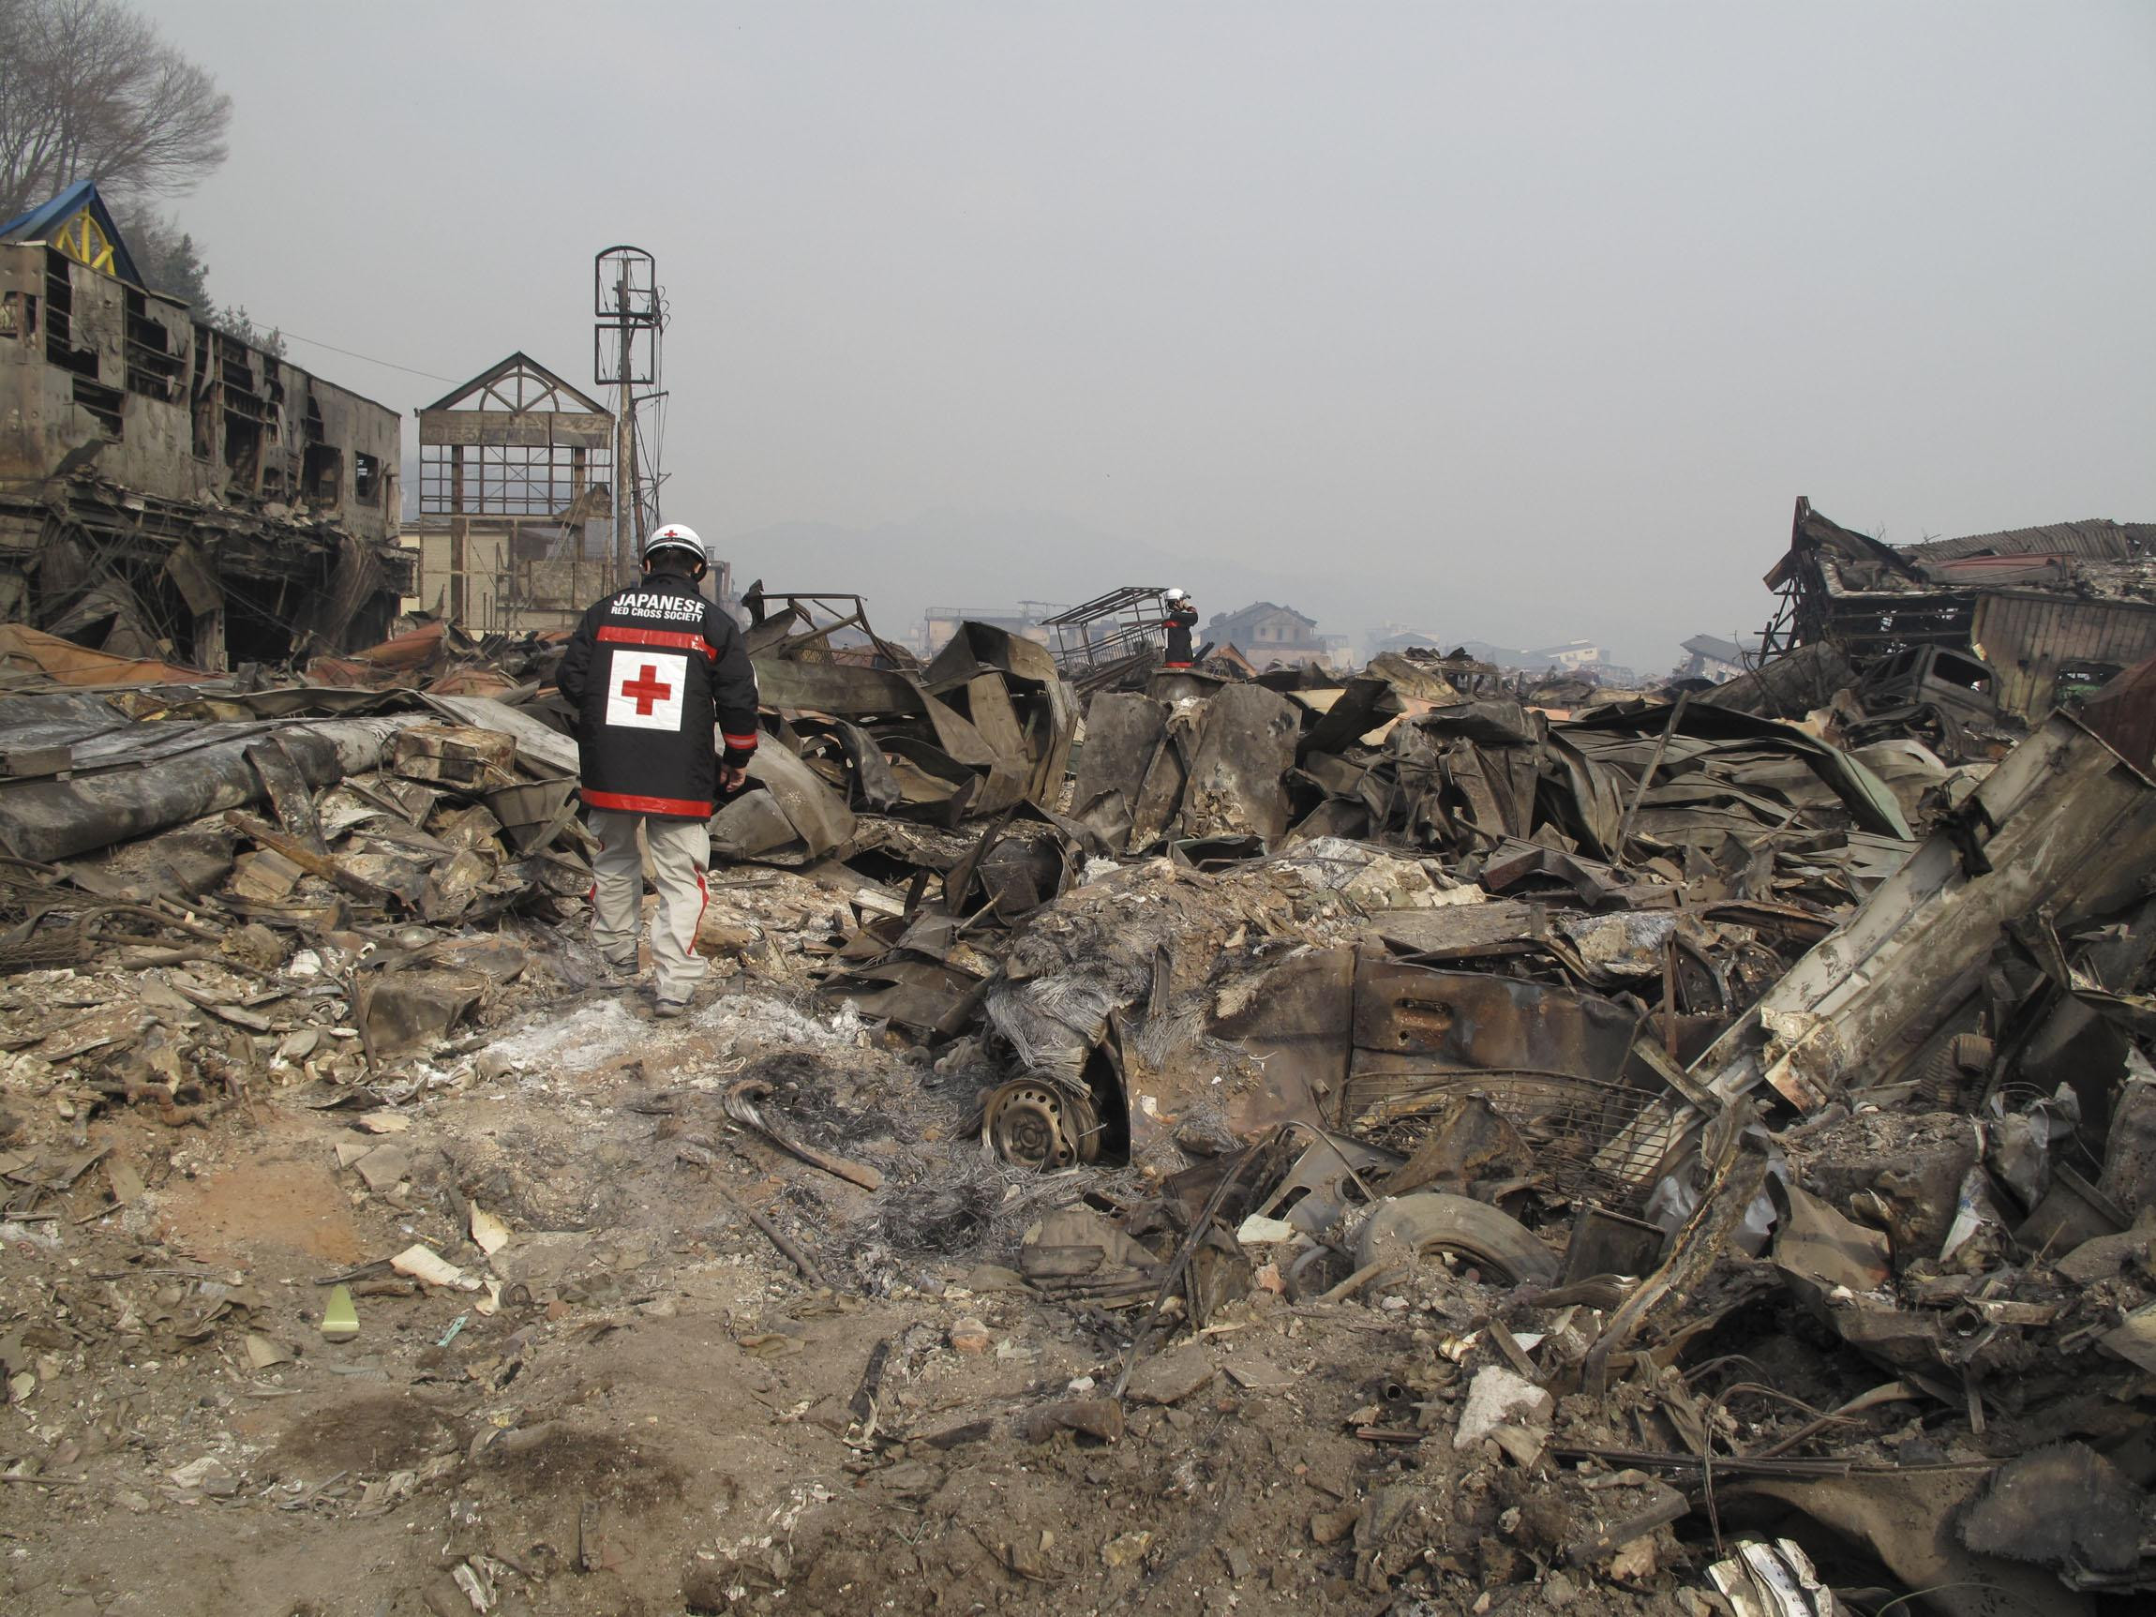
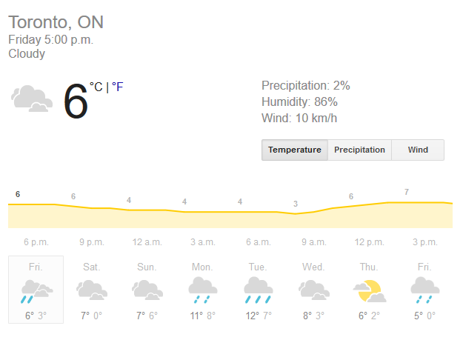
Weather, climate,
natural disasters
SPACEMATTERS.CA
Notes:
-Monitoring and forecasting weather patterns, climate, and natural disasters
-Assisting in disaster response and rescue operations in planning their routes and finding people in need
*International Charter Space and Major Disasters: is an international effort to aid in the response, rescue, and recovery after natural disasters by using satellite imagery. Canada’s RADARSAT2 satellite plays a huge role in providing high resolution imagery of these locations.

Slide 7
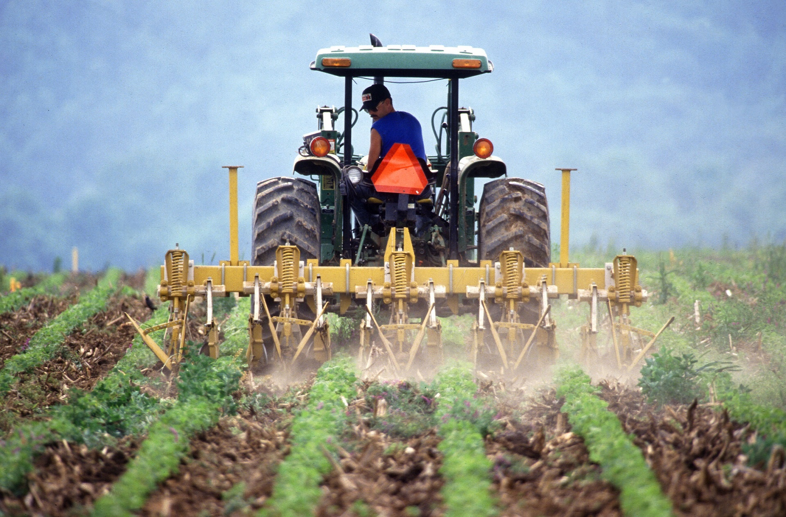
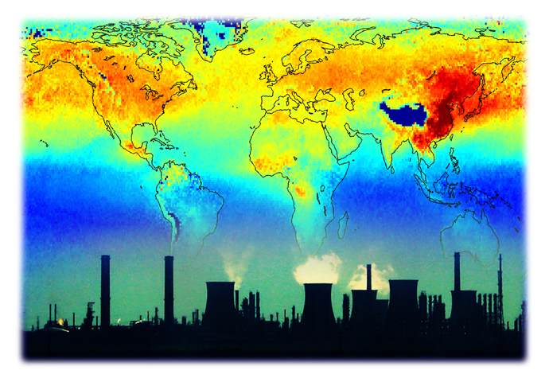
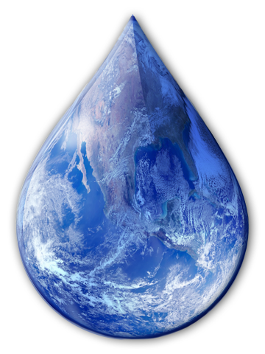
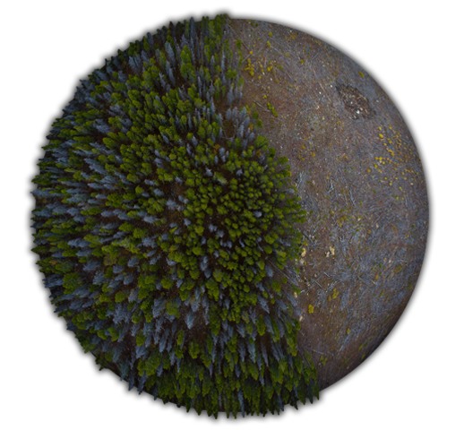
Earth systems
SPACEMATTERS.CA
Notes:
Studying Earth:
-Monitoring our atmosphere and pollution
-Monitoring our forests and oceans/snow/ice
-Assessing vegetation health and soils, help farmers plan and prepare for their seasons and crops
*Earth observation is especially important in the study of climate change: observing patterns over time can help us understand causes, predict future outcomes, and plan accordingly.

Slide 8
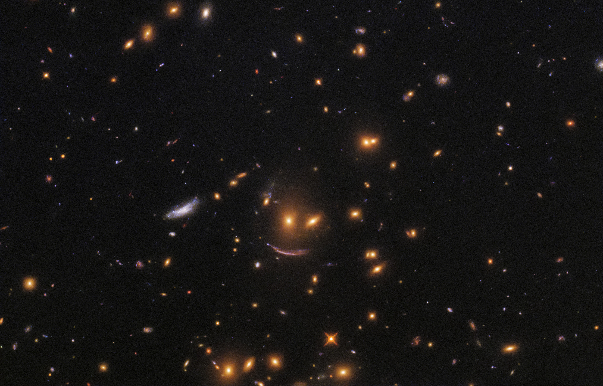
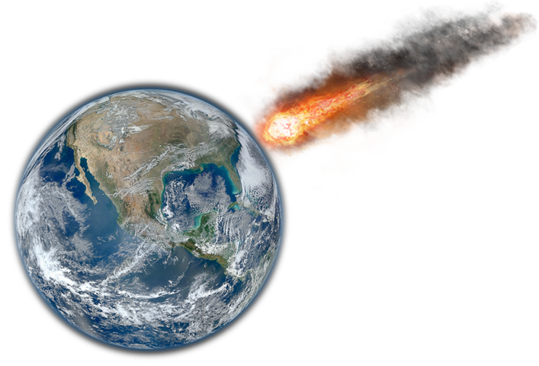
Space science and exploration
Image: ESA/Hubble & NASA; Acknowledgment: Judy Schmidt (geckzilla)
SPACEMATTERS.CA
Notes:
-Or looking out into space, studying stars and far away galaxies
-Watching for near-Earth asteroids… kind of important
These are just a few satellite applications. Today we are going to take a look at one in particular…

Slide 9
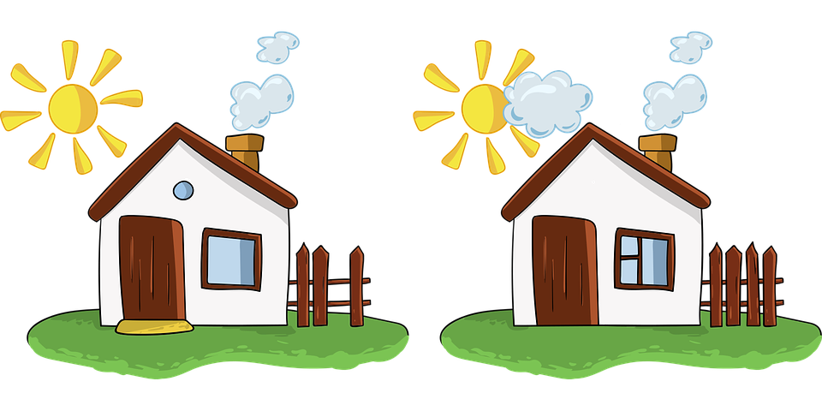
Change detection
Using images or pictures to look for changes.
Study the past
Understand the cause
Forecast the future
Spot the difference!
SPACEMATTERS.CA
Notes:
Change detection. Change detection is like those ‘Spot the difference’ games: you compare images for anything that is different. Older images can help us study the past. Watching changes over time can help us understand the cause and forecast the future.

Slide 10
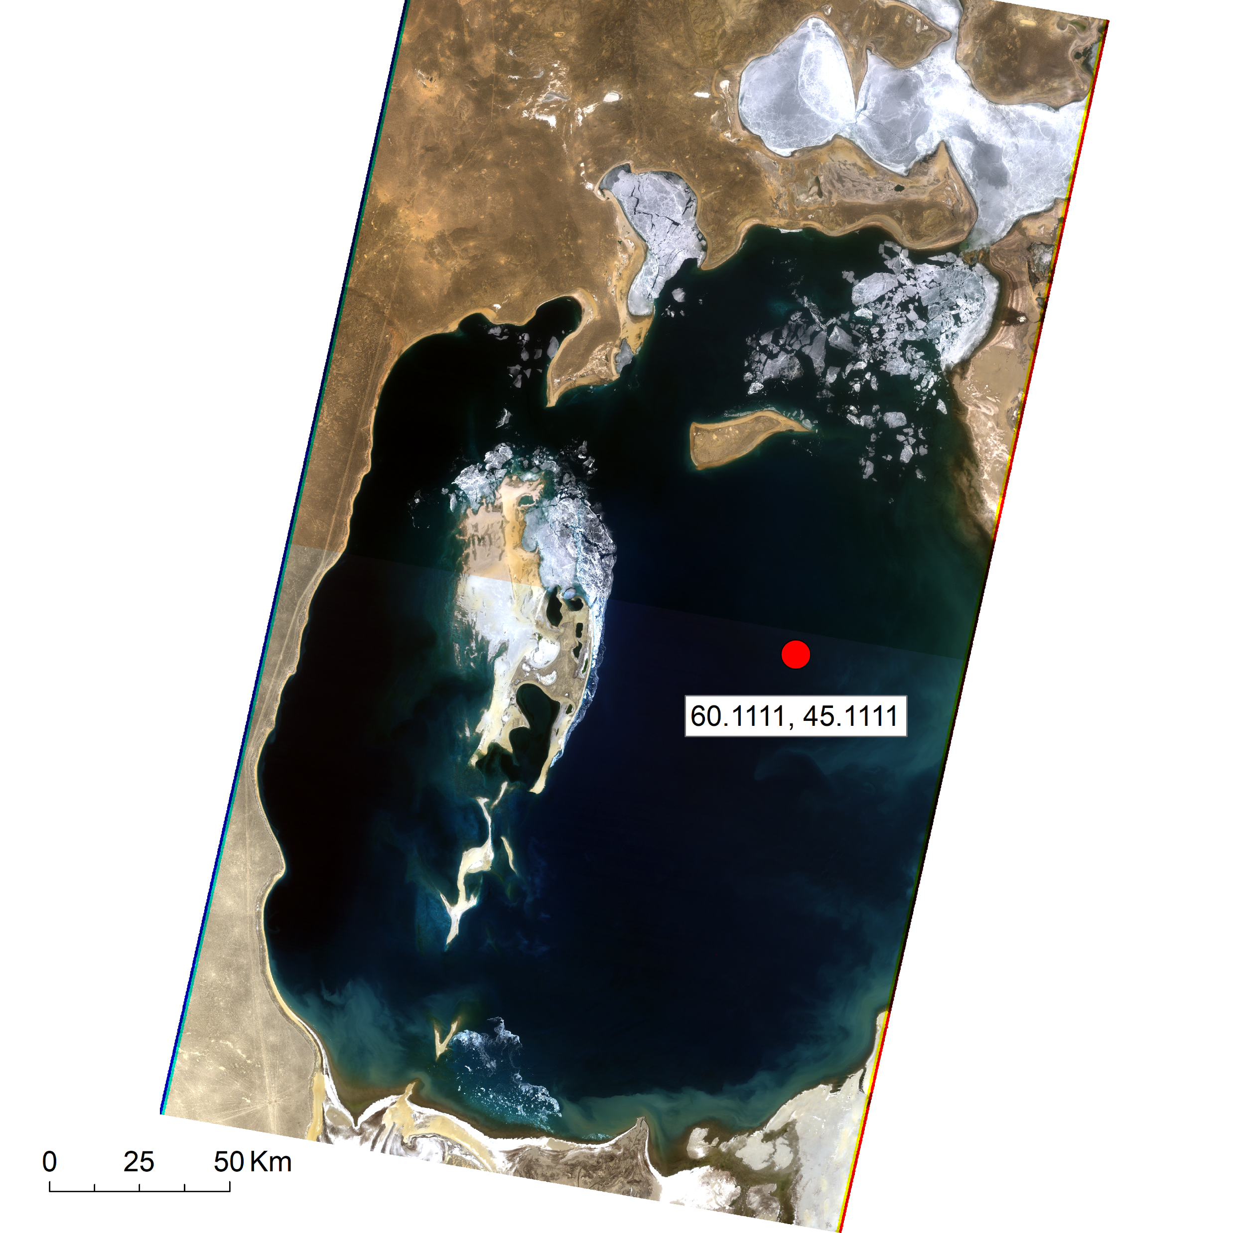
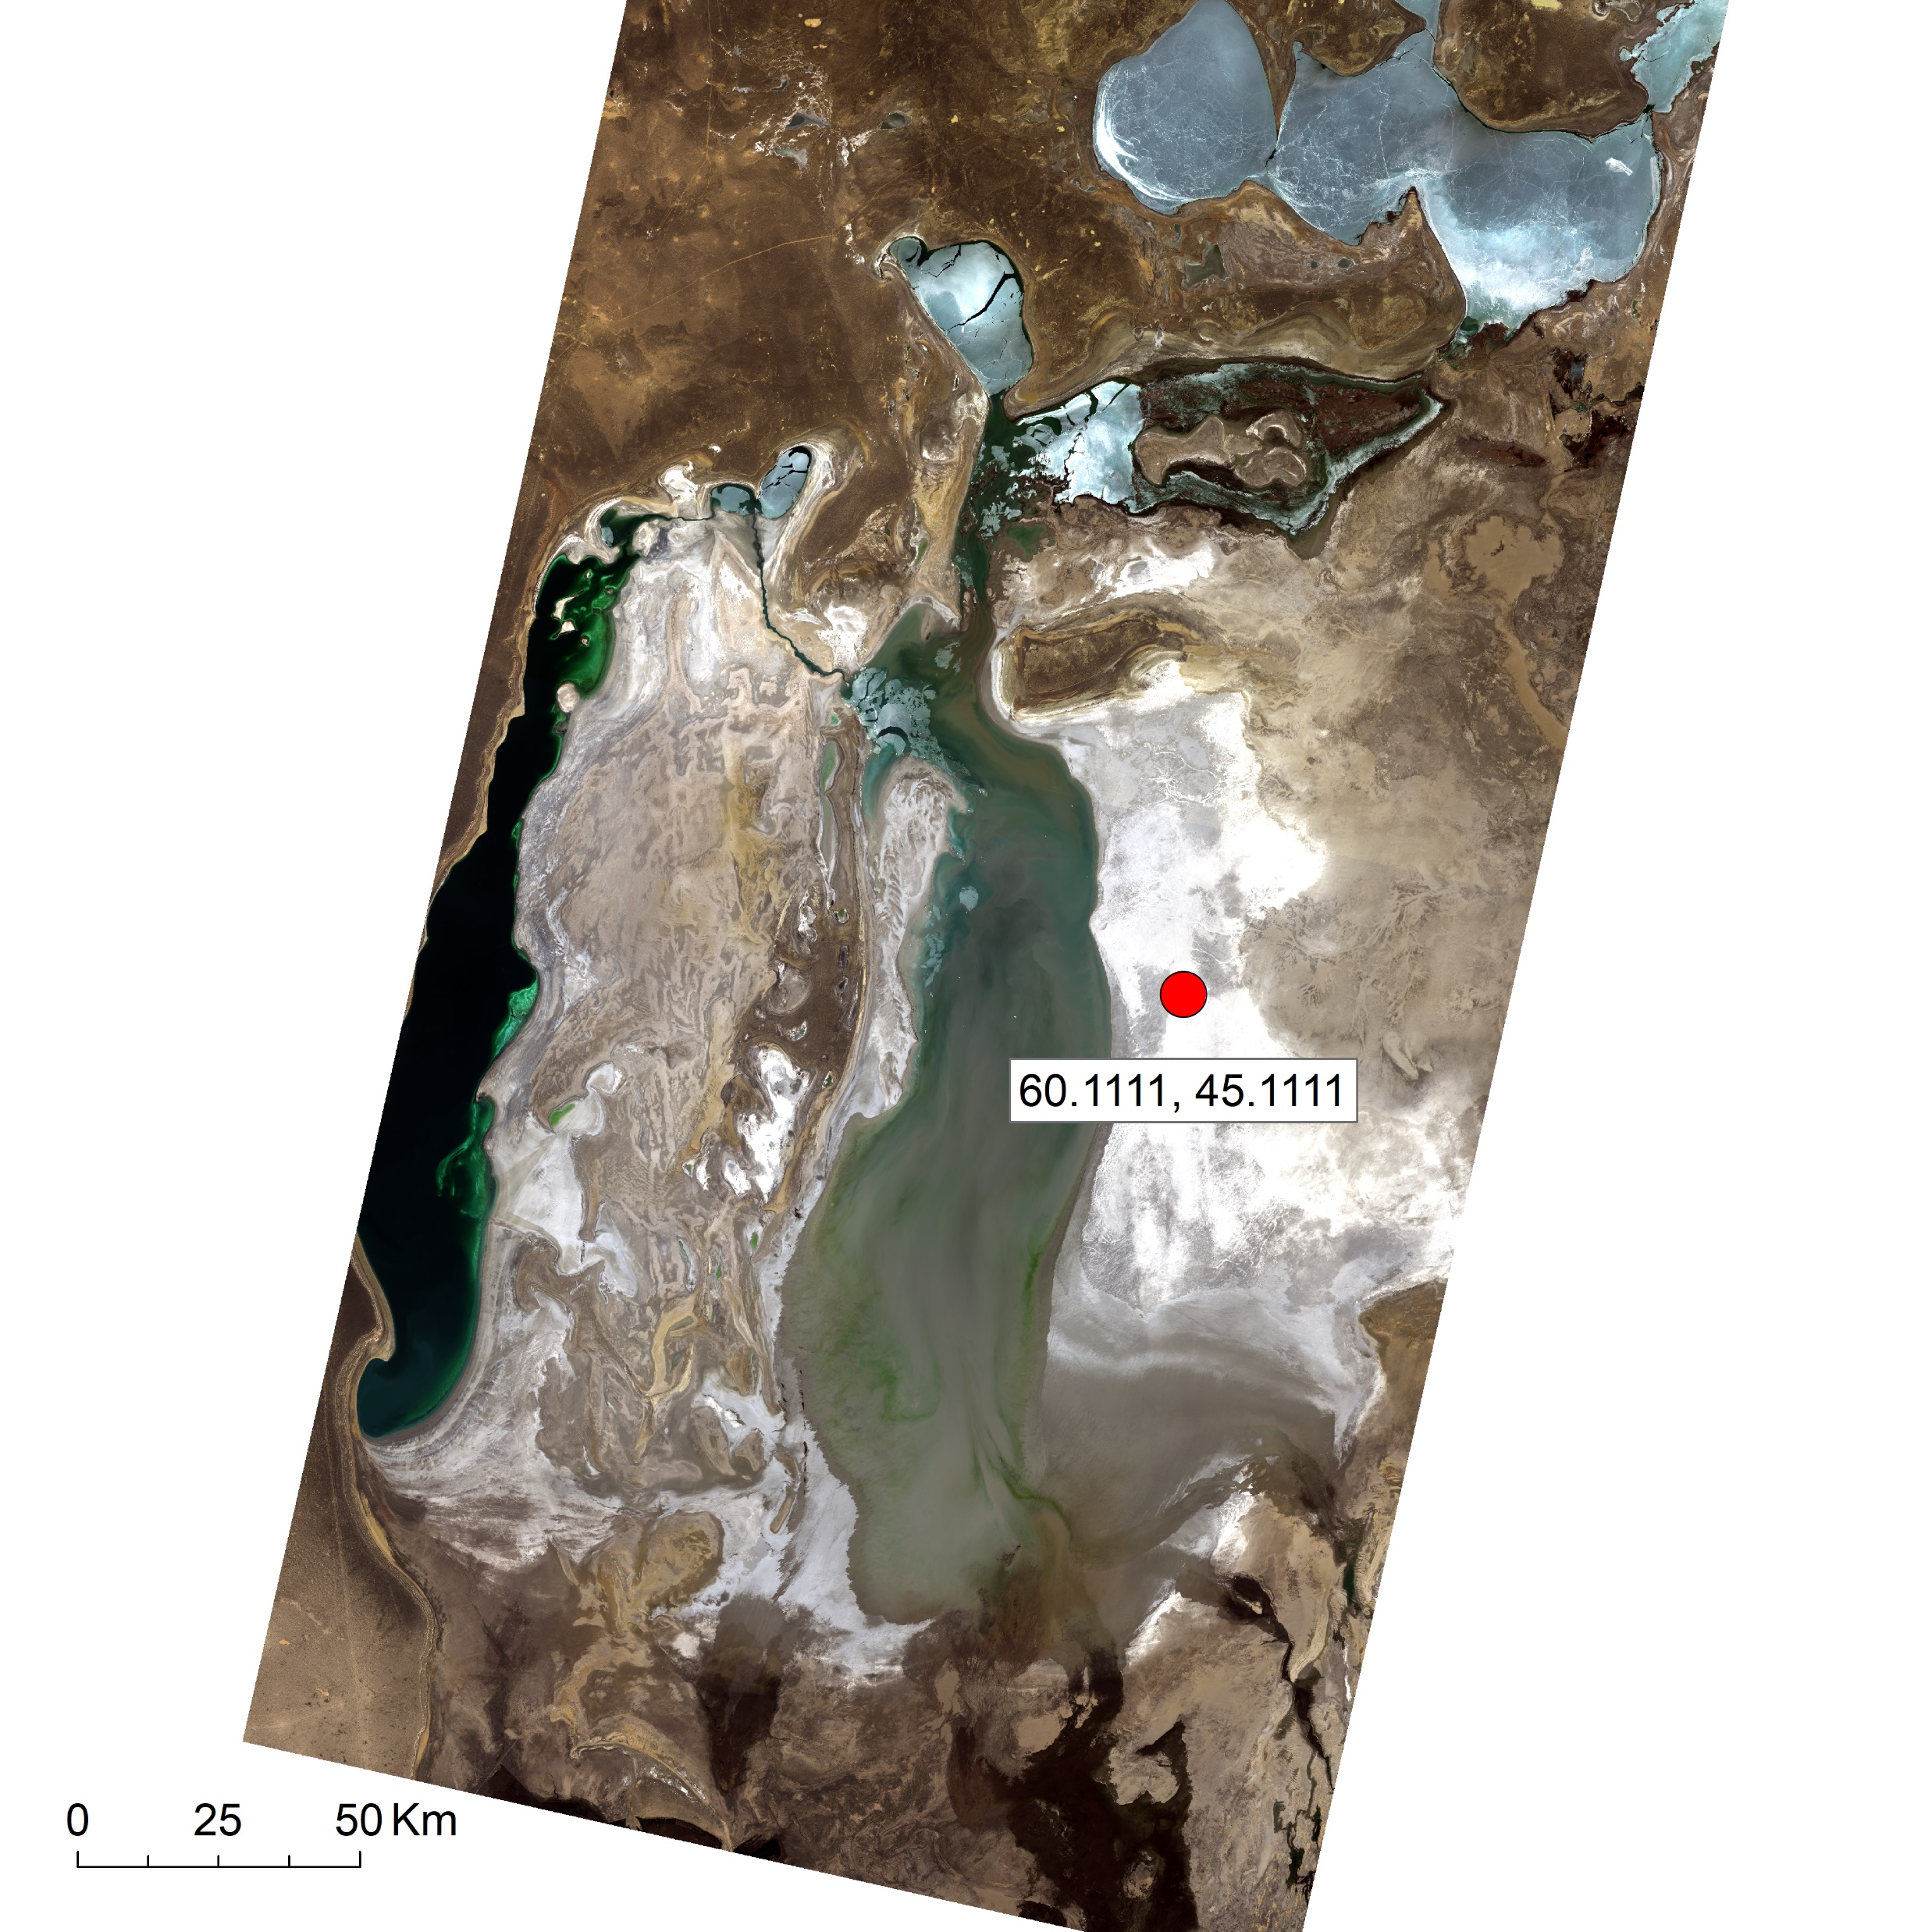
April 1986
April 2018
Landsat satellite images courtesy of U.S. Geological Survey
SPACEMATTERS.CA
Notes:
We are going to do some change detection right now. In your groups/pair you will be looking at satellite images like this and seeing what changes you can see. The worksheets have a few questions that you should brainstorm together as well. Let’s try this one together.
Describe what you see? Answer: water/lake, land, snow/ice
What are the differences? Answer: The image on the left is over 30 years older than the image on the right. less water on the right
What caused this/what does this tell us/why is it important? Answer: the lake is drying up! This is bad because we need water for growing crops, for the fish and wildlife, and the dry conditions left behind feed dust storms that are toxic to the people (this area was used for nuclear testing so the sediment contains toxic material that can be dangerous if suspended and transported in the air).
*This is Aral Sea, Kazakhstan. It used to be the 4th largest lake in the world but the rivers that fed it were used for watering surrounding crops so it has since dried up. We use satellite imagery to monitor our lakes and oceans for the water levels and pollution.

Slide 11
IN YOUR GROUPS
1. Describe what you see
2. What are the differences between the images?
3. What caused this/what does this tell us/why is this important?
SPACEMATTERS.CA
Notes:
Have the pairs/groups examine each image and brainstorm the following questions:
1. Describe what you see.
2. What are the differences between the images (students can use markers to circle or measure changes)
3. What caused this/what does this tell us/why is this important?

Slide 12
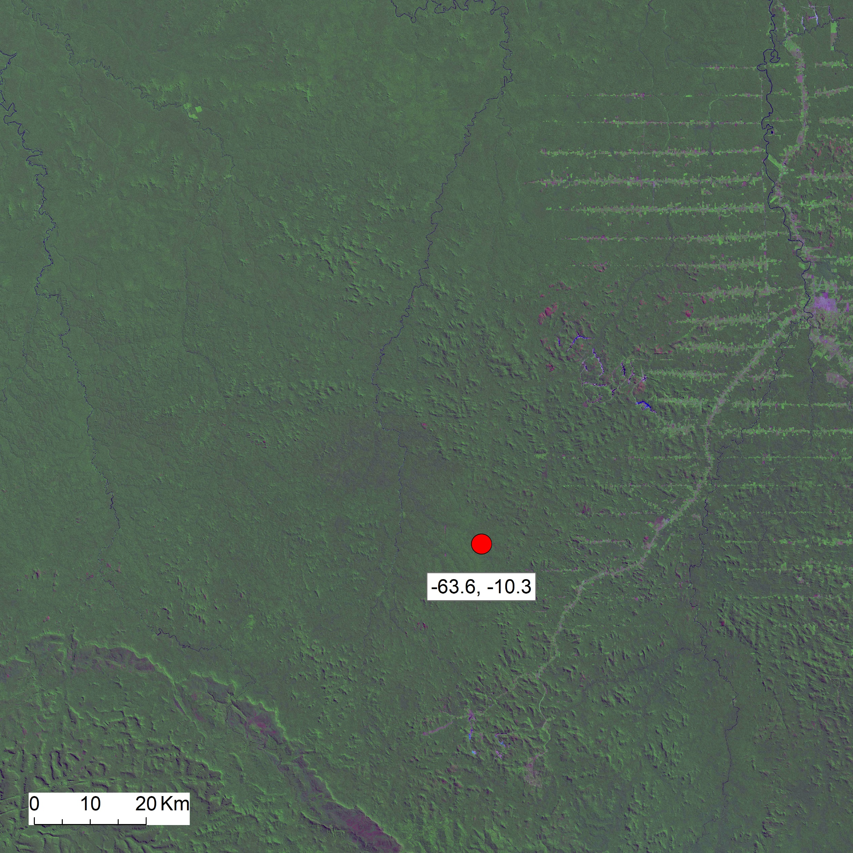
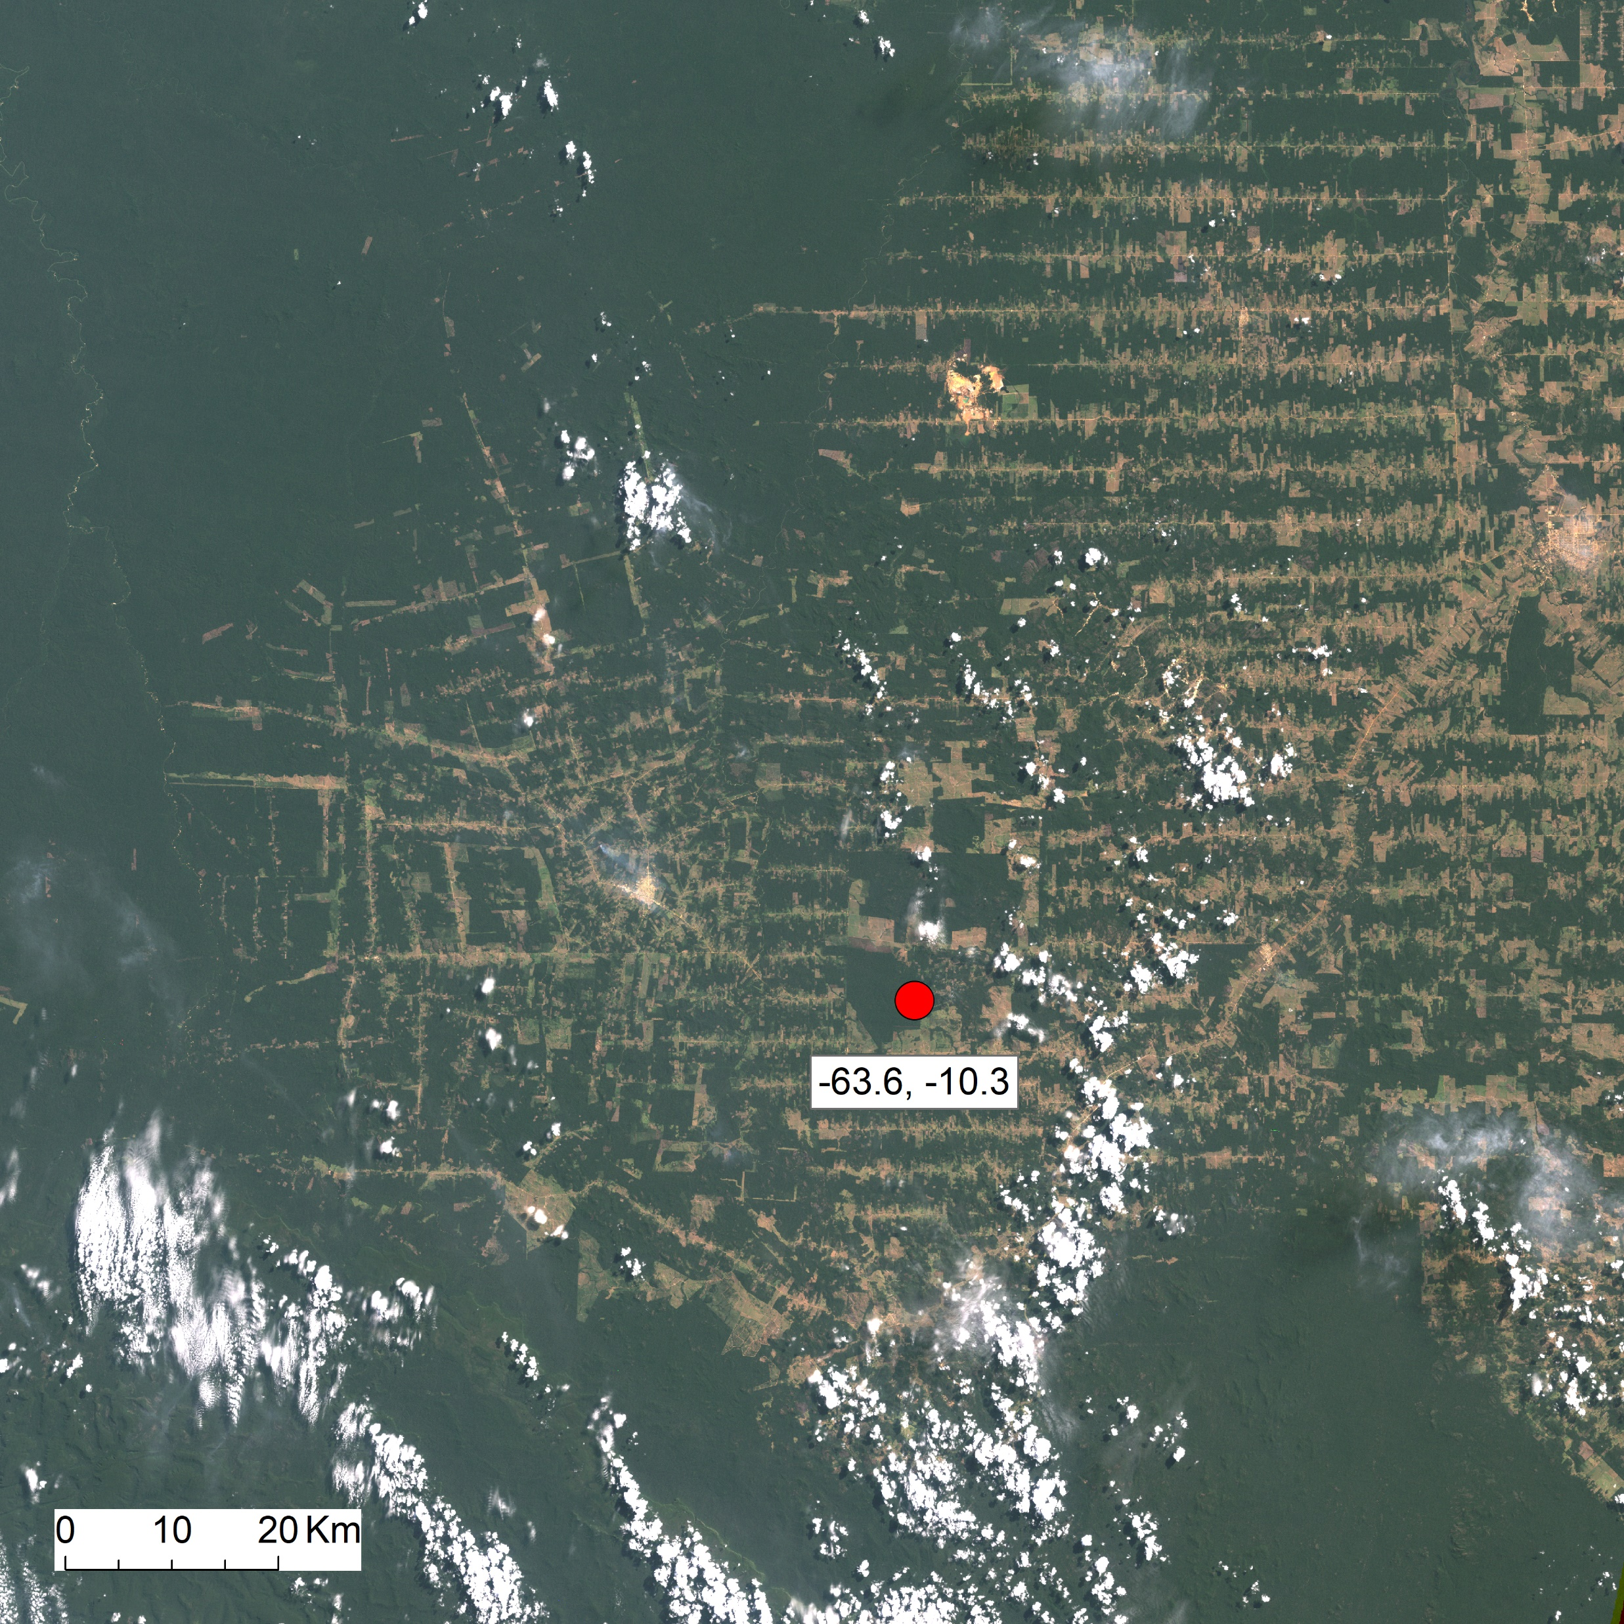
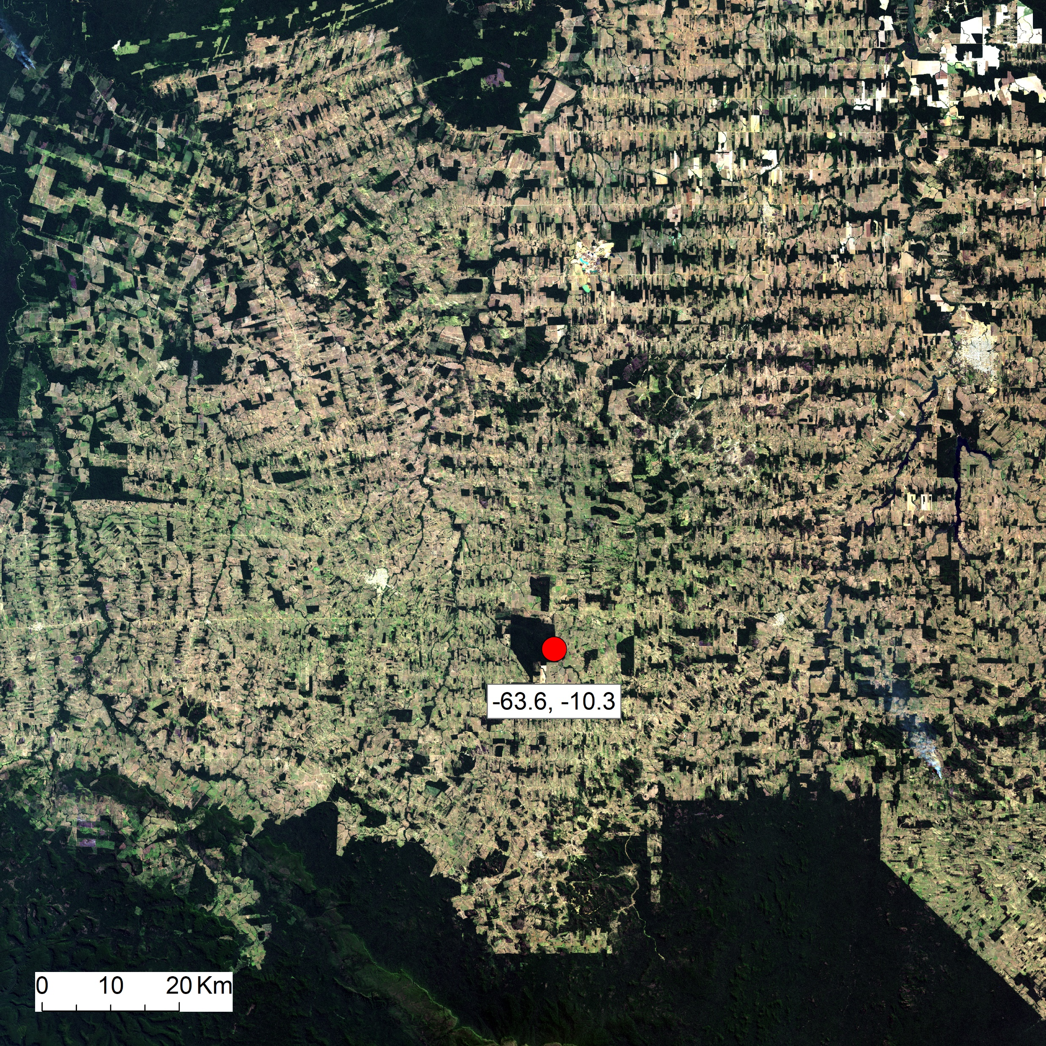
Scene A
June 1984
July 2000
July 2018
SPACEMATTERS.CA
Notes:
**Ask the class:
Describe what you see. Answers: trees/plants, rivers, clouds, treeless land.
What are the differences between the images? Answers: 16 years between 1st and 2nd image, and 18 years between 2nd and 3rd. Less and less trees with time. A much bigger change between the 2nd and 3rd image.
3. What caused this/what does this tell us/why is this important? Answers: Deforestation. Deforestation rates have increased. We need forests for many reasons:
-Clean up the atmosphere (take in carbon dioxide), and reduce global warming
-Home to millions of species including indigenous communities that need the forests to survive and practice their traditional ways of life
-Provide the oxygen we breathe
Regular monitoring of forests is needed for sustainable forest management, e.g., monitoring for over-harvesting, assessing reforestation efforts, and knowing what areas to protect. Satellites can help us understand the health/condition of forests and also the effects of deforestation and/or reforestation.
*This is part of the Amazon rainforest, Rondonia, Brazil. The main driver of deforestation here is cattle ranching.

Slide 13
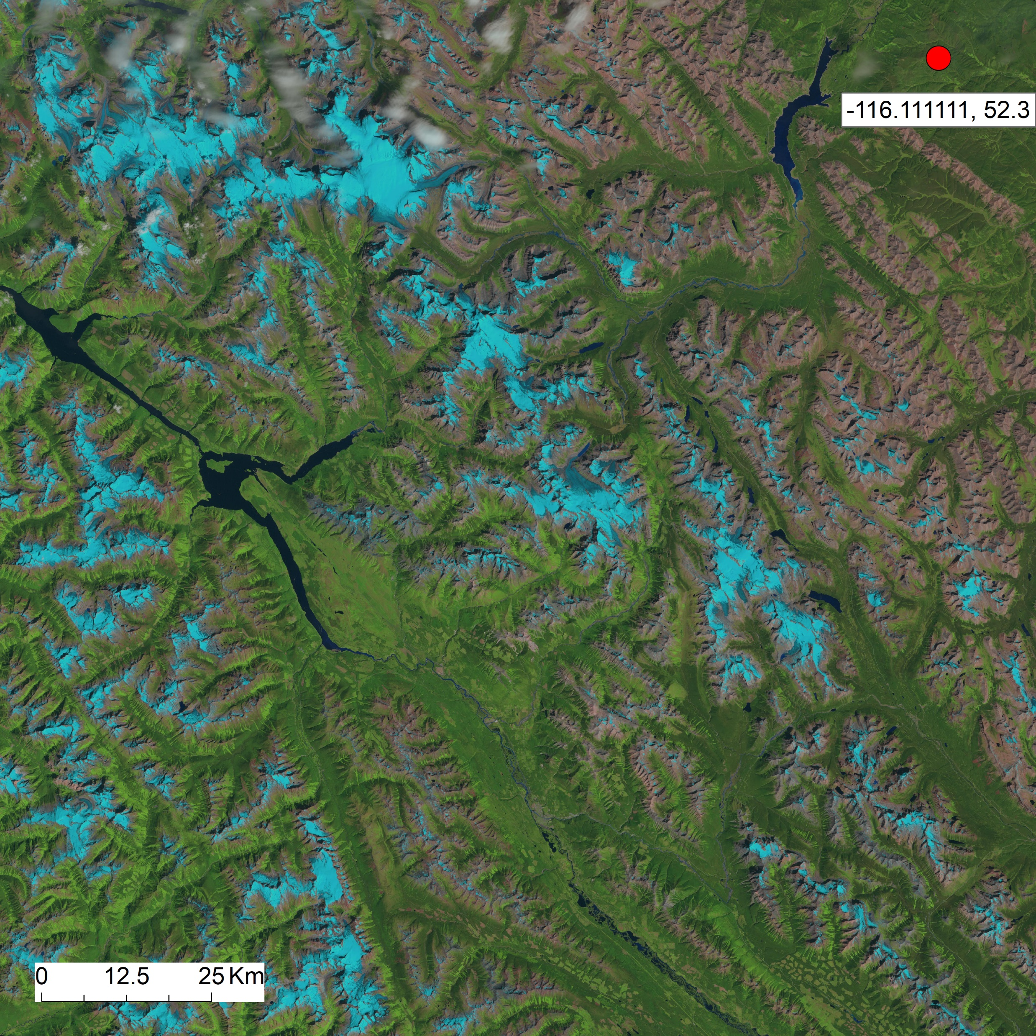
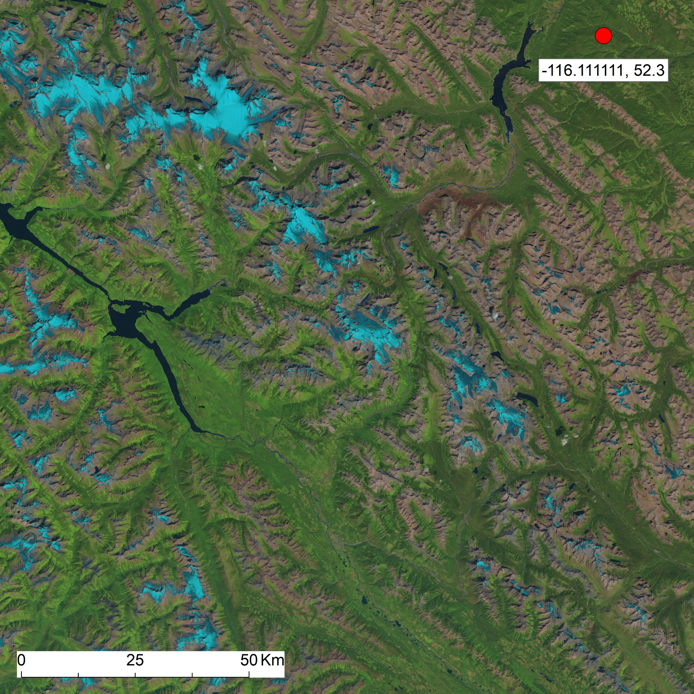
Scene B
August 1990
August 2015
SPACEMATTERS.CA
Notes:
**Ask the class:
1. Describe what you see. Answers: Mountains, tree/plants, glaciers/ice, rivers.
2. What are the differences between the images? Answers: A 25-year difference. The glaciers/snow are shrinking with time.
3. What caused this/what does this tell us/why is this important? Answers: The glaciers and snow are melting because the climate is warming. Snow and glaciers are important for many reasons:
-Reflecting sunlight, which helps to keep the Earth cool. This is called the ‘Albedo effect’. With less snow, albedo effect decreases, more sun is absorbed by the Earth, which creates warmer conditions, which melts more snow, which decreases albedo… and so on. This is a feedback loop that increases the rate of global warming.
-Glaciers are also a source of fresh water for people and animals down stream.
* These are glaciers of the Rocky Mountains, Alberta, Canada, including Peyto Glacier.

Slide 14
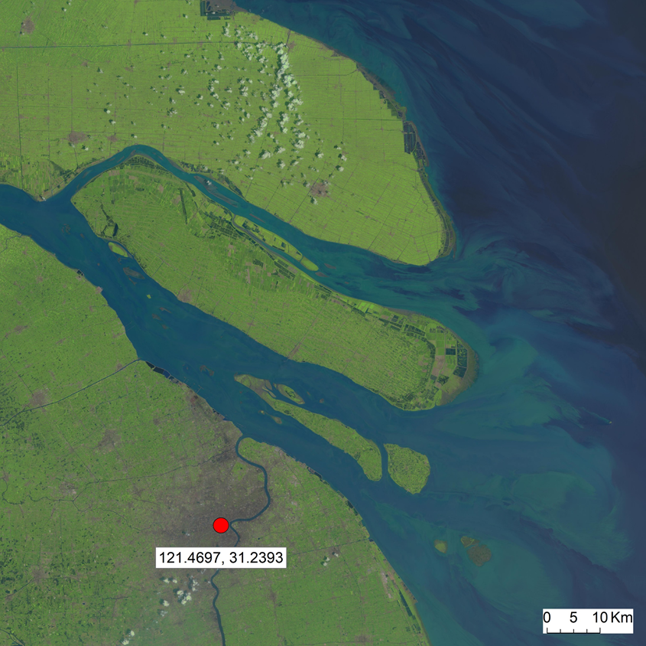
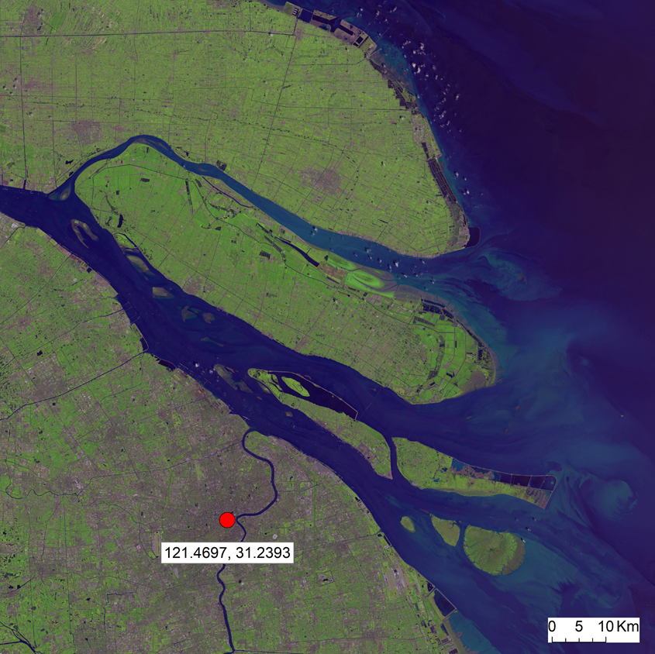
Scene C
September 2000
August 2017
SPACEMATTERS.CA
Notes:
**Ask the class:
1. Describe what you see. Answers: Water, clouds, green land, a big city, and some smaller cities/towns, boats (in second image).
2. What are the differences between the images? Answers: A 27-year difference. The cities are getting bigger. New docks on the coast.
3. What caused this/what does this tell us/why is this important? Answers: Urbanization! Population is growing and more people are moving into cities. Monitoring city growth is important in urban development such as planning transit systems, water systems, and housing and business.
*This is Shanghai, China.

Slide 15
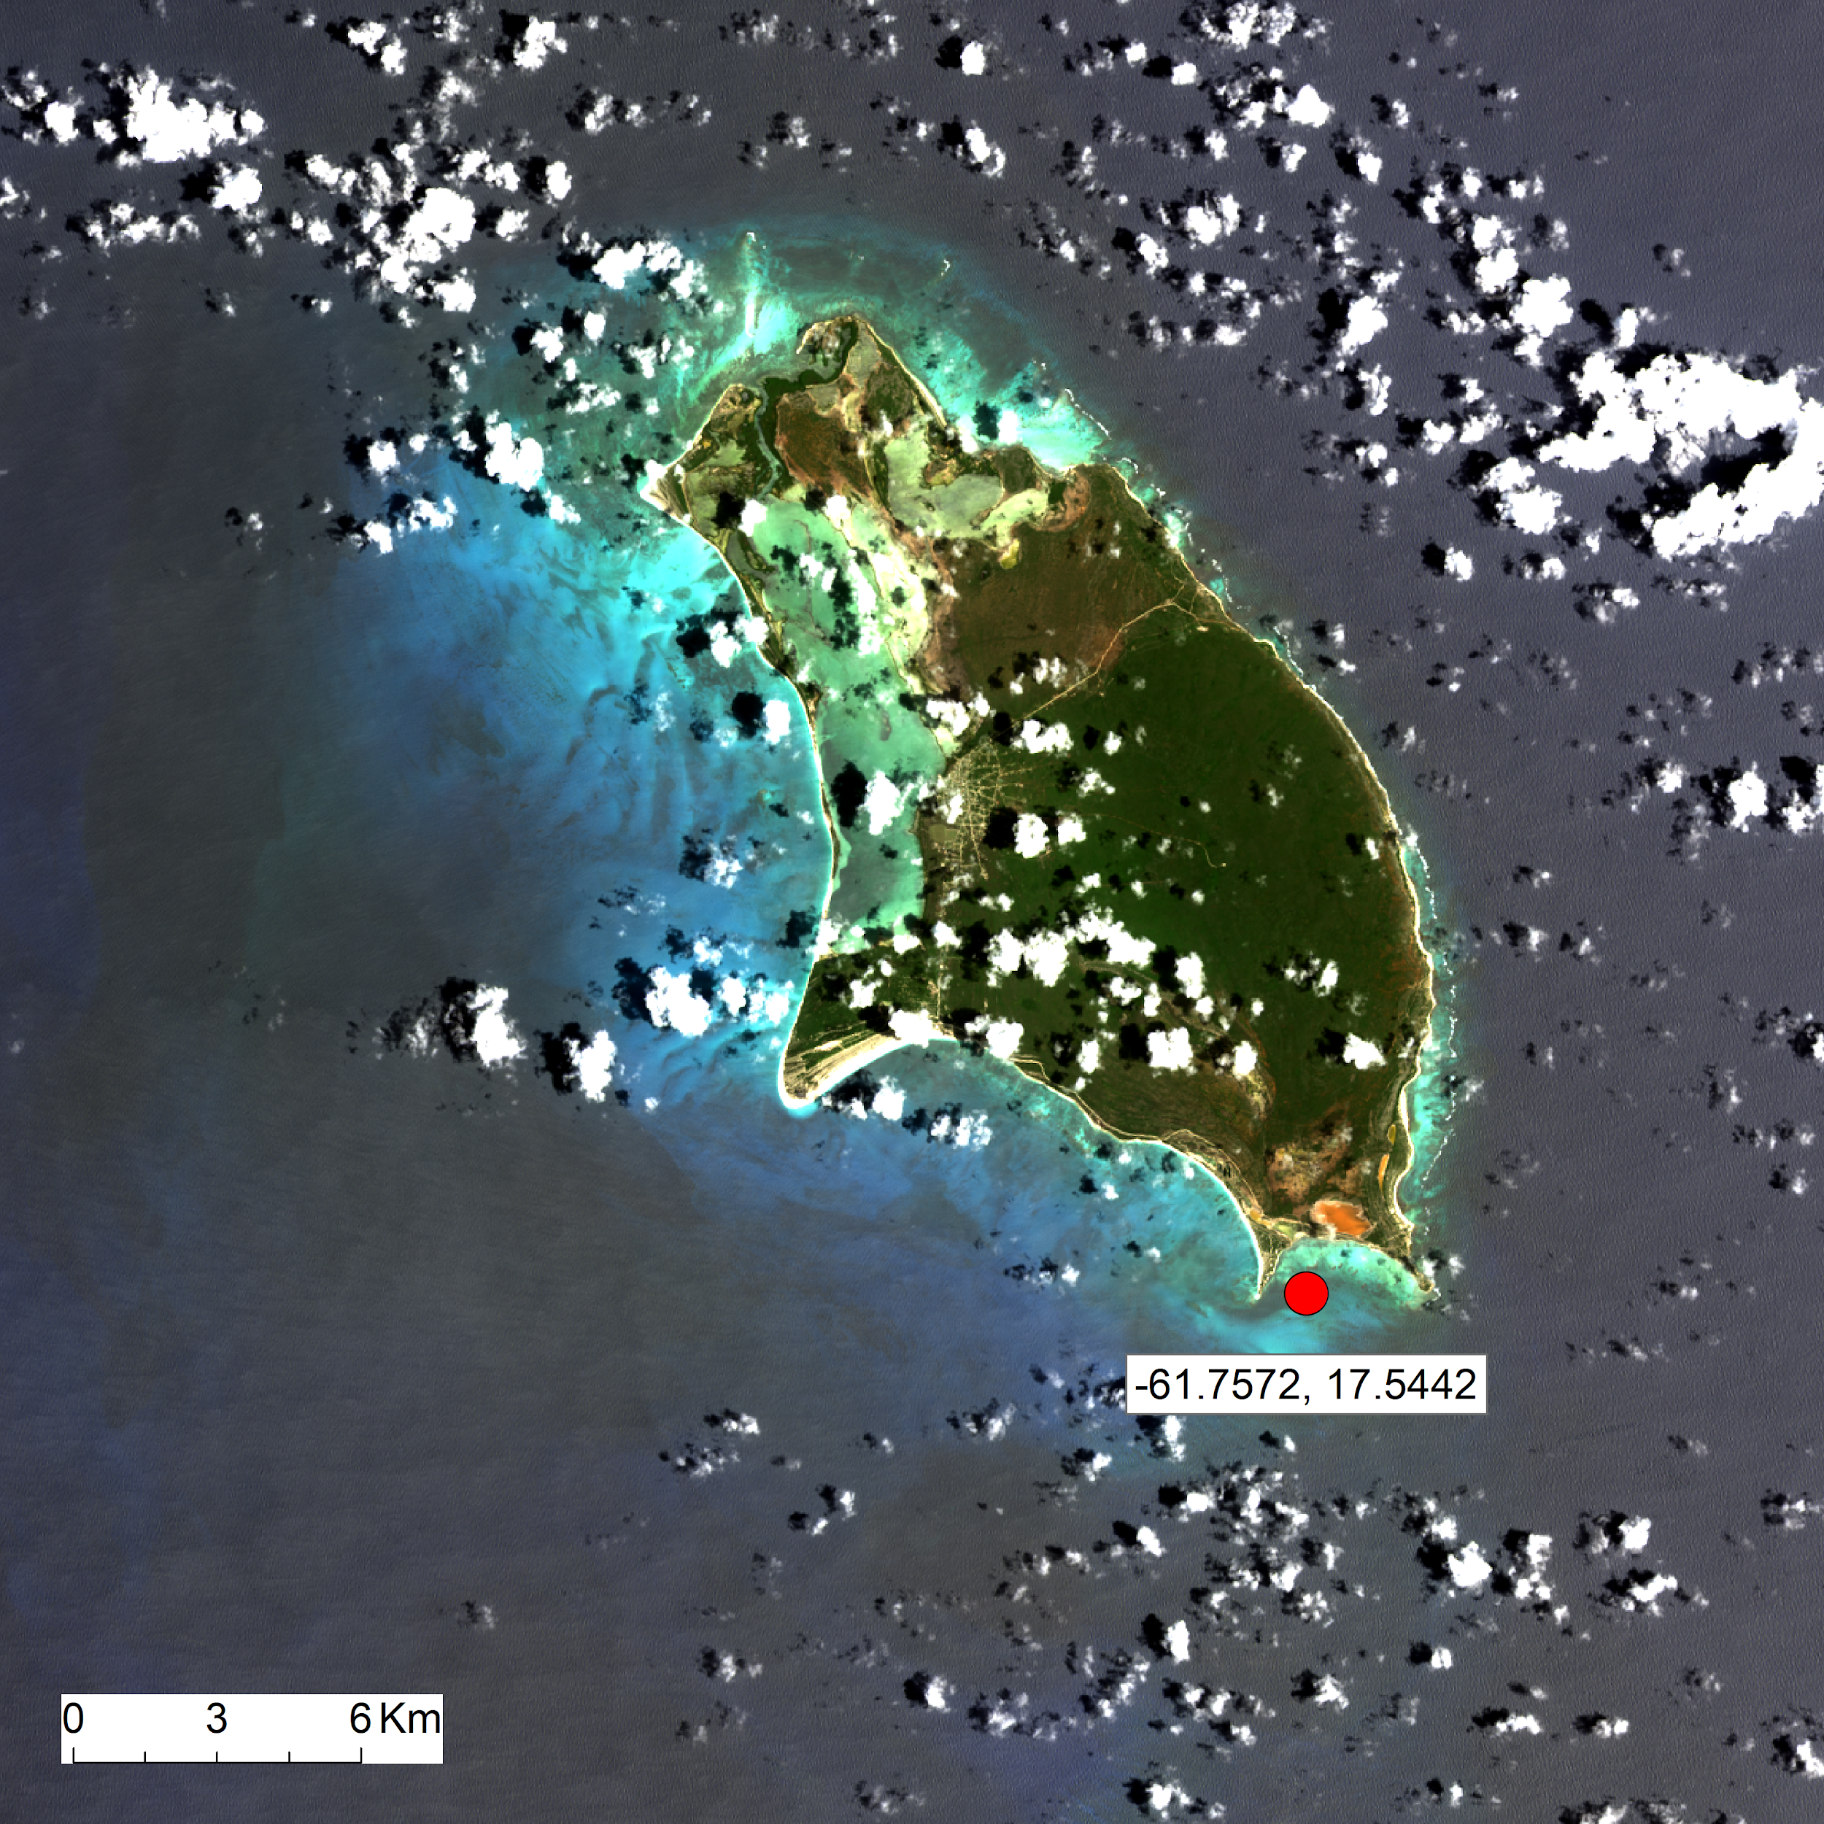
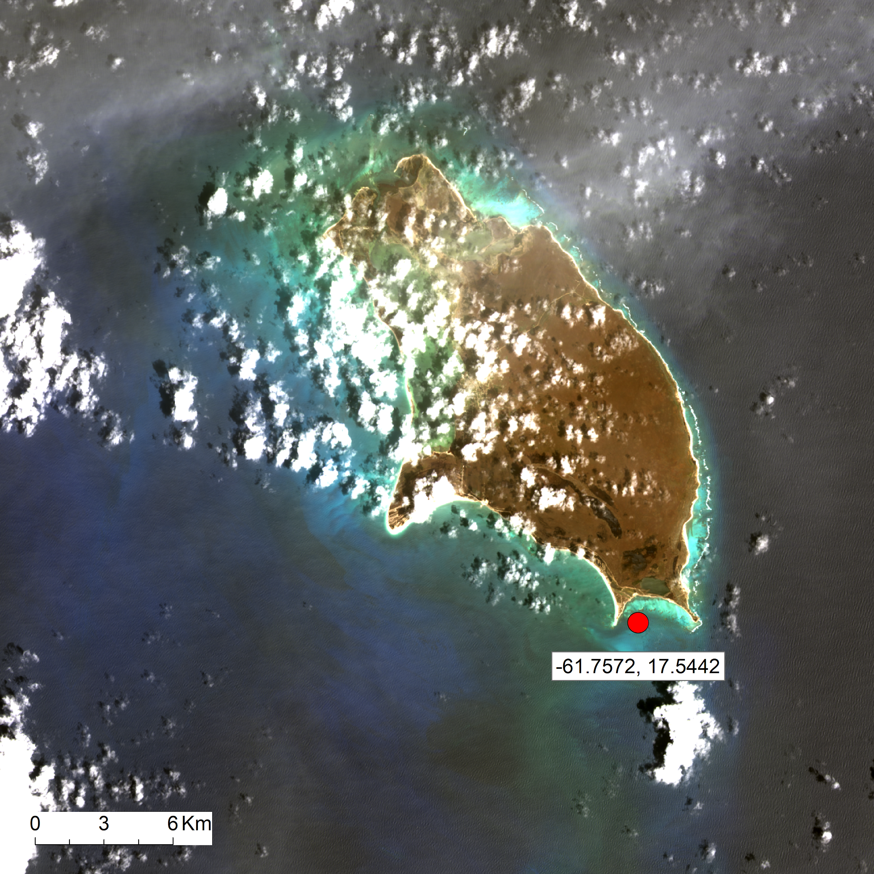
Scene D
August 27 2017
September 12 2017
SPACEMATTERS.CA
Notes:
**Ask the class:
1. Describe what you see. Answers: Water, clouds, an island,
2. What are the differences between the images? Answers: About a 2 week difference. The island changed from green to brown.
3. What caused this/what does this tell us/why is this important? Answers: Hurricane damage. High winds, storm surge, and intense rainfall destroyed the island. The change in color from green to brown is caused by the destruction of the green vegetation. Satellite imagery is important in rescue operations, assessing damage, and assisting in reconstruction planning. Weather satellites can help track hurricanes movement and intensity so that citizens can be warned and have time to evacuate.
*This is Caribbean island, Barbuda. Hurricane Irma destroyed the island and all residence had to be evacuated to Antigua, a nearby island.

Slide 16
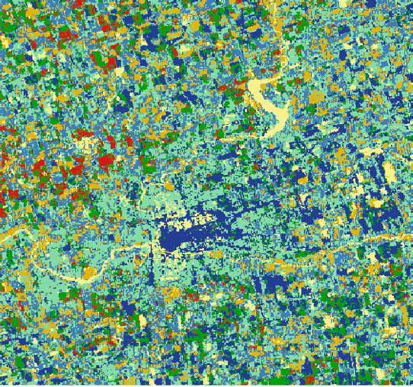
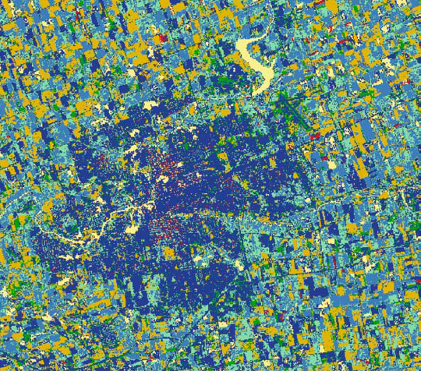
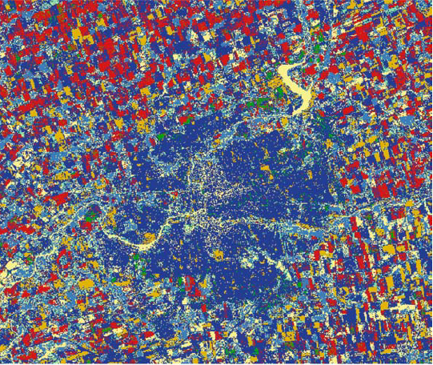
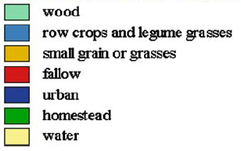
1974
1990
2000
Urban = 10.07%
Urban = 16.72%
Urban = 22.25%
(Nirupama & Simonovic, 2007)
SPACEMATTERS.CA
Notes:
That was a taste of change detection. To actually measure the changes happening, computer software is used to classify every pixel of the image as something e.g., trees, grass, concrete, buildings, houses, etc., and then calculate the change in pixels. But just by using our eyes you can already see what’s happening.
*This is London, Ontario! By these results it looks as though London has doubled its size between 1974 and 2000. Image classification and change detection is a very useful tool and you will likely learn more about how to do this in remote sensing courses.

Slide 17
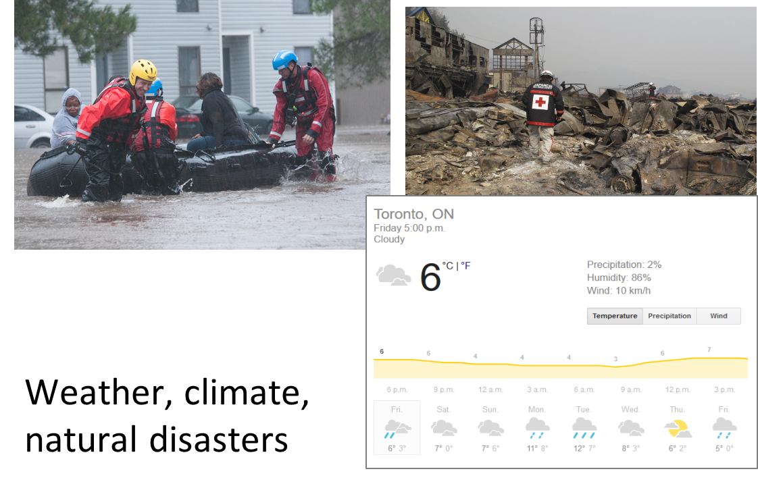
Earth systems
Space science and exploration
Communication
and navigation
Notes:
Satellites play a role in pretty much every aspect of our life. In the next few days I’d like you to think about how satellites affect your life and what a day without them would be like… Thank you.

