Slide 1

Tour of Our Solar System
Prepared by: Parshati Patel
@westernuCPSX
cpsx.uwo.ca/outreach
Facebook.com/westernuCPSX
Notes:
Ask students what is a solar system and what they think is part of the solar system; can make a list on the board of items students think are members of Solar System

Slide 2
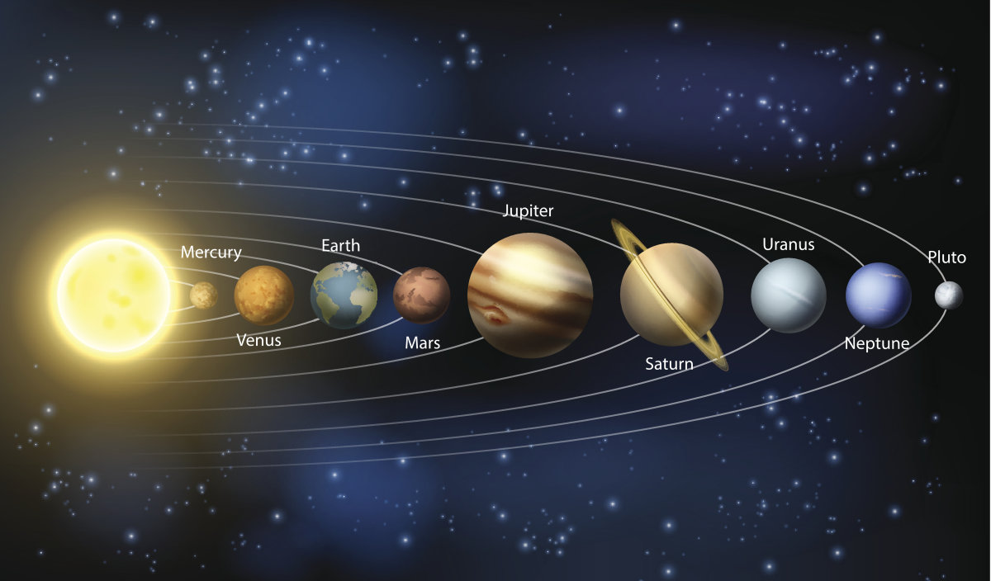
Our Solar System
Notes:
this is what the big bodies in our solar system look like; students would guess most of these (including pluto-they might even know its now called a dwarf planet)

Slide 3
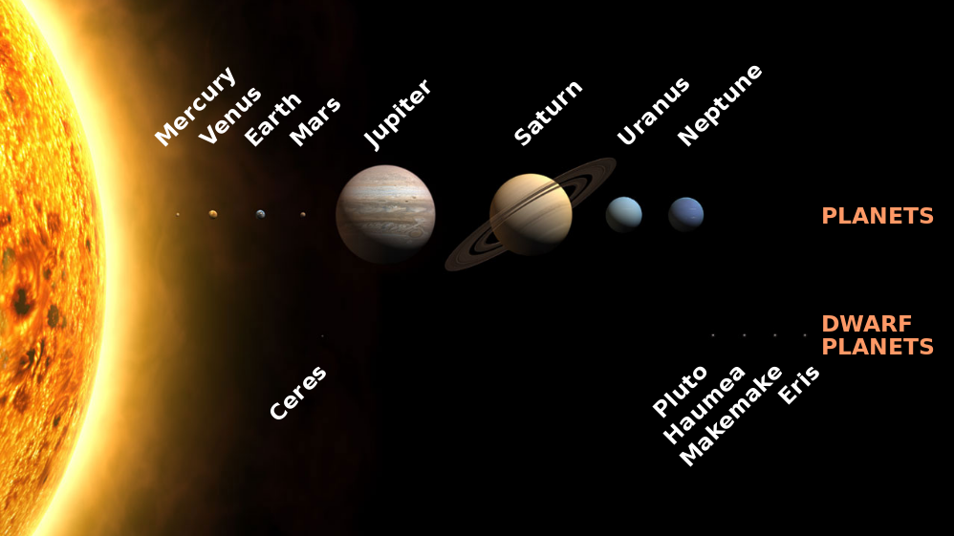
Our Solar System
Notes:
More recent view of the large bodies in our solar system! Pluto, Ceres (largest body in the asteroid belt) as well as others are clumped up into the category of dwarf planets! We will see in this presentation why.

Slide 4
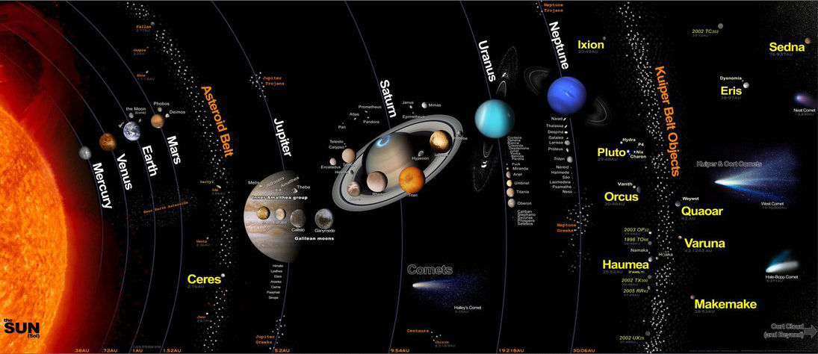
Our Solar System
Notes:
In reality, there is much more to the solar system than sun, planets and dwarf planets. We have moons, asteroids, comets, kupier belt objects (point them out on the board)

Slide 5
What makes up our Solar System?
Star (Sun)
Planets (8)
everything that orbits the Sun
  Dwarf planets
  Comets
  Asteroids
  Meteoroids
  Kuiper Belt objects
Notes:
http://solarsystem.nasa.gov/planets/

Slide 6
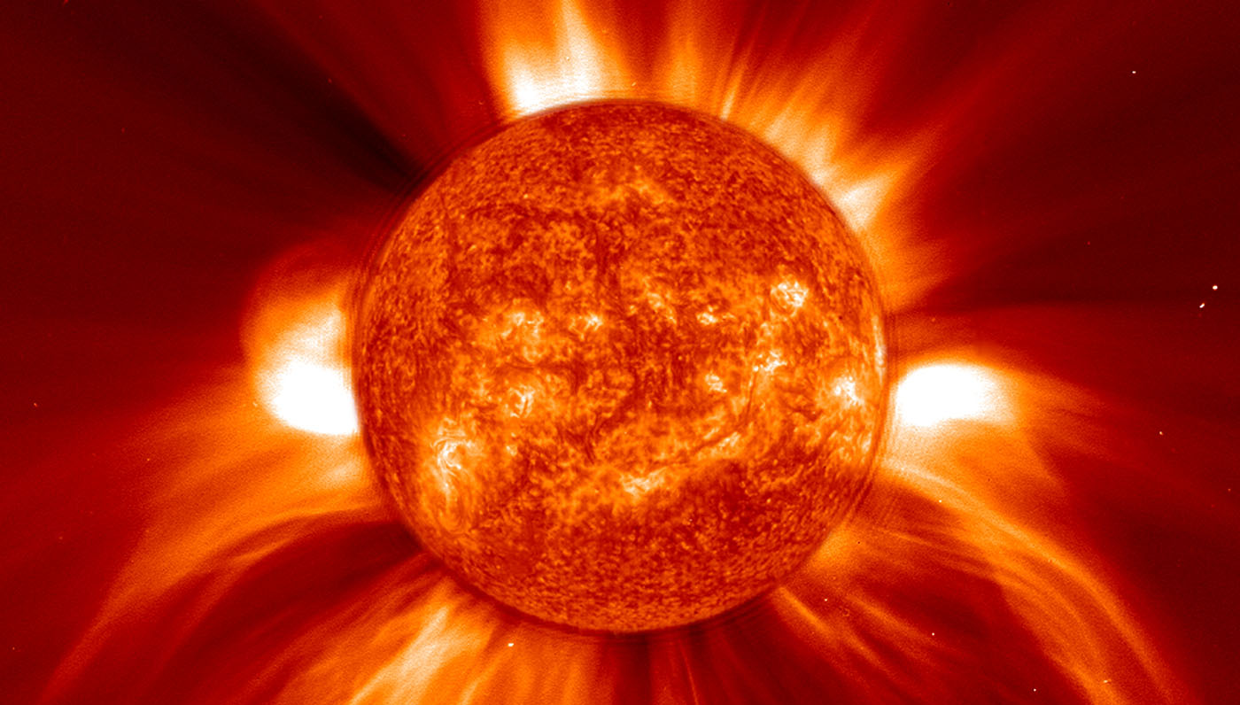
Sun
Notes:
150 000 000 km away from Earth (150 million km), 1 391 940 km across -- 109 Earth sized planets could fit across the Sun
Surface temp: ~6000°C ---- contains > 99% of mass in the Solar System
different layers (important ones mentioned here):
Sunspots
Granule
Photosphere
Prominence
Flare

Slide 7
Planets
spherical
orbit the Sun
clear the neighborhood around its orbit
8 planets total:
  terrestrial (4)
  gas giants (4)
Notes:
Definition of a planets: last point on clear the neighborhood is one of the key reasons why Pluto is not a planet anymore (more on this later)
Mentions to students, how the terrestrials are clumped close to the stars while the gas giants are found further away from the star
We will go through each plant and talk about its unique features

Slide 8
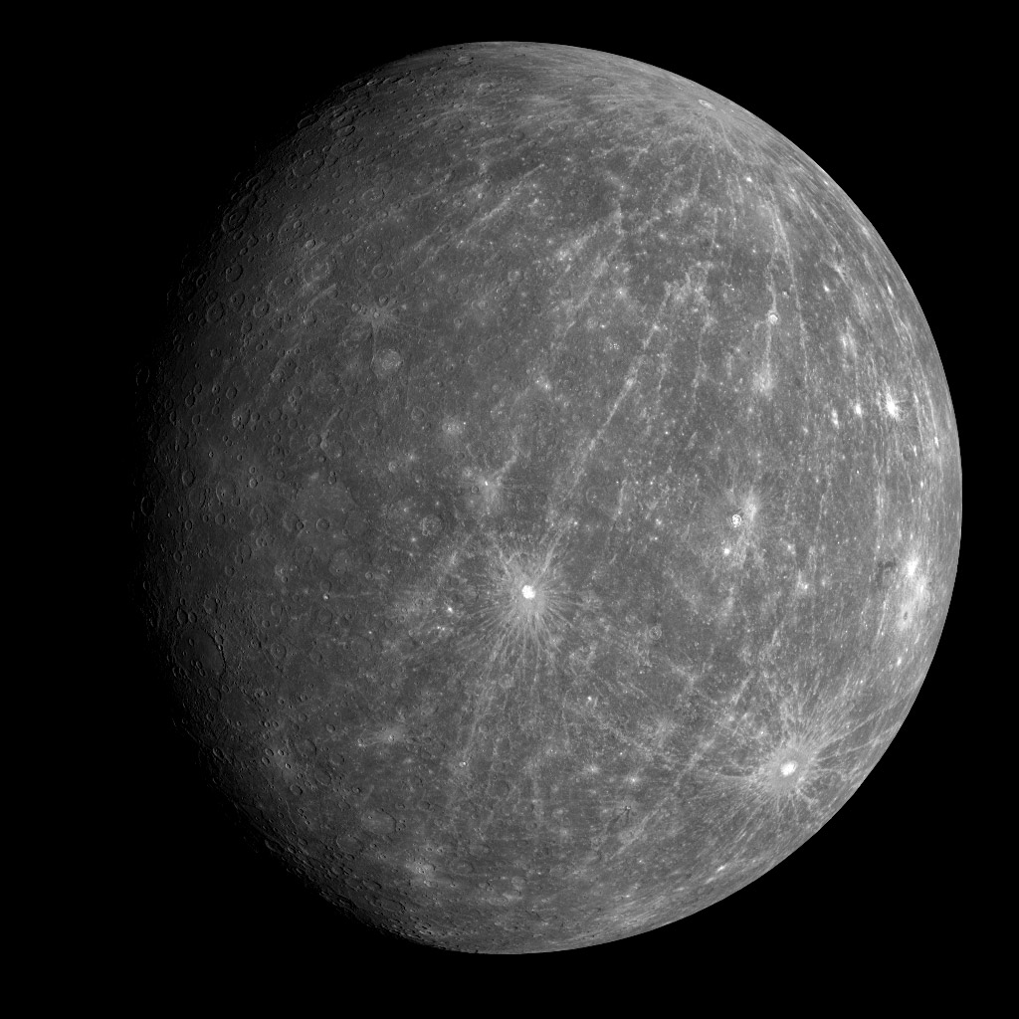
Mercury
1 day on Mercury = 59 Earth days
1 year on Mercury = 88 Earth days
Temperatures: -180 C to 430 C
Notes:
--slightly bigger than the Moon
--very slow rotator: one day on Mercury = 59 days on Earth, imagine you standing on a crater on Mercury at noon, the next noon comes 59 days after
temps range from [-180, 430] degrees Celsius; shadowed regions such as insides of craters are cold places with temperature going down to almost -180C.

Slide 9
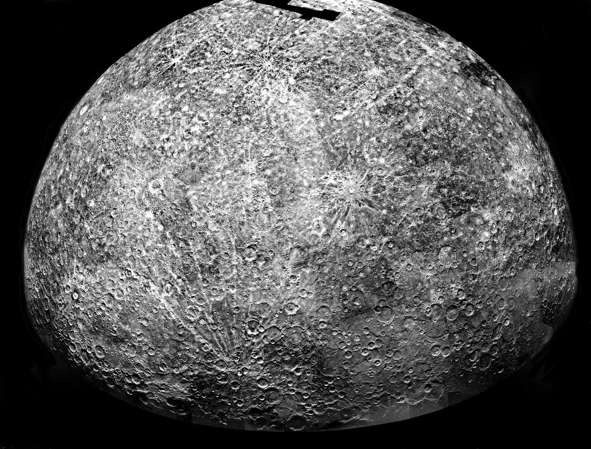
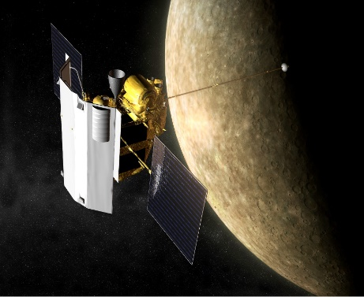
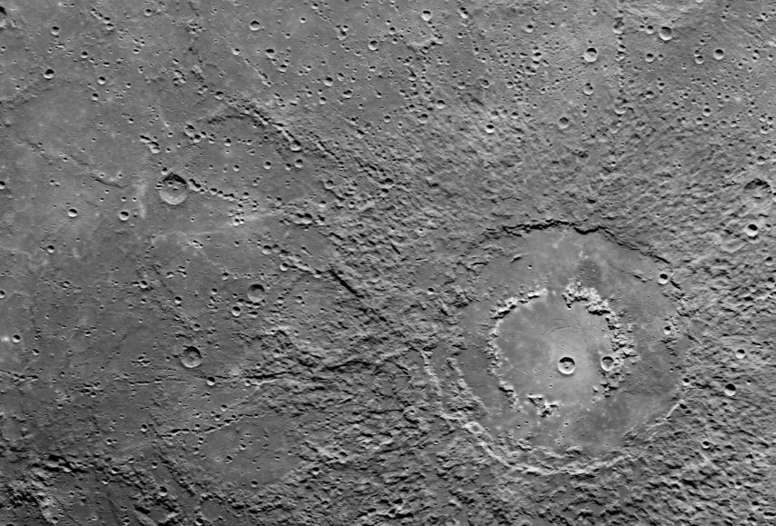
Has magnetic field
Water ice was found on permanently shadowed regions
Tenuous atmosphere- mostly oxygen (42%), sodium (29%), hydrogen (22%), helium (6%), trace amounts of water vapor, nitrogen etc.
Notes:
dry, rocky, covered in craters– very very thin atmosphere to burn meteoroids up- 0.5% potassium Trace amounts of argon, nitrogen, carbon dioxide, water vapor, xenon, krypton, and neon
Notice the top and bottom images on the right: the surface feels very much like the moon. Lots of craters can be seen.
Central image: MESSENGER (MErcury Surface, Space ENvironment, GEochemistry, and Ranging)--- Got there March 2011 and crashed in April 2015--clear up six key issues: Mercury's high density, its geological history, the nature of its magnetic field, the structure of its core, whether it has ice at its poles, and where its tenuous atmosphere comes from

Slide 10
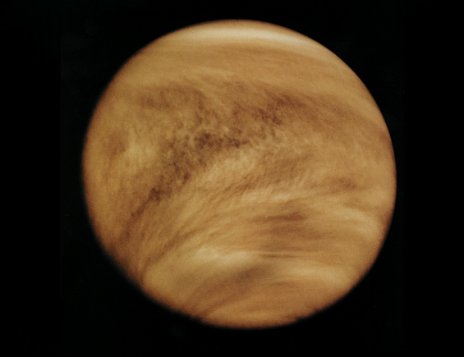
Venus
Surface Temperature: 462 C
Hotter than Mercury
1 year on Venus = 224.7 Earth days
Notes:
similar to Earth in terms of size, mass– sometimes called Earth’s twin
surface temp: 462– ask students why they think Venus is hottest planet in the solar system? It’s the runaway greenhouse effect
many volcanic features
It covered with a thick layer of clouds (as seen in the image) ; can’t see the surface from space, need radar to penetrate through clouds

Slide 11
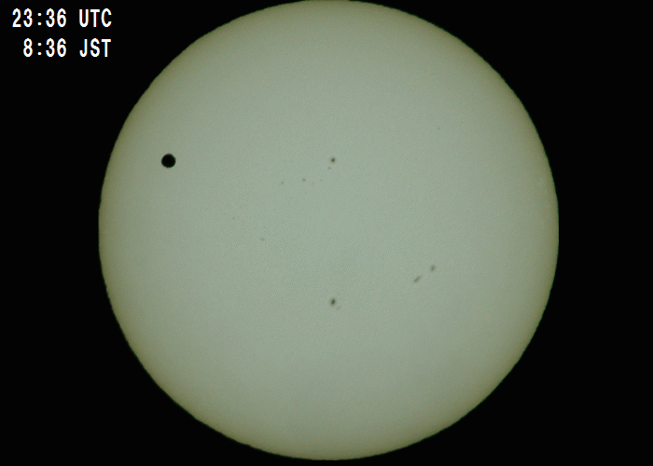
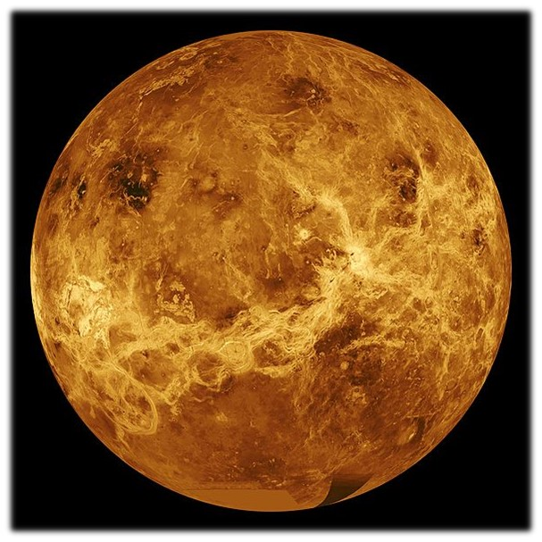
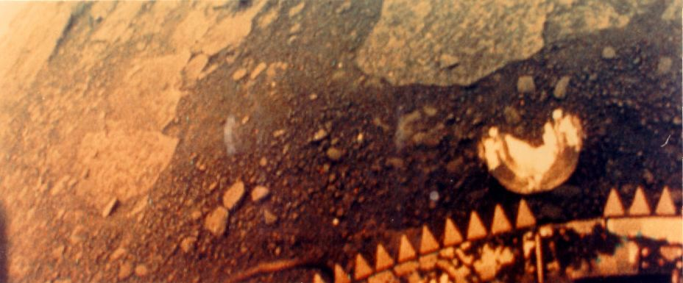

Very thick atmosphere- carbon dioxide (96.5%), nitrogen (3.5%), trace amounts of water vapour, carbon monoxide, sulfur dioxide etc.
Surface of Venus by the Venera 13 in 1982.
Notes:
lots of volcanoes; rocks– radar is used study Venus since it can penetrate through clouds and allow us to student the surface features
The diameter of Venus is 12,092 km (only 650 km less than Earth's) and its mass is 81.5% of Earth's.
The mass of the atmosphere of Venus is 96.5% carbon dioxide, with most of the remaining 3.5% being nitrogen.
The first successful landing on Venus was by Venera 7 on December 15, 1970. It remained in contact with Earth for 23 minutes, relaying surface temperatures of 455 °C to 475 °C.

Slide 12
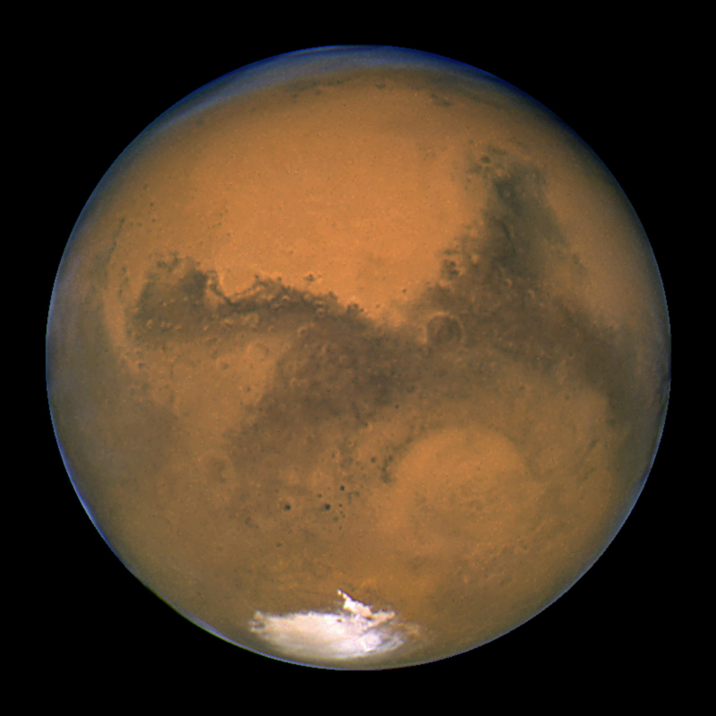
Mars
Craters, volcanoes, valleys, ice caps
Olympus Mons – highest volcano in the Solar System
1 year on Mars = 686 Earth days
Notes:
lots of missions to mars: Mars Global Surveyor; Pathfinder; Mars Express; Spirit & Opportunity; Phoenix; Dawn; Curiosity; and many more!
Polar ice caps;
volcanic features;
2 satellites (captured asteroids?)- Phobos and Demos
half the size of Earth;
water on Mars? lots of evidence

Slide 13
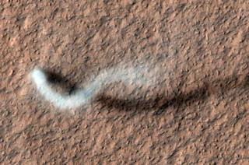
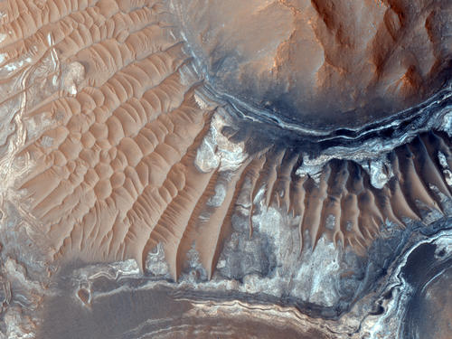
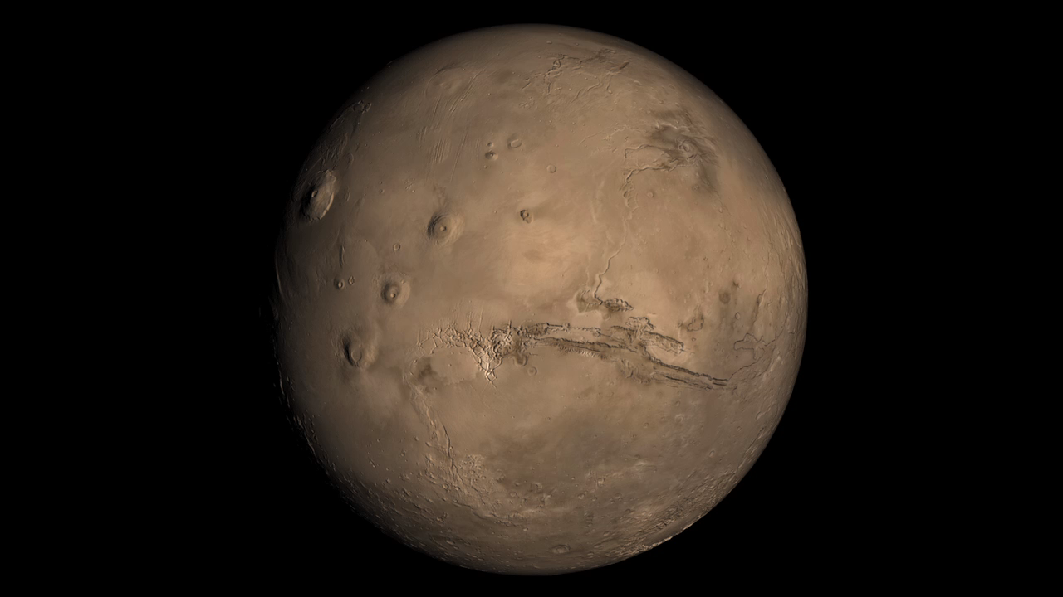
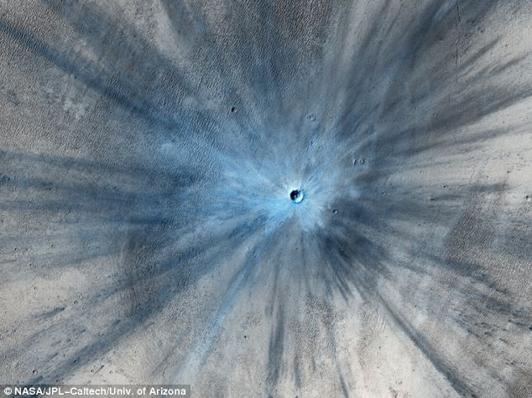
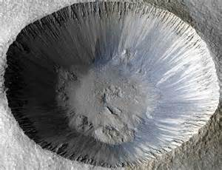
Notes:
Olympus Mons – 24 km high while Mt Everest: 9 km high– Olympus Mons is the highest mountain in the solar system (can be seen in top right image)
Top left image- towering dust devil casts a serpentine shadow over the Martian surface in this image acquired by the High Resolution Imaging Science Experiment (HiRISE) camera on NASA's Mars Reconnaissance Orbiter.
Bottom right image is a global video of Mars
Bottom Left images: Craters on Mars- Left- Fresh new crater; Right- Mohawk Crater

Slide 14
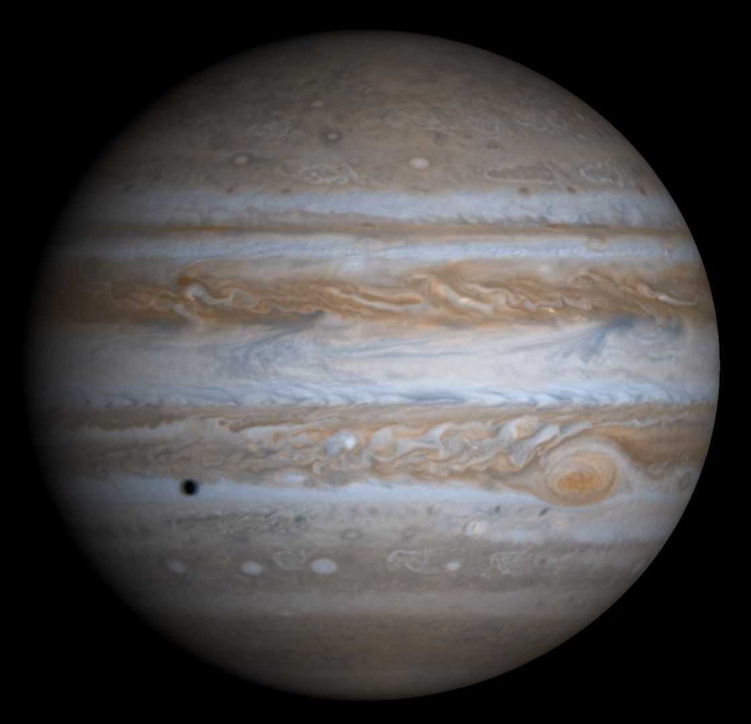
Jupiter
1 Jupiter year = 12 Earth years
Great Red Spot
faint ring system (dust)
Notes:
largest planet in our solar system
great red spot – hurricane that has been raging for atleast 400 years (more on next slide)
It does have a faint ring system
Jupiter is primarily composed of hydrogen with a quarter of its mass being helium
All the different colors seen in this picture are clouds! It has a very complex atmosphere
It may also have a rocky core of heavier elements,^{[15]} but like the other giant planets, Jupiter lacks a well-defined solid surface.

Slide 15
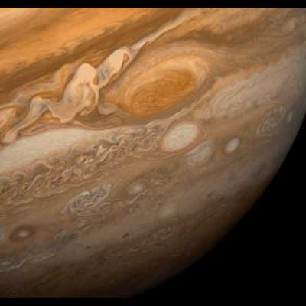
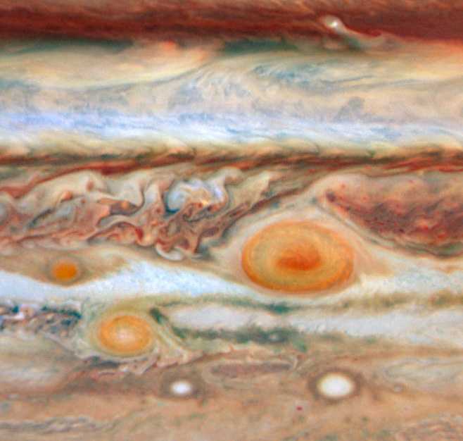
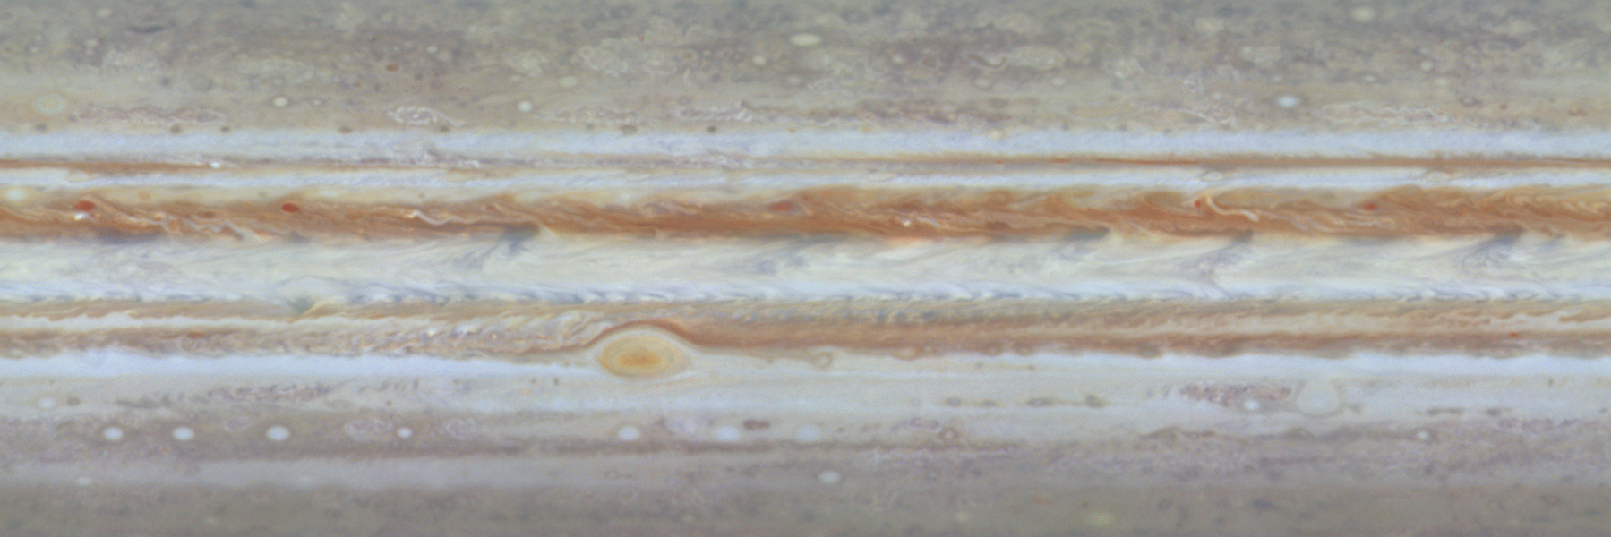

Notes:
Great Red Spot is over 400 years old
White and red bands are two different types clouds (white = zones; red = belts)
belts = air moving down; zones = air moving up
3 earths would fit inside great red spot
Bottom image is a video of great red spot and shows motion of the clouds

Slide 16
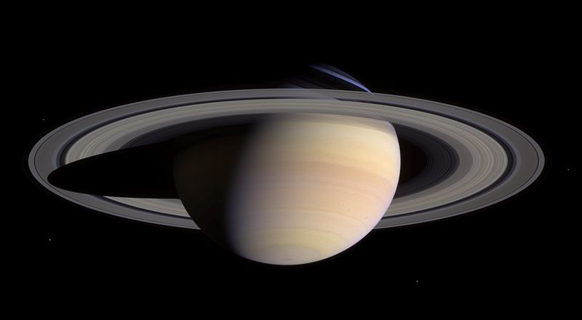
Saturn
1 year on Saturn = 30 Earth years
ring system: dust + ice
Complex atmospheres
main rings: up to 480 000 km from center
Notes:
Density is less than that of water, very light
Known for its enormous ring system, which can range upto 480000 km from the centre and contains dust and ice. The size of these particles can range from grain of sand to objects as big a skyscraper
Just like Jupiter, the clouds and the atmosphere is pretty complex, it also has bands of clouds of different colors (made of different molecules)

Slide 17
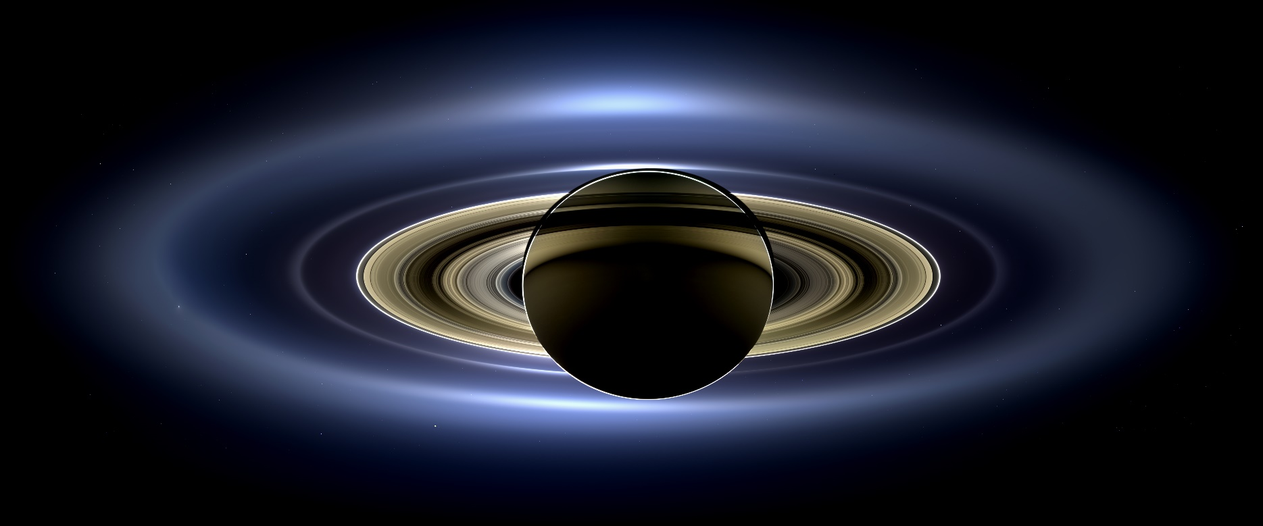
Saturn
Cassini’s view of Saturn and its rings!
Notes:
Cassini mission going to end in 2017; crash in Saturn; Cassini orbiter, named for the Italian-French astronomer Giovanni Domenico Cassini, discoverer of Saturn's ring divisions and four of its satellites; and the ESA-developed Huygens probe, named for the Dutch astronomer, mathematician and physicist Christiaan Huygens, discoverer of Titan.
Lancuhed 1997, arrived 2004, has been still going on

Slide 18
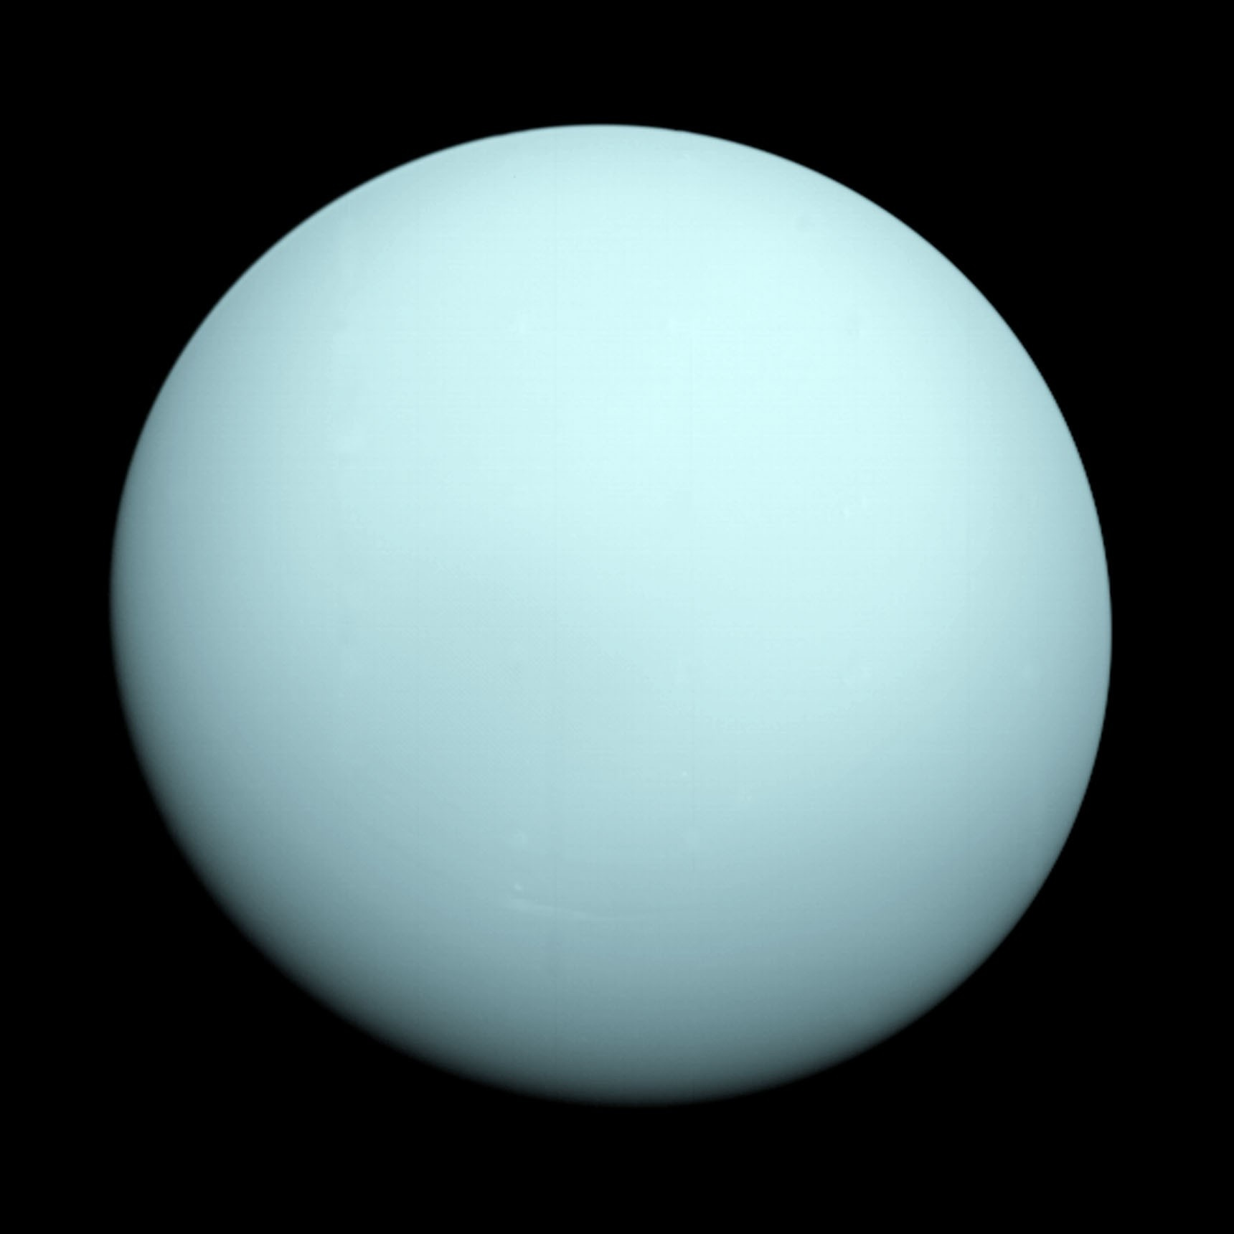
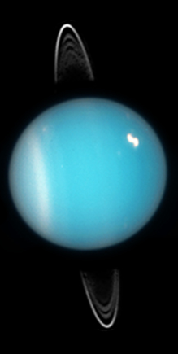
Uranus
1 year on Uranus = 84 Earth years
13 rings
Coldest planetary atmosphere
Voyager 2 is the only spacecraft that visited
Notes:
It is tilted axis of rotation– almost 98 deg! Scientists think it was probably hit by a large object which tilted its axis of rotation
Just like Jupiter and Saturn, Its primary composition of hydrogen and helium, but it contains more "ices" such as water, ammonia, and methane, along with traces of other hydrocarbons.
It is the coldest planetary atmosphere in the Solar System, with a minimum temperature of 49 K (−224.2 °C), and has a complex, layered cloud structure with water thought to make up the lowest clouds and methane the uppermost layer of clouds.
Right image-13 rings

Slide 19
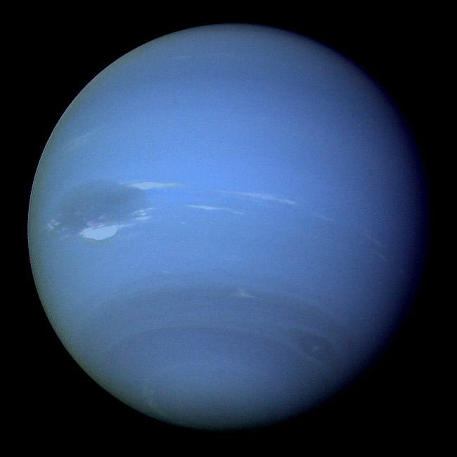
Neptune
1 year on Neptune = 164 Earth years
Great Dark Spot
6 rings
Voyager 2 is the only spacecraft that visited
Notes:
1 year = 164 Earth years
Great Dark Spot – similar to Jupiter’s Great Red Spot– large hurricane raging in its atmosphere.
It has active & visible weather patterns unlike Uranus
Neptune's atmosphere is very similar to that of Uranus

Slide 20
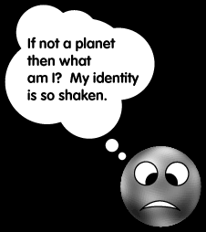

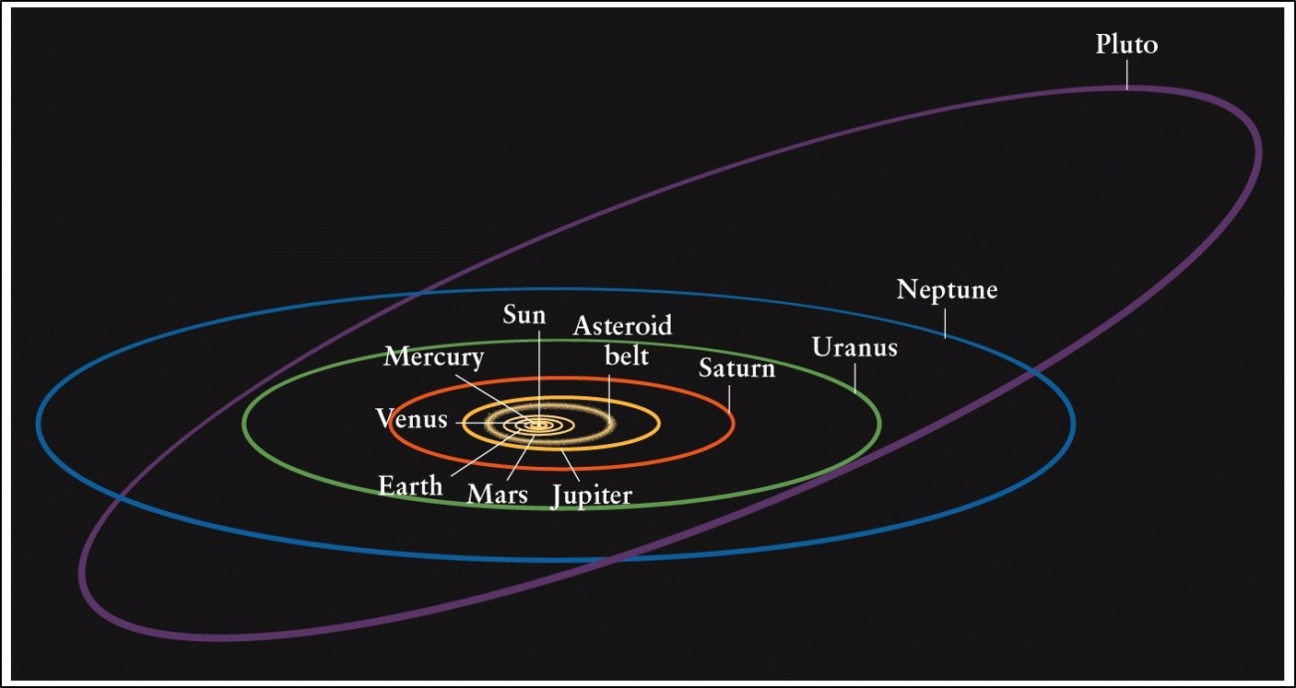
Pluto- A Planet?
Notes:
Now remember Pluto is no more a planet now! I will tell you why!
Pluto is terrestrial and rocky while the planets before it are gaseous, so we don’t expect it to be there!
Its smaller than moon so cant consider it as a planet, which means pluto has not cleared it neighbourhood. It also has a moon half its size so some astronomers suggests it might be binary.
Also all planets go around the sun in flat plan but as seen in the picture Pluto has rather 17 degree angle with the flat plane. The orbit is bizarre and also very elliptical, you can see it crosses neptune’s orbit!

Slide 21
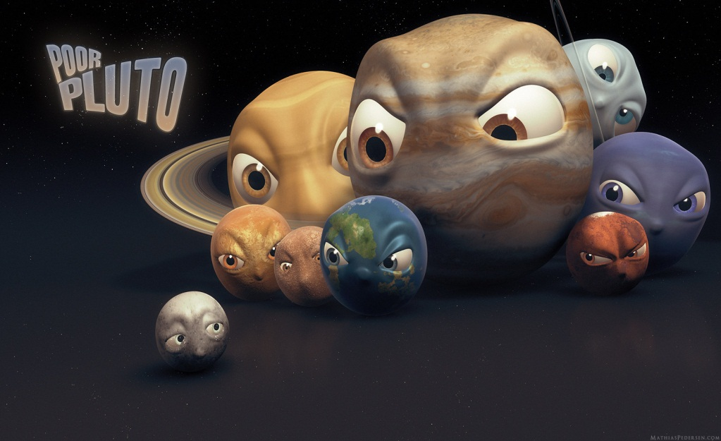
Dwarf Planets
A celestial body that
  Orbits around the Sun.
  Is not a satellite.
  Has sufficient mass for a self-gravity to overcome rigid body forces so that it assumes a nearly round shape.
  And has not cleared its neighbourhood around its orbit.
We know lots of them and lot of them still wait to be detected.
Notes:
In 2006, International Astronomical Union decided on a definition of a dwarf planet, which is Pluto now a part of!

Slide 22
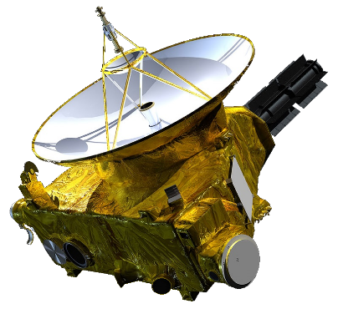
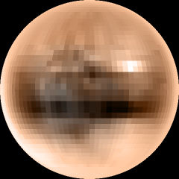
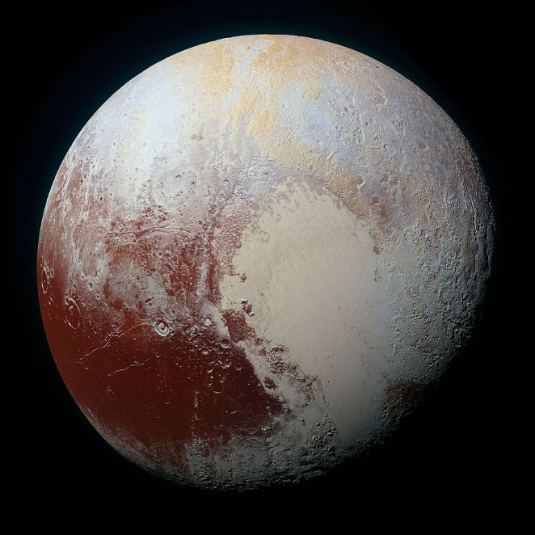
Pluto
Before New Horizons
After New Horizons
Notes:
Discovered in 1930.
Size: 1200 km in radius
Mean temp: -230C, very cold
New Horizons (2015)- launched in 2006 and arrived at Pluto in 2015, now on route to a Kuiper belt object

Slide 23
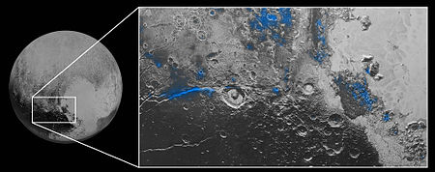
Pluto
Regions where water ice has been detected (blue regions)
Notes:
Pluto's surface is composed of more than 98 percent nitrogen ice, with traces of methane and carbon monoxide. Nitrogen and carbon monoxide are most abundant on the anti-Charon face of Pluto (around 180° longitude, where Tombaugh Region's western lobe, Sputnik Planum, is located), whereas methane is most abundant near 300° east.
Sputnik Planum, the western lobe of the "Heart", is a 1000-km-wide plain of frozen nitrogen and carbon monoxide ices, divided into polygonal cells which are interpreted as convection cells that carry floating blocks of water ice crust and sublimation pits towards their margins; there are obvious signs of glacial flows both into and out of the plain. It has no craters that were visible to New Horizons, indicating that its surface is less than 10 million years old.

Slide 24
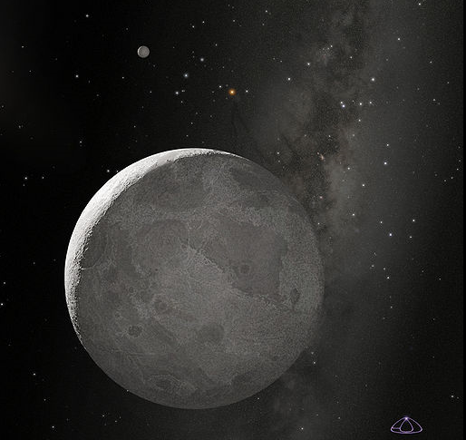
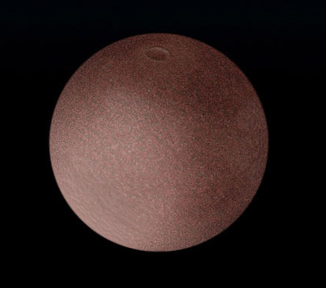
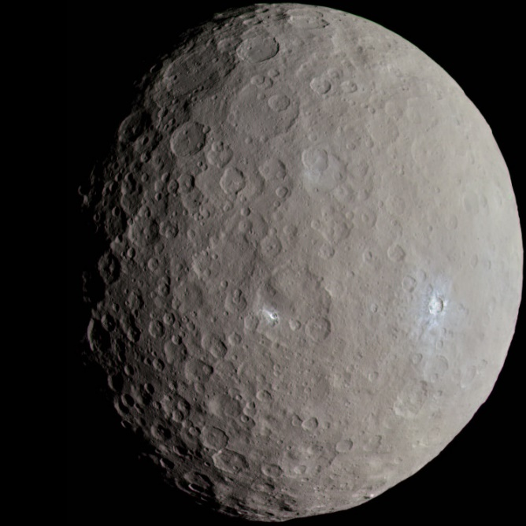
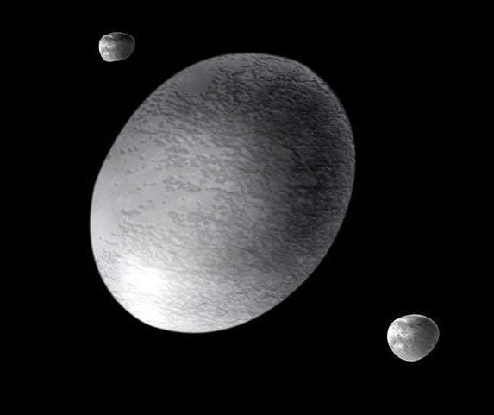
Dwarf Planets
Makemake
Eris
Haumea
Ceres
Notes:
Here are the 5 current dwarf planets. Eris, Pluto and Ceres were the original 3, with Haumea (How-me-ah) and Makemake (mach-eh-mach-eh) being added to the list in 2008.
It is suspected that another 100 or so in the Solar System are dwarf planets. Estimates are that up to 200 dwarf planets may be found when the entire region known as the Kuiper belt is explored, and that the number may exceed 10,000 when objects scattered outside the Kuiper belt are considered.
Ceres visited by Dawn Spacecraft in 2015 (dawn launchyed in 2011, to visit asteroids, vesta and ceres)

Slide 25
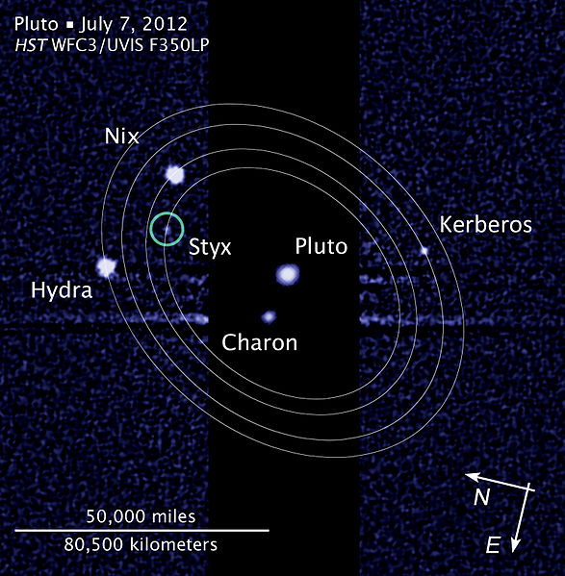
Dwarf Planets’ Moons
Haumea and
Namaka & Hi’aka
Eris and Dysnomia
Notes:
Dwarf planets can also have moons. Here are the three dwarf planets and their moons.

Slide 26
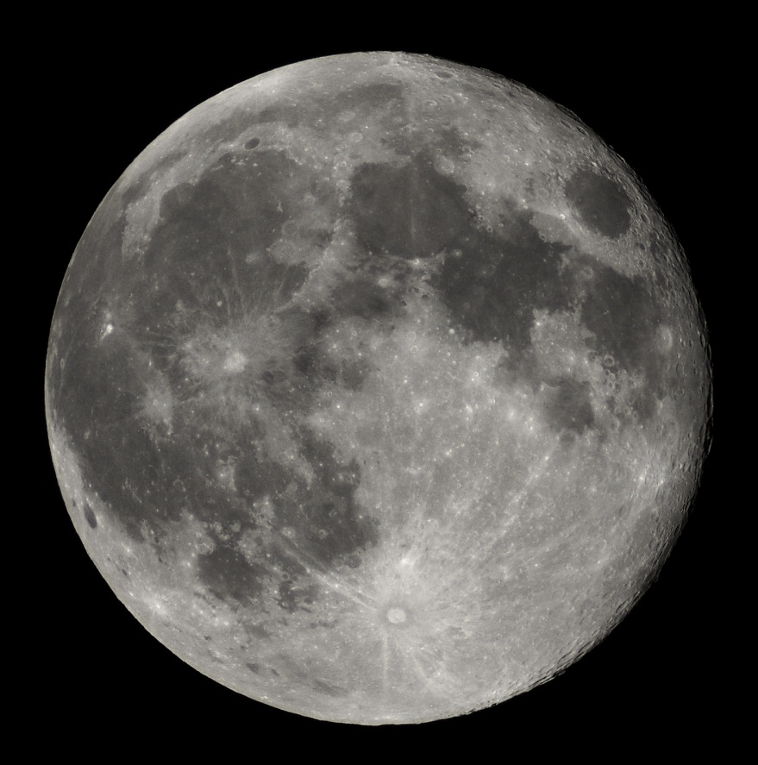
Natural Satellite (Moons)
Moon is a celestial body that orbits a planet or a small body.
~170 and counting
They vary in shapes: Round to irregular in shape.
Ganymede (moon of Jupiter) is the largest moon of our Solar System.
Notes:
Ganymede is bigger than Mercury.

Slide 27
Planets | # of Moons | Name/Misc.
Earth | 1 | Luna-The only one we have landed on!
Mars | 2 | Phobos and Deimos
Jupiter | 67 | Ganymede (largest), Io, Calisto, Europa (Galilean Moons)+ many more!
Saturn | 62 | Titan, Enceladus+ many more!
Uranus | 27 | Titania, Miranda + many more!
Neptune | 14 | Triton, Larrisa+ many more!
Notes:
Titan (Saturn) is the second largest moon of Solar System. Here only some of the moons are listed for gas giants
Q for students: why do you think Venus and Mercury do not have any moons?
A: its lose to the sun, smaller bodies generally get attracted to Sun’s high gravity and fall into the sun

Slide 28
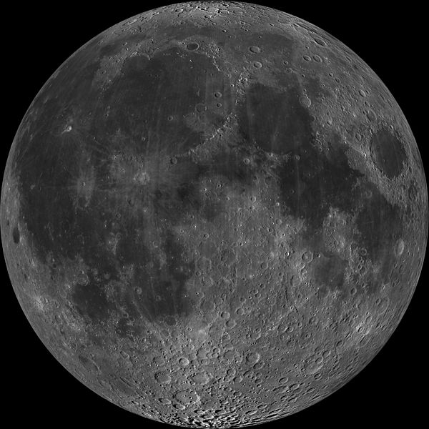
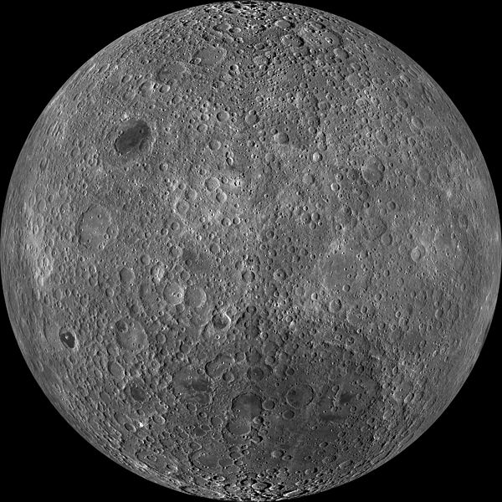
Earth’s Moon: Luna
Nearside
Farside
Notes:
Tidally locked i.e. we see the same side (nearside) of the moon all the time.
No magnetic field and No atmosphere- very dangerous place for humans since there is no shielding from sun’s intense radiation
Surface is potmarked with thousands and thousands of craters. On the nearside, the dark areas are volcanic lava flow (basaltic in nature)
Tons of spacecrafts, landers and Apollo programs

Slide 29
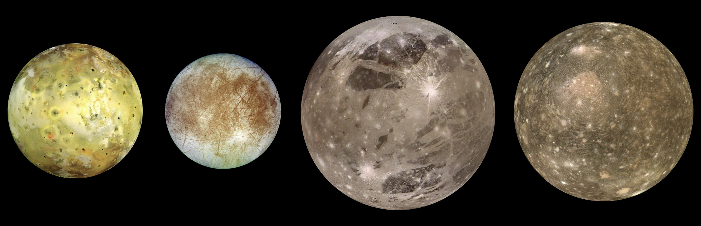
Jupiter’s Galilean Moons
Io
Europa
Ganymede
Callisto
Notes:
Galileo discovered these 4 moons in January 1610.
Io is the most inner moon and the most geologically active body in the solar system. The dots here are volcanic mountains, some of which are larger than Mount Everest. It has more than 400 active volcanos.
Europa is second of the 4 moons. Water Ice covers the moon in 100km thick sheet. Since it has very less craters aka smoothed, it looks like the surface is geologically young as the surface has been recycled. It may have life in the liquid water under the thick surface.
Ganymede is the largest moon of Solar System (bigger than Mercury). It is the only moon known to have Magnetic Field.
Calisto: It has a very thin atmosphere composed of CO2. It might have liquid water under the surface. Since this moon is heavily cratered we can say that the surface is old and geologically dead.

Slide 30
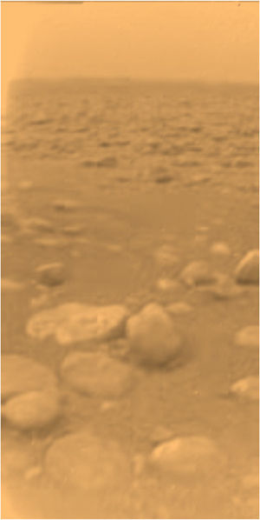
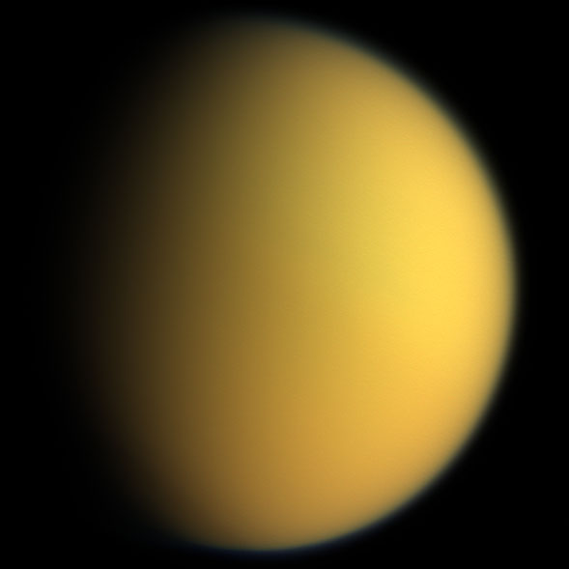
Saturn’s Moons
Titan as seen by Huygens Probe
Titan
Notes:
Titan is the only known solar system body (other than Earth) to have surface liquid (aka lakes). Mainly composed of Water Ice and Rocky material. It has clouds and dense atmosphere is made of mainly nitrogen; with minor components of methane and ethane.
In January 2005, the Huygens probe landed on Titan.

Slide 31
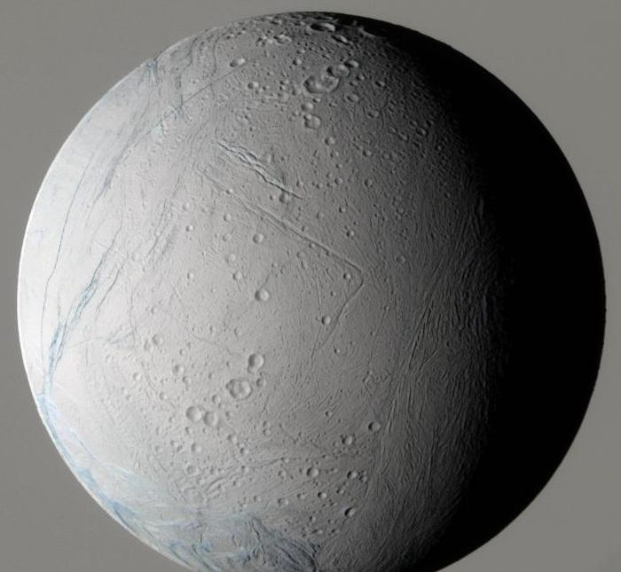
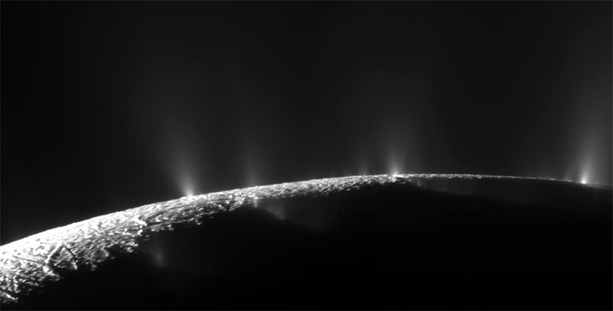
Moons: Saturn
Geysers on Enceladus
Enceladus
Notes:
Enceladus: is also geologically active body. 2nd largest moon of Saturn. On the right, you can see water rich plume gushing out of the body. This is overshoot of the mix of hydrocarbons such as propane, ethane and acetylene
Potential for life in the huge liquid ocean underneath the thin sheet of ice.

Slide 32
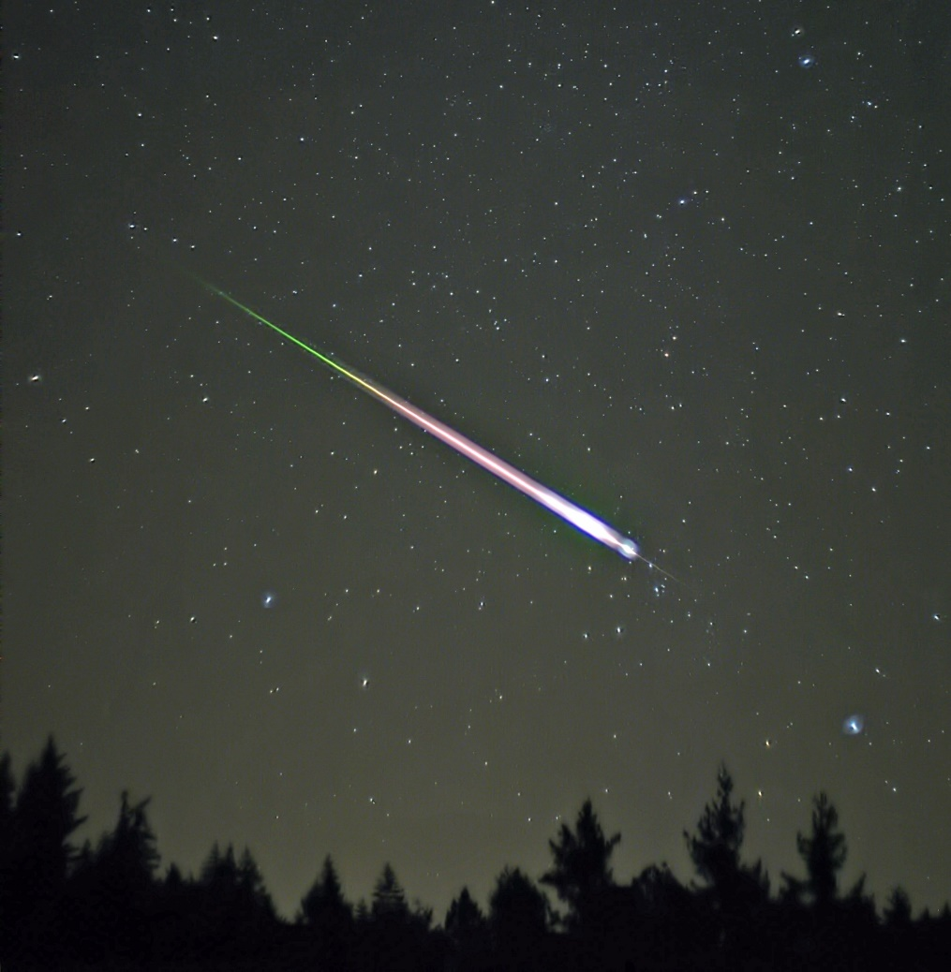
Meteoroids, Meteors & Meteorites
Little chunks of rocks and debris in space are called Meteoroids.
Meteoroids become Meteors (or shooting stars) when they fall through the planet’s atmosphere; leaving a bright trail as they are heated by the friction of atmosphere.
The pieces that survive this journey and hit the ground are called meteorites.
Sizes range from few mms to few meters.
Notes:
Very interesting to study, infact we have a Meteor physics group here at Western who study meteors ☺

Slide 33
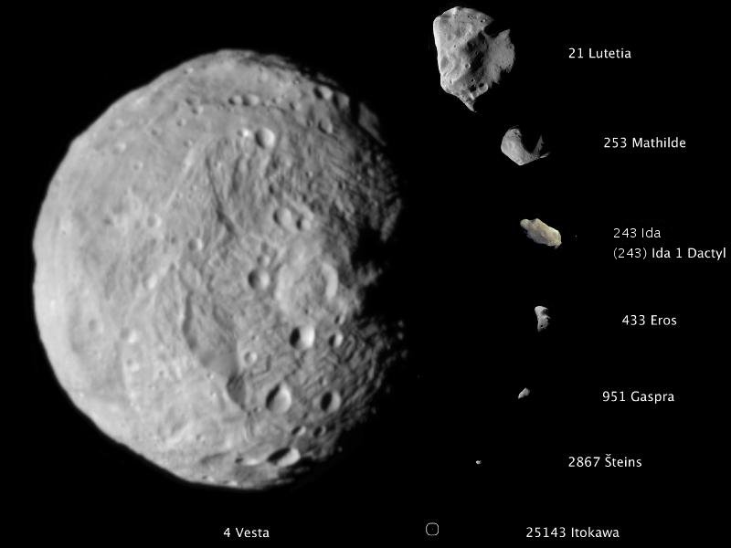
Asteroids
Asteroids are rocky, airless worlds that orbit our sun, but are too small to be called planets.
Most of them are found in the Asteroid Belt (a doughnut shaped ring) between Mars and Jupiter.
Range from 500 kms to 1 km in size.
Composite image of largest to smallest asteroids imaged to the scale in high resolution.
Notes:
Asteroids are millions and millions of planetesimal that never grew large enough to become planets

Slide 34
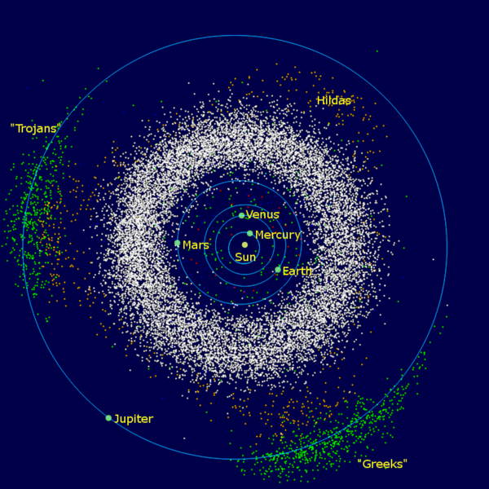
Asteroids
Divided in 3 groups based on their location:
  Asteroid belt
  Trojans
  Near Earth Asteroids
Notes:
Trojan asteroids are a population that share an orbit with a larger planet or moon, but do not collide with it because they orbit in one of the two areas that lie 60° ahead of and behind the larger body.
Jupiter has lots of Trojans, Mars has couple and Earth has also 1 known Trojan asteroid (Our own Dr. Paul Weigert was part of the team that discovered this asteroid in 2011).
But asteroids can also come into the inner solar system and can come close to earth. Those that come close to us are called Near Earth Asteroids. There are three groups. The Amours which are just outside the Earth’s orbit. The Atens which are mostly inside the Earth’s orbit, and the Apollos which cross the Earth’s orbit. If any of these objects are going to hit Earth it would most likely be an Apollo asteroid.

Slide 35

Asteroids
Divided in 3 groups based on their location:
  Asteroid belt
  Trojans
  Near Earth Asteroids
Notes:
Trojan asteroids are a population that share an orbit with a larger planet or moon, but do not collide with it because they orbit in one of the two areas that lie 60° ahead of and behind the larger body.
Jupiter has lots of Trojans, Mars has couple and Earth has also 1 known Trojan asteroid (Our own Dr. Paul Weigert was part of the team that discovered this asteroid in 2011).
But asteroids can also come into the inner solar system and can come close to earth. Those that come close to us are called Near Earth Asteroids. There are three groups. The Amours which are just outside the Earth’s orbit. The Atens which are mostly inside the Earth’s orbit, and the Apollos which cross the Earth’s orbit. If any of these objects are going to hit Earth it would most likely be an Apollo asteroid.

Slide 36

Trans-Neptunian Objects (TNO)
TNO is any object with an orbit outside Neptune’s orbit.
Where they can be found?
  Kuiper Belt: Is a disc-shaped region of icy objects.
  Oort Cloud: Spherical cloud of comets.
Notes:
Kuiper Belt- Origin of Short-period comets; Found between 30- 50 AU from the Sun.
Oort cloud- Roughly up to ~50,000 AU. Origin of Long Period and Halley type comets.
Objects contains mainly water, ammonia and methane.

Slide 37


Comets
A comet is an asteroid like object, basically loose collection of ice, dust and small rocky particles.
It orbits the Sun and exhibits a coma and/or tail from Solar radiation heating when near the Sun.
Gas Tail- points directly away from the sun.
Dust Tail- often called anti-tail because its curved.
Top: Comet 103/Hartley
Bottom: Comet Hale-Bopp
Dust Tail
Gas tail
Notes:
Comet orbits range from a few years to hundreds of thousands of years.
Comet nuclei range from a few hundred meters to tens of kilometers, composed of rock, dust, water ice and frozen gases.
Gas Tail- points directly away from the sun.
Dust Tail- often called ani-tail because its curved.

Slide 38
Summary of our Solar System
Star (Sun)
Planets (8)
everything that orbits the Sun
  Dwarf planets
  Comets
  Asteroids
  Meteoroids
  Kuiper Belt objects
Notes:
Recap!

Slide 39
Thank you!
Questions?
@westernuCPSX
cpsx.uwo.ca/outreach
Facebook.com/westernuCPSX

