Slide 1
Journey Through the Universe
Pocket Solar System

Slide 2
Building scale model of the solar system is a challenge
→ Massive difference in distances and size
You will create a model to show the relative distances between the planets from each other and the Sun.
Relative: Compared to something else!

Slide 3
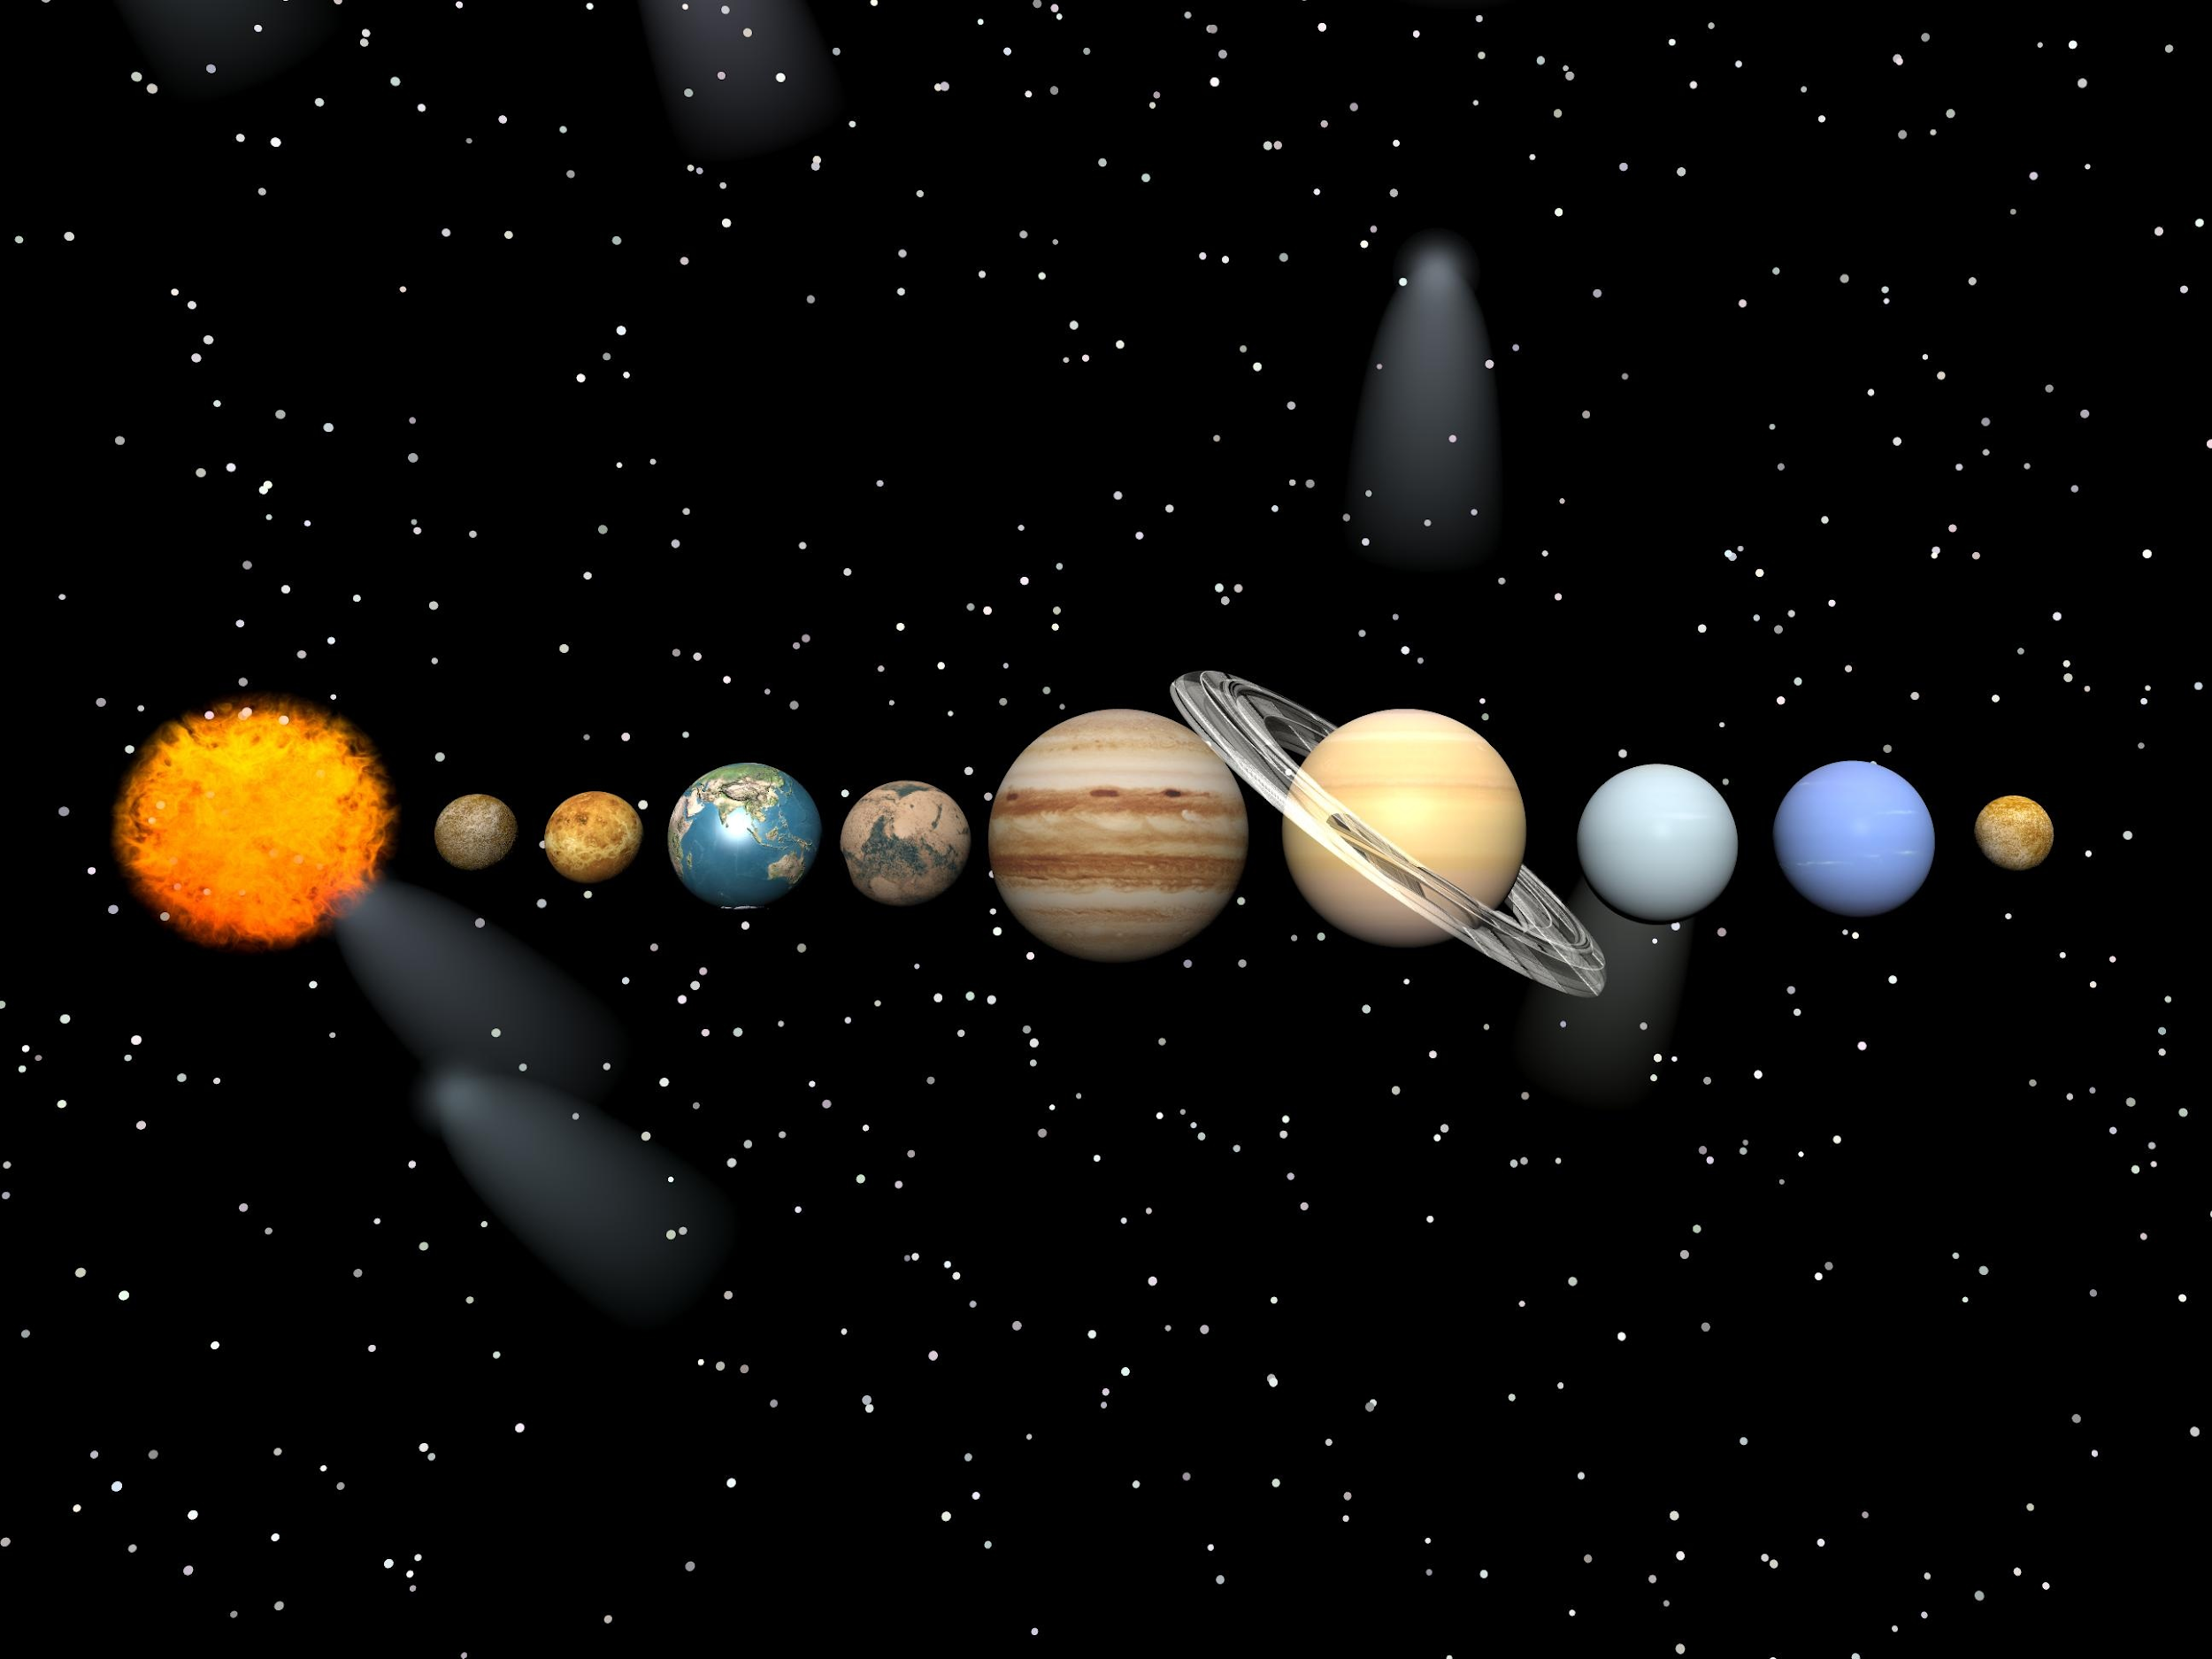

Slide 4
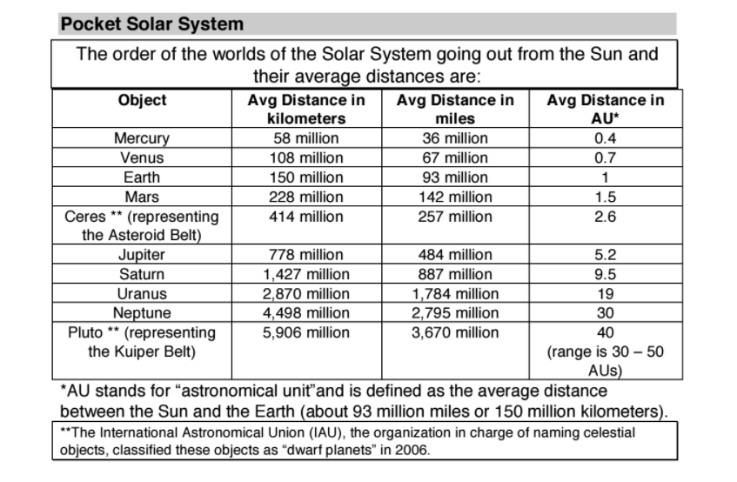

Slide 5

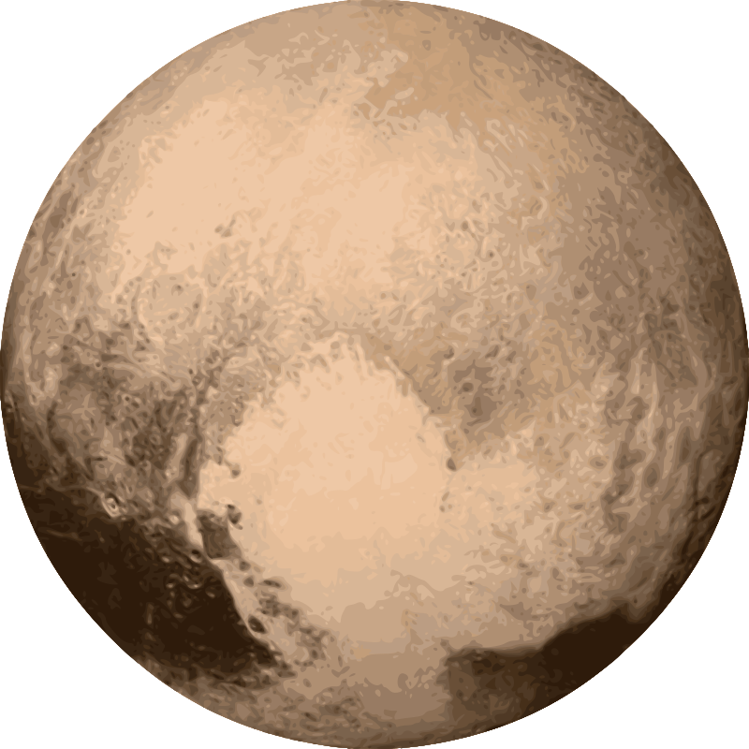
STEP 1
Mark the SUN (draw a semicircle) on one end of the strip of paper and PLUTO on the other end.

Slide 6
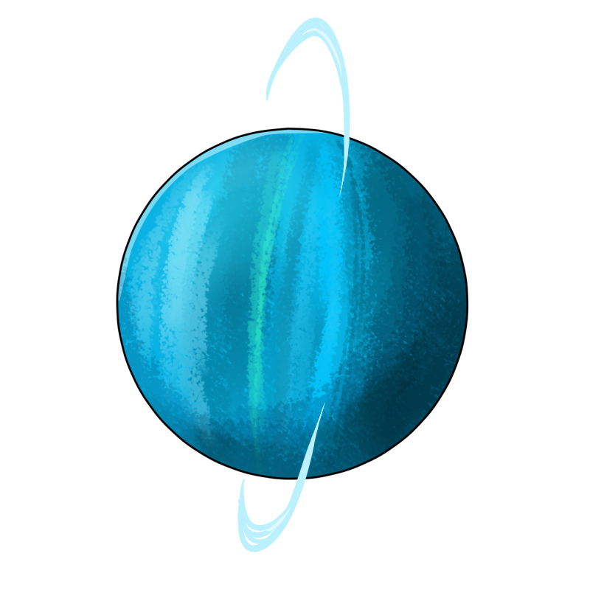
STEP 2
Fold the paper in half, and at the half point mark it for URANUS. Leave a label at the bottom of the page,
so the planet can be drawn in.

Slide 7
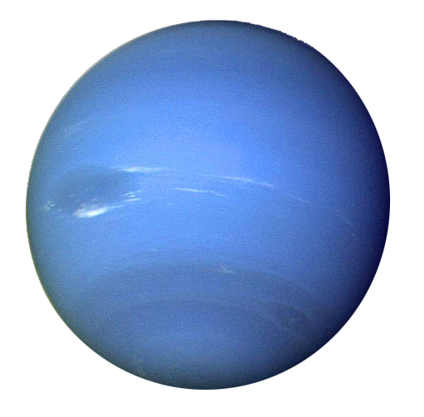
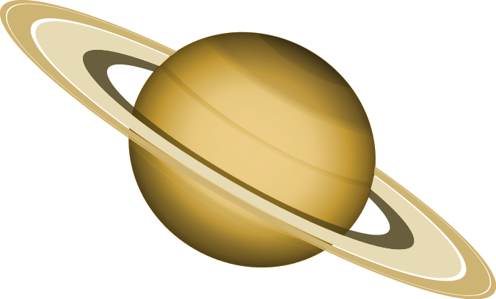
STEP 3
Fold the paper from the Sun to Pluto then fold it in half from Uranus to the Sun. At the two new folds mark one as SATURN (closest to the Sun) and NEPTUNE (closest to Pluto).

Slide 8
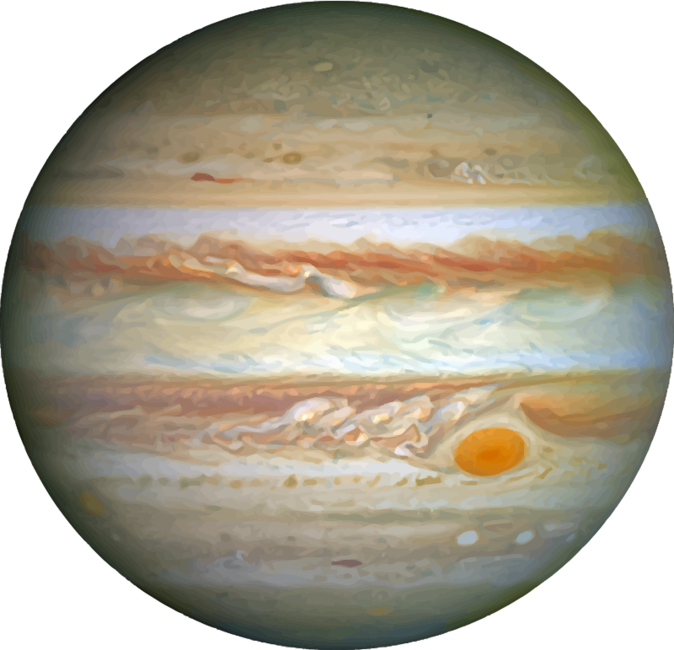
STEP 4
The next step, fold the Sun to Saturn. On the crease, place a mark and label JUPITER.

Slide 9
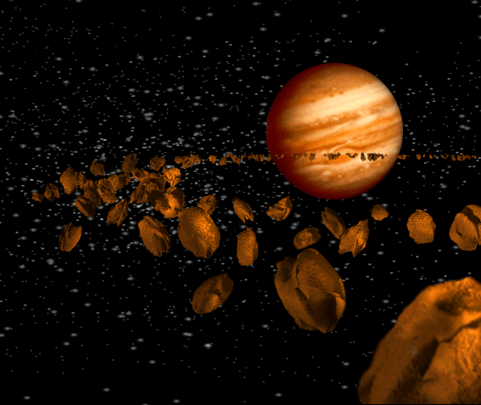
STEP 5
Fold the Sun to Jupiter,
and label the crease AB
(ASTEROID BELT).

Slide 10
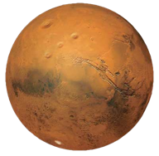
STEP 6
Fold the Sun to AB, label as MARS.

Slide 11
STEP 7
Fold the Sun to Mars, and without unfolding, fold in half. You should have three creases.
Label the creases:
Closest to the Sun → MERCURY
Second → VENUS
Third → EARTH (closest to Mars).

Slide 12
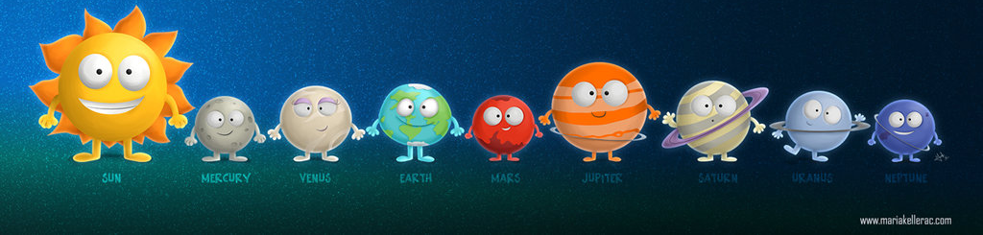
STEP 8
Take your time illustrating each planet, be as accurate and creative as you want!
CHALLENGE: Draw the planets in RELATIVE SCALE
(E.g. Venus is smaller than Earth but larger than Mars).

