Slide 1

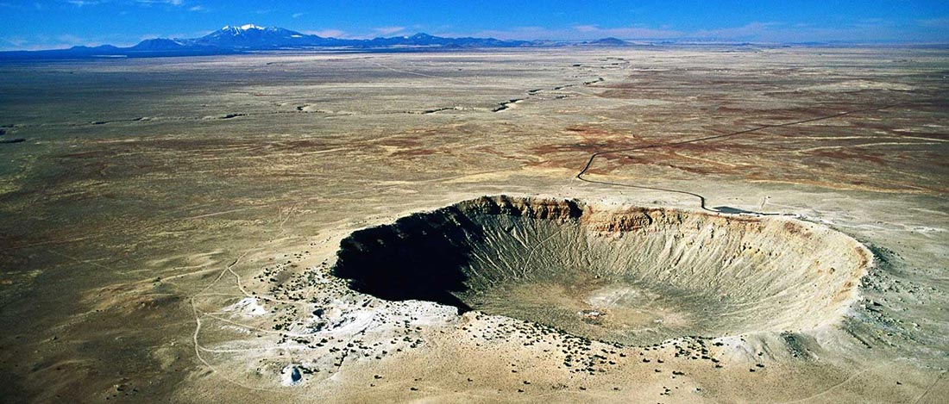

Impact Cratering
Updated by: Jennifer Newman
@westernuCPSX
cpsx.uwo.ca/outreach
Facebook.com/westernuCPSX
Notes:
*before starting presentation, get students to fill out pre-activity forms
*once they have handed them in, give out the activity booklet

Slide 2
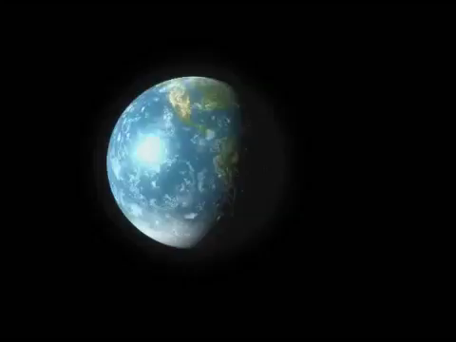

Slide 3
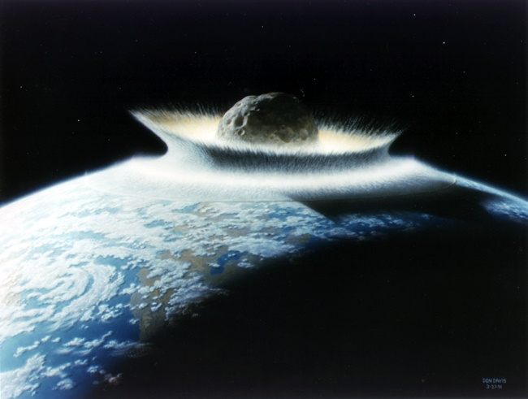
What forms craters?
Artwork: D. Davis
Notes:
Ask students: What forms craters?
The answer we’re looking for is collisions or, more correctly, impacts.
Image Credit: Don Davies

Slide 4
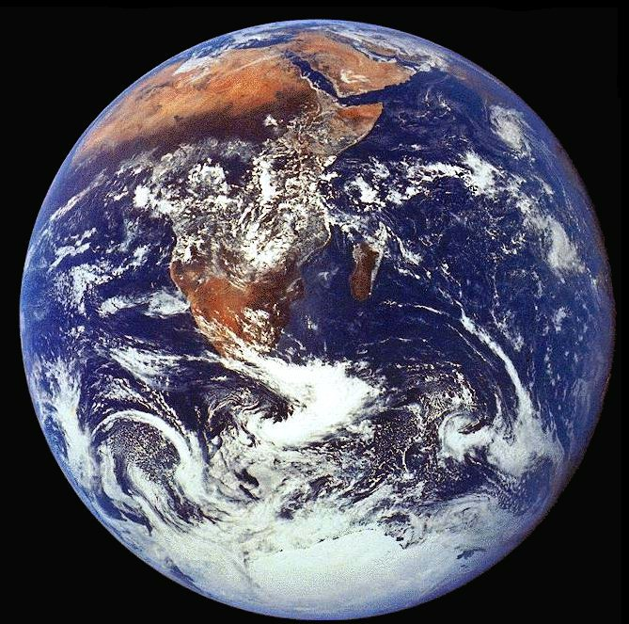
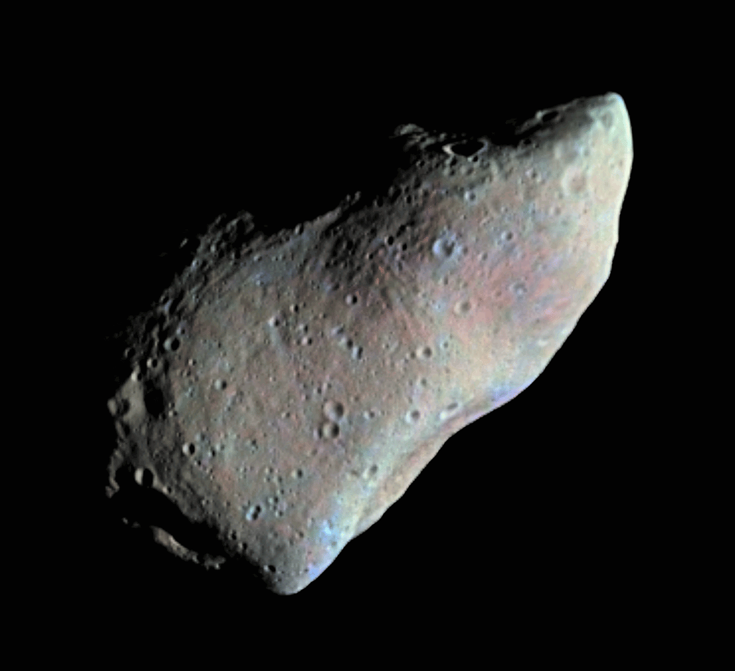
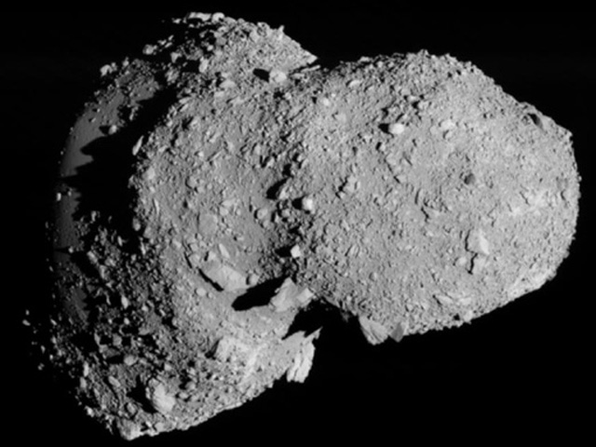
Most common object:
Asteroids!
Notes:
Most commonly, impactors are Asteroids.
Ask the students: Where do asteroids come from?
(Pictured here are asteroids Itokawa and Gaspra, Credit: NASA)

Slide 5
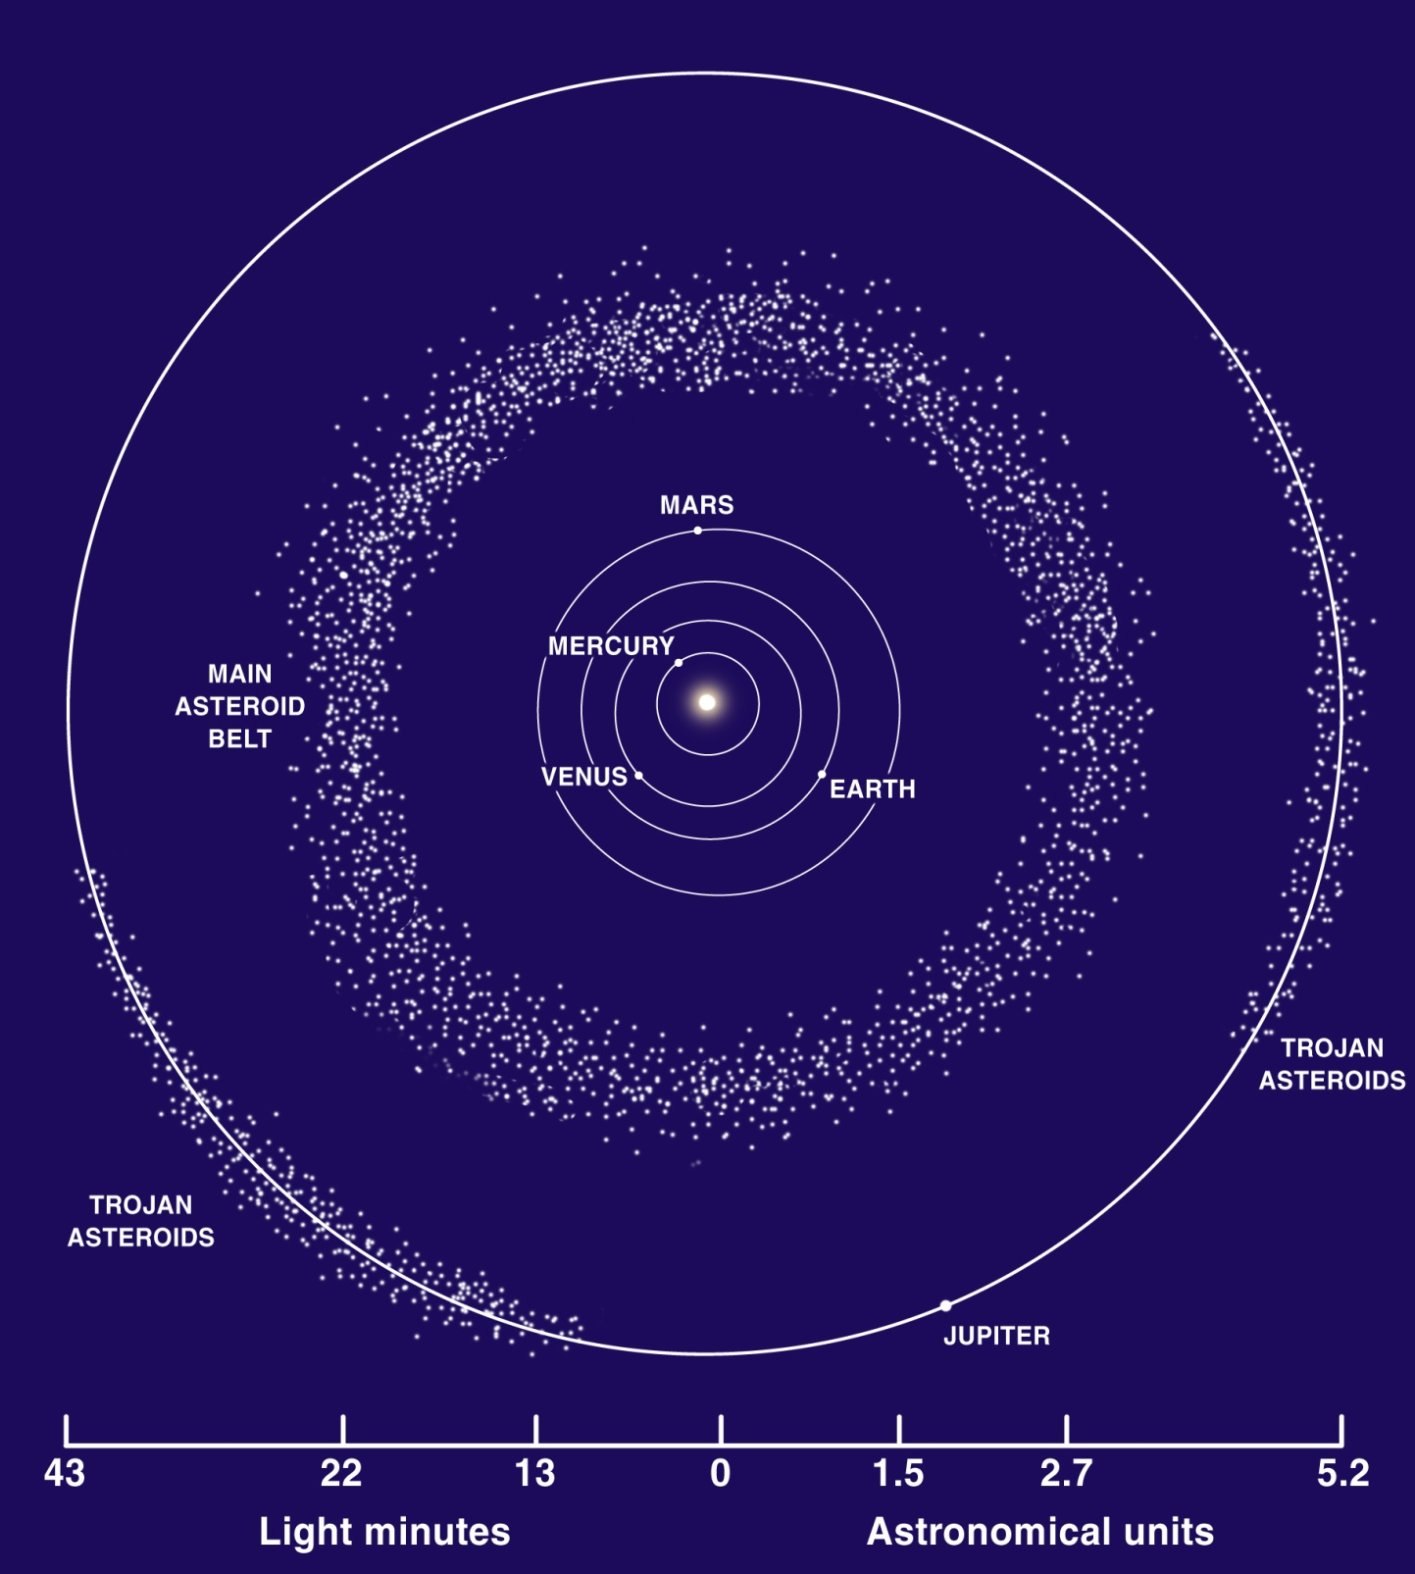
Asteroids!
Notes:
From the asteroid belt between Mars & Jupiter. These rocky bodies fall in or out from their orbit due to collisions with one another, and may move into a position in the orbital path of a planet or moon such that an impact can happen. Asteroids break up due to these collisions, so that small asteroid fragments are formed – these fragments are the most likely material to for meteors, which we will discuss shortly.

Slide 6
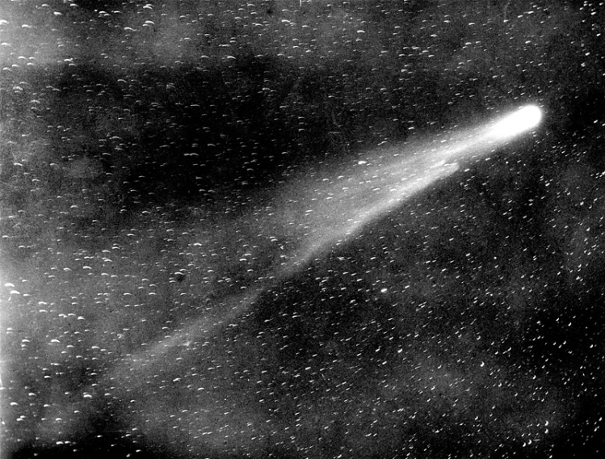
Comets!
Notes:
Comets can also collide with planets and moons. Comet orbits are very elliptical and these “dirty-snowballs” spend very little time passing through the inner solar-system. As a result, impacts involving comets are much less common.

Slide 7
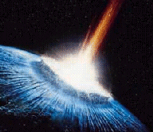
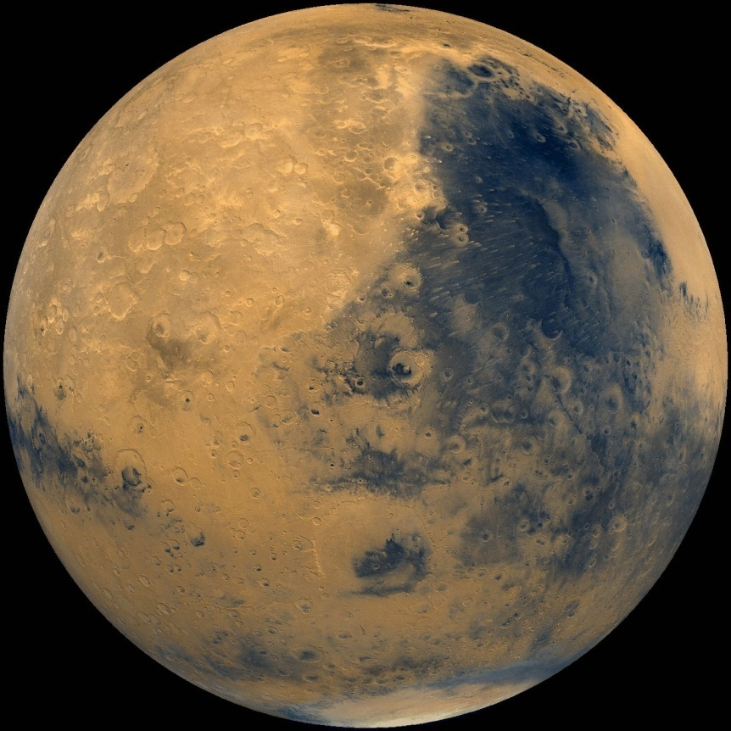
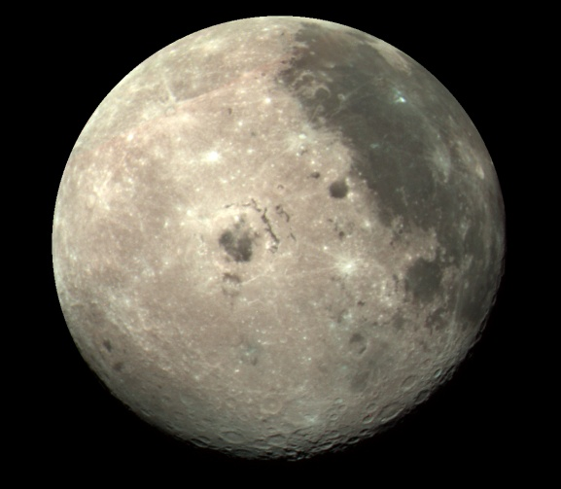
Pieces of other planets!
Notes:
Impacts can also cause pieces of planets or moons to be ejected and ‘thrown’ off surface. These pieces can then land on other solid planets/moons.
For example: An asteroid impacting Mars could eject a piece of Mars into the solar system. Then, this now “space-bourne” piece of Mars could land on another planet, or a Moon. By this mechanism we could have pieces of Mars on the Moon, or even pieces of Earth on the Moon. At the Centre for Planetary Science and Exploration, we have pieces of Mars which have landed on Earth.
Note: Rocks ejected from the surfaces of planets or moons are likely to be much smaller than asteroids.

Slide 8
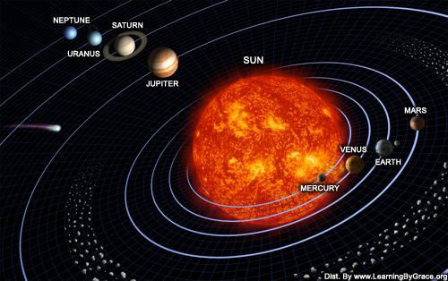
Inner Solar System
Notes:
Let’s take a look at other rocky planets and Moons in our solar system….
Image credit: www.newscientist.com

Slide 9
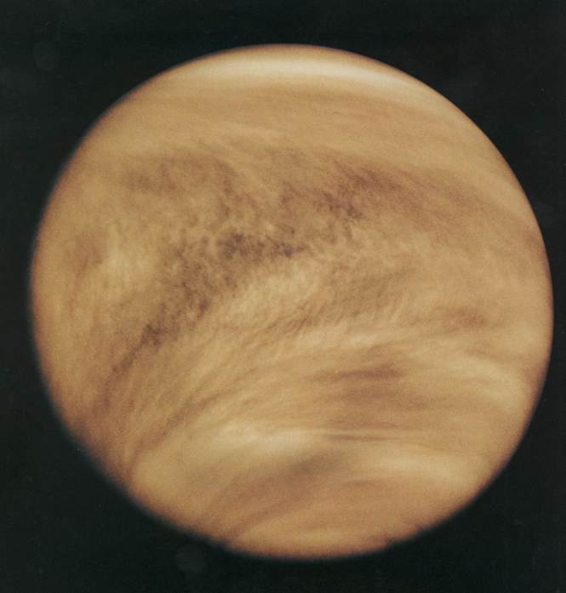
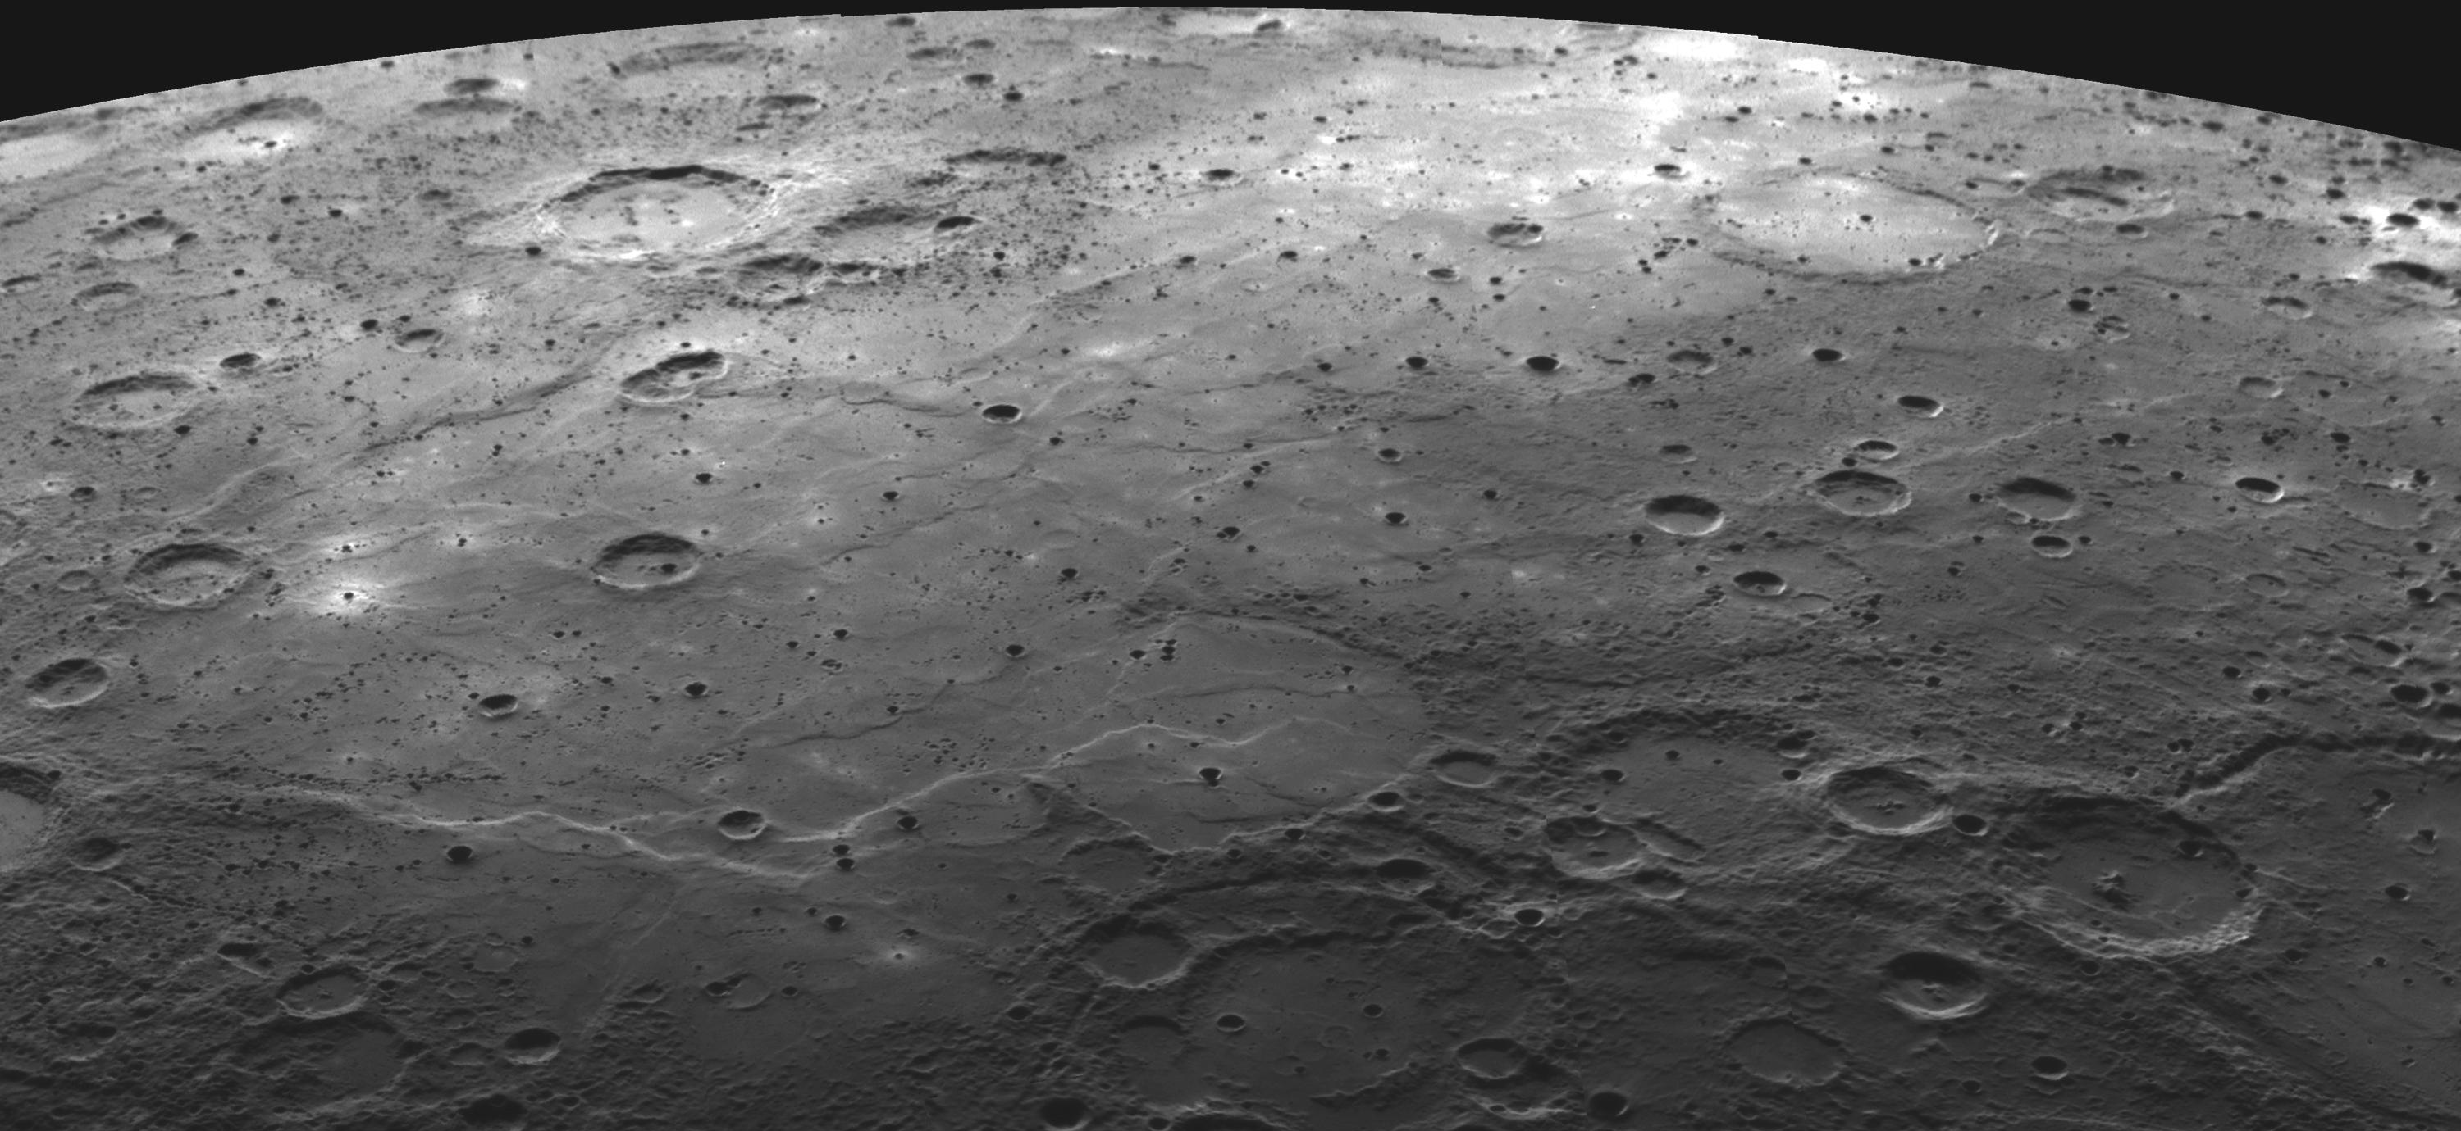
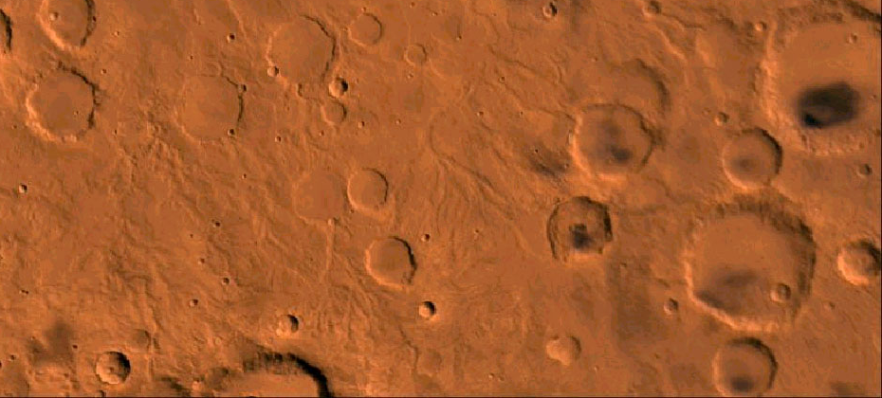
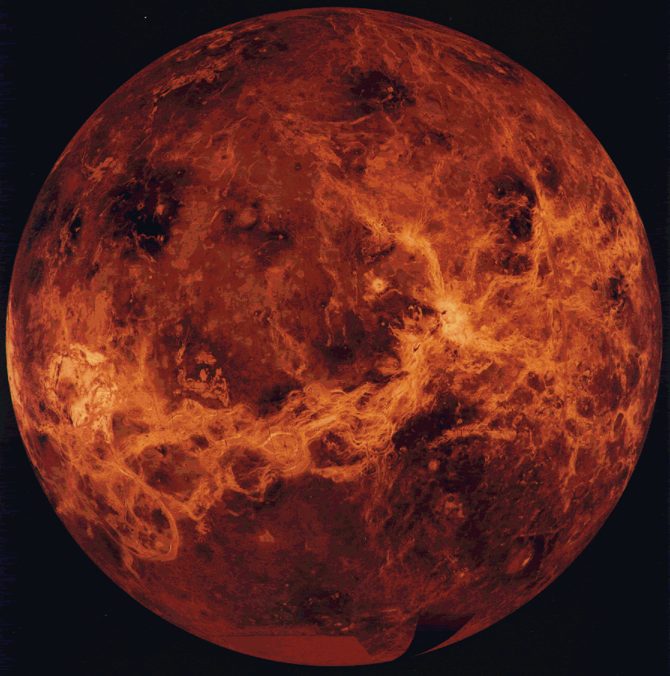
Mercury
Venus
Mars
Notes:
The inner planets have a lot of impact craters. It’s hard to see the surface of Venus because it’s covered in a very thick layer of clouds. But, we can use RADAR (explain if they don’t know how this works) to get images of the surface.
Image credit: NASA

Slide 10
Outer Solar System
Notes:
What about the gas giants in the solar system? Do you think there are craters on these planets? No – because they are made of gas.
Image credit: www.newscientist.com

Slide 11
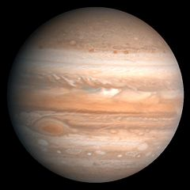
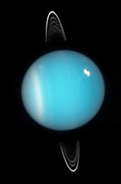
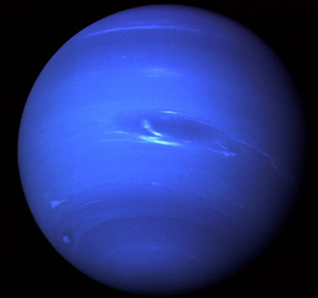
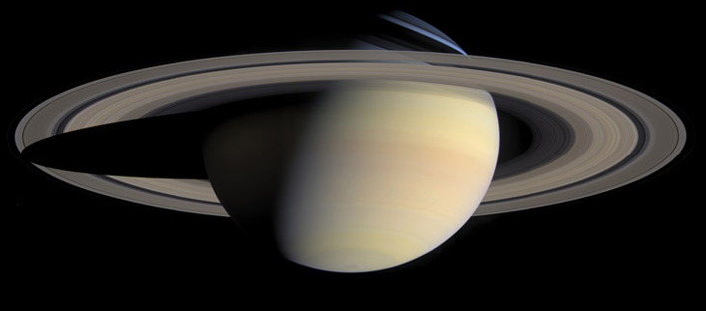
Notes:
Here are the four outer, gas planets – Jupiter, Saturn, Uranus and Neptune. They all are made up mostly of gas – though scientists think there may be icy or rocky cores at the centre of most or all of them.
Even though they don’t show impact craters like solid, rocky bodies do, they do so evidence of impacts.
Image credit: NASA

Slide 12
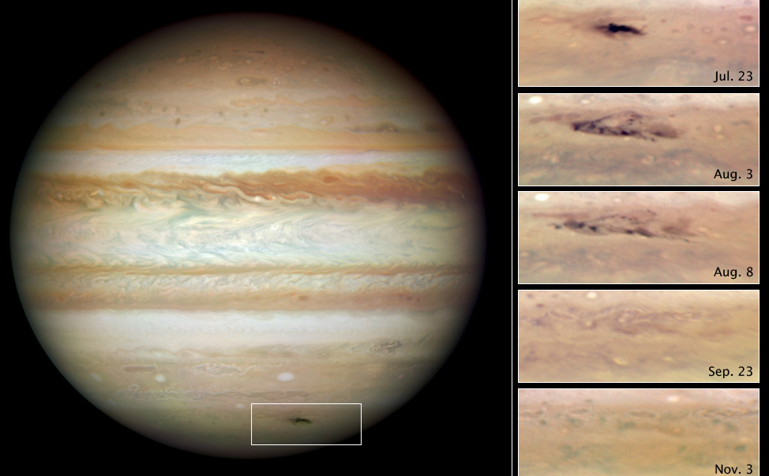
Jupiter: 2009 Impact
Notes:
For example, in 2009, an asteroid crashed into Jupiter. NASA Image from Hubble Space Telescope. It left a mark in the upper layers of the atmosphere for a few months! Impacts on gas planets don’t leave long-lasting marks as they do on solid planets, but we know they happen on a regular basis. In fact, Jupiter probably gets hit the most because it’s the largest planet in our solar system, and therefore has the largest gravity and attracts the most small bodies!
Image credit: Hubble Space Telescope image of the Jupiter 2009 Impact. NASA, ESA, M. Wong (University of California, Berkeley), H.B. Hammel (Space Science Institute, Boulder, Colorado), I. de Pater (University of California, Berkeley), and the Jupiter Impact Team.

Slide 13
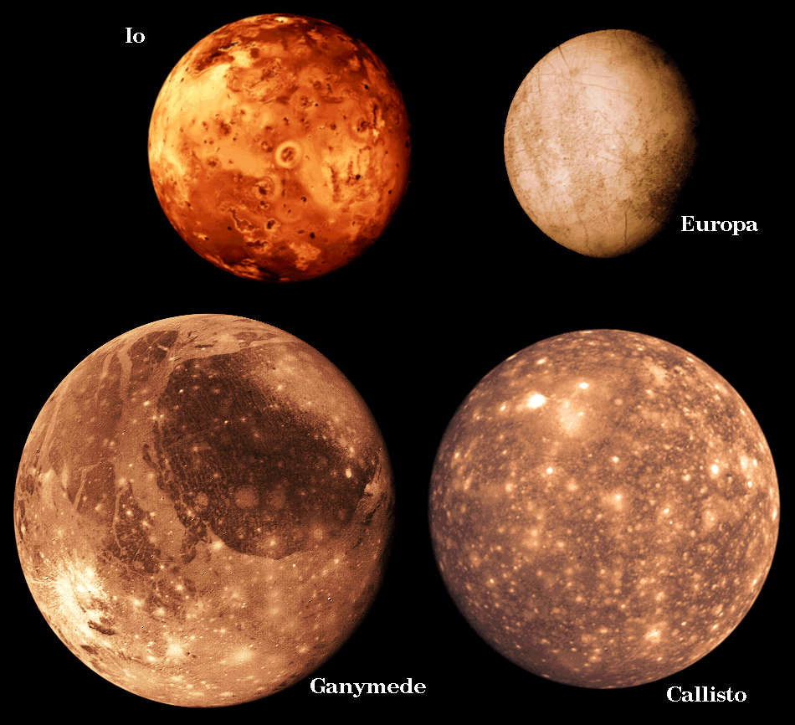
Moons of Jupiter
Notes:
We also can see craters on the moons of Jupiter! Here are pictures of 4 main moons of Jupiter.
(Io = the size of our moon)
Ganymede and Callisto have many craters (white splotches). Io and Europa don’t seem to have as many, and that’s because they’re surfaces are continually being renewed (volcanism/gysers on Io, water breaking through ice on Europa).
Image credit: NASA

Slide 14
What planet have we missed?
Notes:
Ask the students…

Slide 15
Are there craters on Earth?
How many?
Notes:
Ask the students how many craters they think there are on Earth.
Image credit: NASA

Slide 16
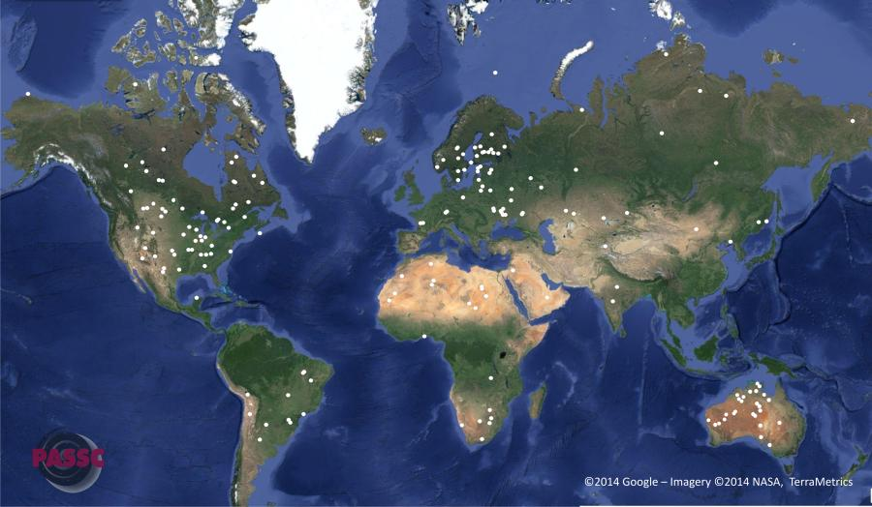
190 confirmed impact craters on Earth
Notes:
If you have an internet connection, click on the Google map viewer link to get info about all known craters.
190 known craters (put this on worksheet) - http://www.passc.net/EarthImpactDatabase/index.html (20 Oct 2016)
Ask: Where don’t we see craters?
Oceans, Greenland, Russia, Alaska.
Ask them to think about why this might be as we look at our nearest neighbor, the Moon.
Image credit: http://www.lpi.usra.edu/publications/slidesets/craters/slide_2.html

Slide 17
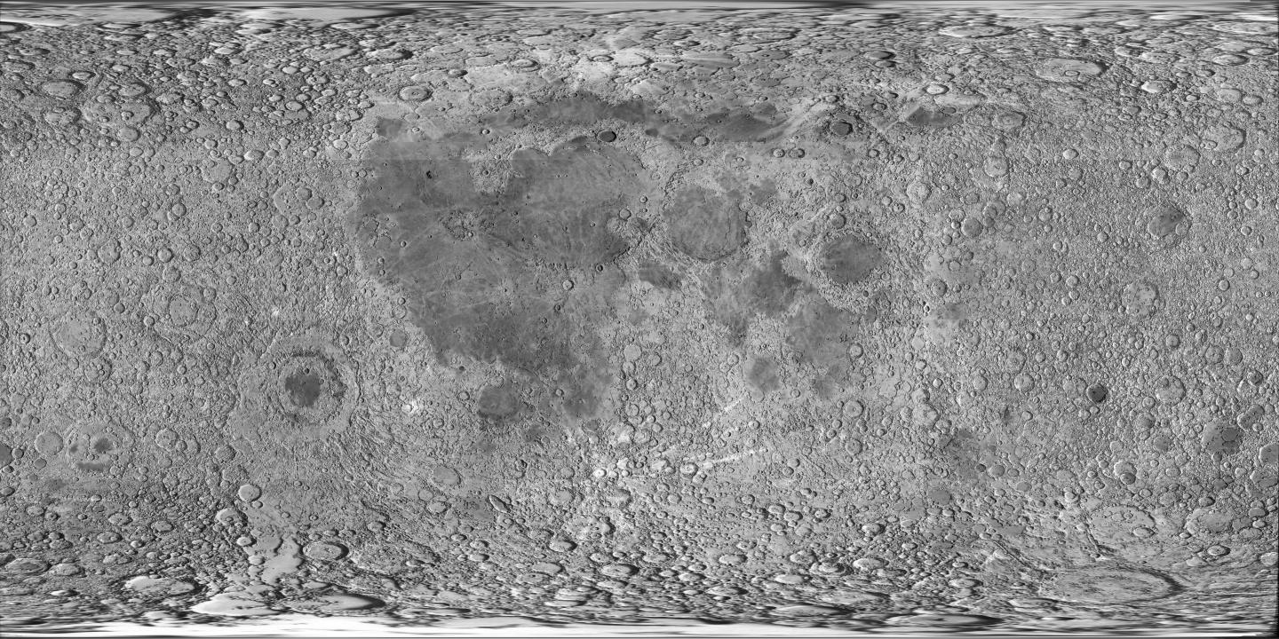
How many craters on the Moon?
More than 30,000!
Notes:
Ask students how many craters are in this photo of the moon (explain that this is the entire moon, front and back).
We can see about 30,000 craters (answer on worksheet) on the moon by looking through a small telescope in your backyard. Can see millions of craters if look in more detail using larger telescopes and cameras on satellites orbiting the Moon.
Image credit: NASA

Slide 18
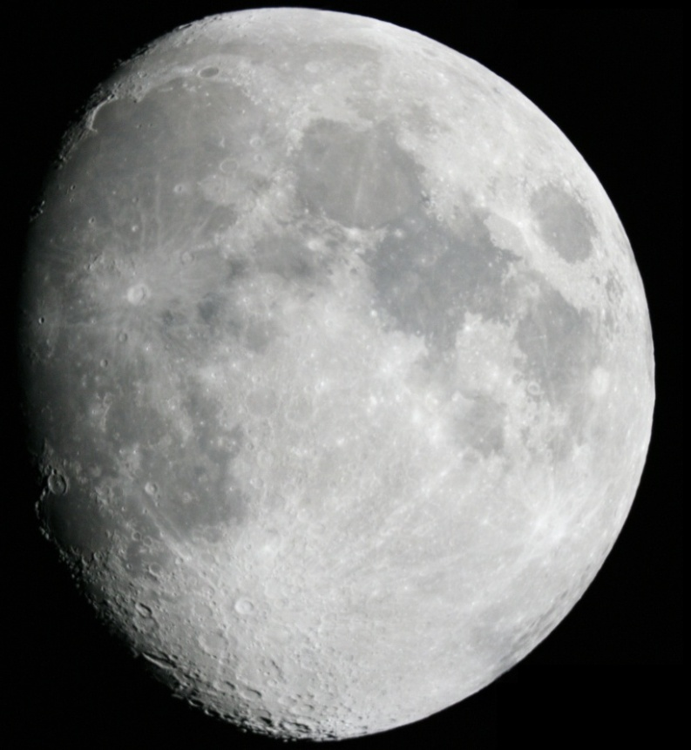
Why do we see fewer craters on Earth than on the Moon?
Notes:
Even though Earth and the Moon are next door neighbors, why don’t we see nearly as many craters on Earth?
Get students to respond – if they’re having trouble, ask them what happens on the Earth that doesn’t happen on the Moon.
Images credit: NASA

Slide 19
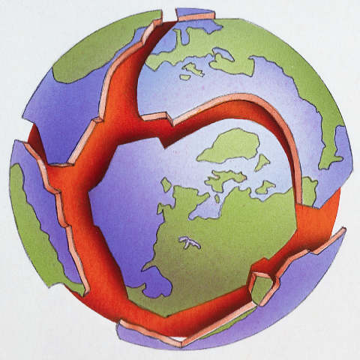
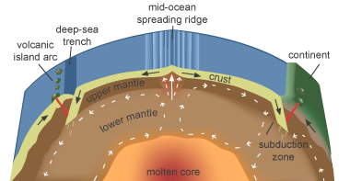
We have an active Earth!!
Atmosphere, plate tectonics, wind, water and gravity. Anything else??
Notes:
It all comes down to the fact that Earth is a very active planet! (answer on worksheet)
Volcanic resurfacing, and tectonic activity are continually erasing impact structures from the rock record of Earth. None of the process happen on the Moon.
Erosional processes are continually erasing impact structures from the rock record of Earth. None of these processes happen on the Moon.
Earth has an atmosphere, which can burn up sizable meteors before hitting the ground (not so on the Moon)

Slide 20
Quiz!!
What planet or moon surface are the following craters found on?
Notes:
Students will write down their guess on the worksheet, then write down the correct answer.
Give students a choice: a) Earth, b) Moon, c) Mars

Slide 21
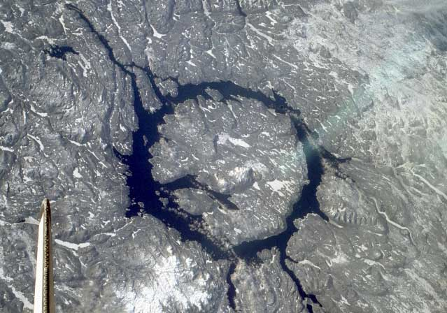
1.
Notes:
Manicouagan crater, Quebec: ~100 km diameter complex impact structure.
Photo taken from during Space Shuttle mission STS-9 in 1983 (north is to the lower right)
(Note wing of space shuttle in bottom left corner of image!)
Image Credit: NASA

Slide 22
1.
Manicouagan crater, Quebec
Notes:
Manicouagan crater, Quebec: ~100 km diameter complex impact structure, 215.5 million years old
Photo taken from during Space Shuttle mission STS-9 in 1983 (north is to the lower right)
(Note wing of space shuttle in bottom left corner of image!)
Image Credit: NASA

Slide 23
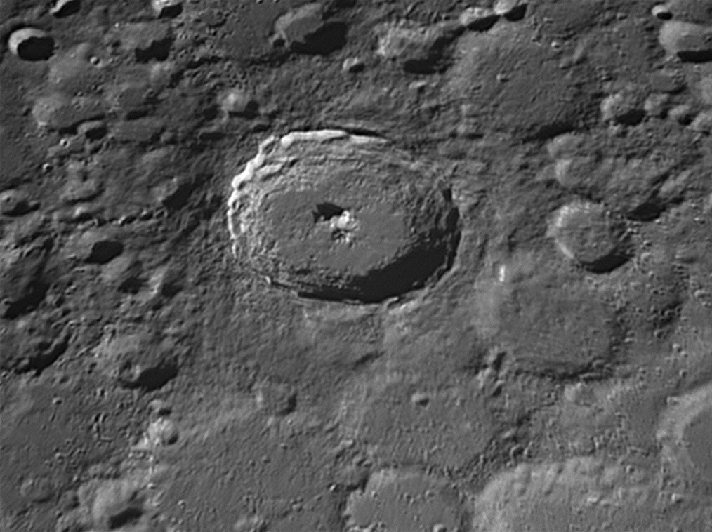
2.
Notes:
Tycho crater on the Moon, NASA
(85 km in diameter)
Image Credit: NASA

Slide 24
2.
Tycho Crater, Moon
Notes:
Tycho crater on the Moon, NASA
85 km in diameter, 108 million years old
Image Credit: NASA

Slide 25
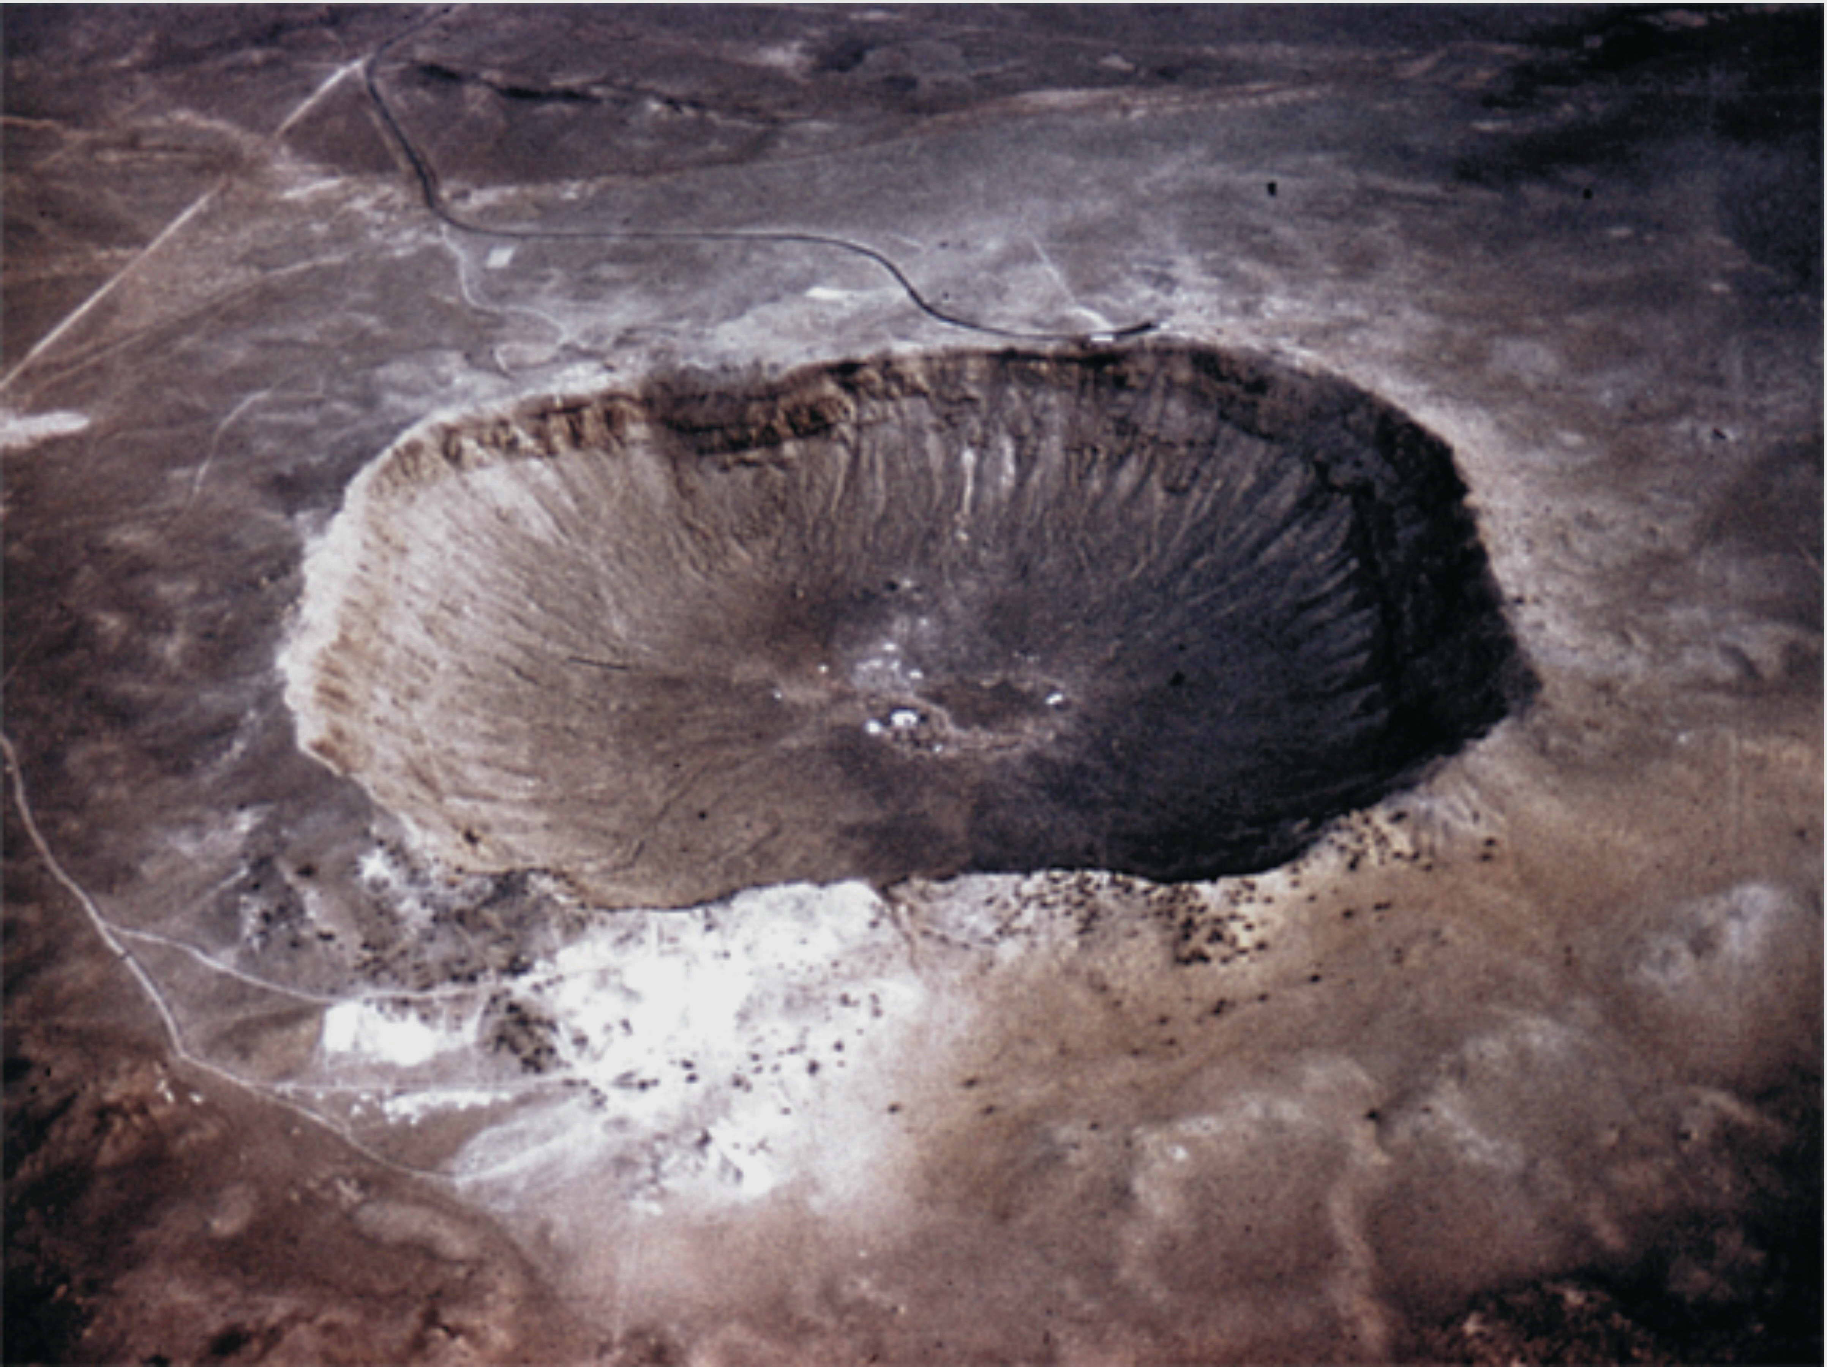
3.
Notes:
Meteor or Barringer Crater in Arizona.
~50,000 years old.
1.2 km diameter.
Image Credit: NASA

Slide 26
3.
Barringer (Meteor) Crater, Arizona
Notes:
Meteor or Barringer Crater in Arizona.
~50,000 years old.
1.2 km diameter.
Image Credit: NASA

Slide 27
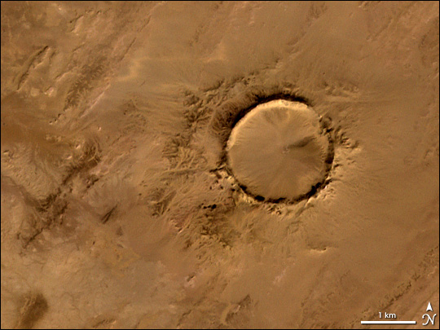
4.
Notes:
Tenoumer, Mauritania (Africa)
Image Credit: NASA image created by Jesse Allen, using data provided courtesy of NASA/GSFC/METI/ERSDAC/JAROS, and U.S./Japan ASTER Science Team.

Slide 28
4.
Tenoumer, Mauritania (Africa)
Notes:
Tenoumer, Mauritania (Africa)
Image Credit: NASA image created by Jesse Allen, using data provided courtesy of NASA/GSFC/METI/ERSDAC/JAROS, and U.S./Japan ASTER Science Team.

Slide 29
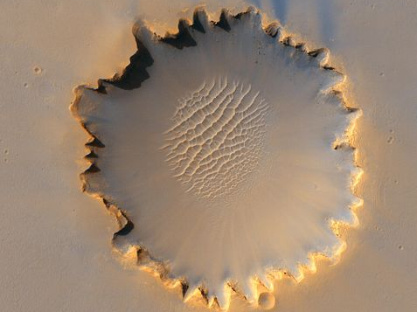
5.
Notes:
Victoria Crater on Mars
Visited by the Mars Exploration Rover Opportunity! It is roughly 730 metres wide.
Image Credit: NASA/JPL-caltech/University of Arizona

Slide 30
5.
Victoria Crater, Mars
Notes:
Victoria Crater on Mars
Visited by the Mars Exploration Rover Opportunity! It is roughly 730 metres wide.
Image Credit: NASA/JPL-caltech/University of Arizona

Slide 31
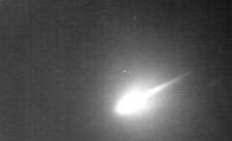
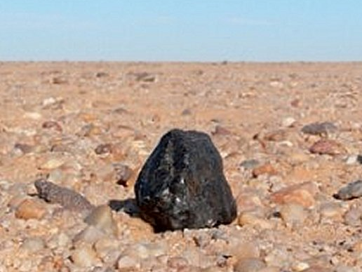
Meteoroid: a piece of asteroid, comet, or another planet in space.
Meteor: light formed by meteoroid traveling through atmosphere.
Meteorite: the rock left on the surface.
Notes:
Here are the definitions for meteoroid, meteor, and meteorite (write on worksheeet).
Hint: Troubles mixing-up meteoroid and meteorite? Consider the suffix…
Meteor-oids and Aster-oids are both objects in space.
Gran-ite, calc-ite, and meteor-ite, are all types of rocks that can be found on Earth.
The middle image is taken from a camera based at the University of Western Ontario, this is an image of the “Grimsby” meteor event that happened in the fall of 2009.
Meteorite found in Northwest Africa: http://planete-mars.com/ciel-et-espace-de-juin/

Slide 32
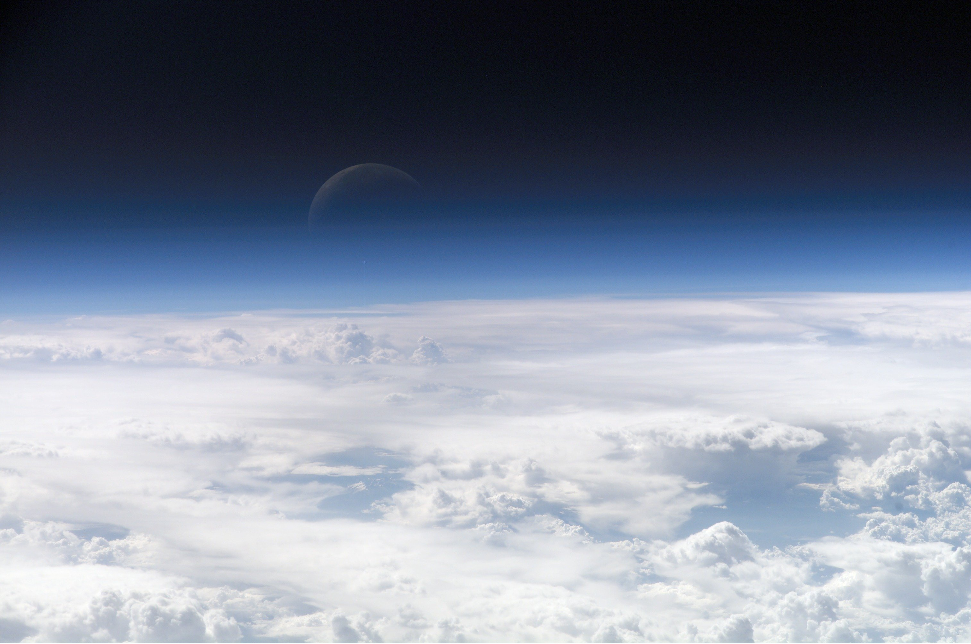
What happens if a meteoroid approaches Earth?
Notes:
Now we’re going to talk about what happens when rocks from space of different sizes approach Earth.

Slide 33
Small meteoroids:
Come from Asteroid Belt
or another planet.
Pulled in by Earth’s gravity.
For small meteoroids approaching Earth…
Notes:
First, let’s start with small objects – and by small, we mean the size of a basketball or smaller when in space.
Small meteoroids commonly originate from Asteroid Belt, or are ejected material from a planetary surface.
If they move into the orbital path of Earth, they may be pulled in by Earth’s gravity.

Slide 34
Starts to burn up in
Earth’s atmosphere (85
km altitude).
The light seen is called a
Meteor.
For small meteoroids approaching Earth…
Notes:
When the object reaches Earth’s Mesosphere (85km altitude) it starts to burn up due to frictional heating with the atmosphere. The light seen is called a Meteor
Note: slide with meteoroid/meteor/meteorite definitions is coming up.

Slide 35
As the object continues to burn up, it loses mass and becomes smaller as it falls towards Earth.
For small meteoroids approaching Earth…
Notes:
As it continues to fall through the atmosphere, it burns up and gets smaller.

Slide 36
Very small objects will burn up completely in the sky and never reach the surface of Earth.
For small meteoroids approaching Earth…
Notes:
Small objects will get completely burned up in the atmosphere and never touch the ground. Every day, 40 tonnes of meteoroids enter the mesosphere!

Slide 37
Larger meteoroids may reach the surface of the Earth. If they are found, we call them meteorites.
(Small objects often
do not leave a crater).
For medium meteoroids approaching Earth…
Notes:
Objects that are a bit larger (between the size of a basketball and a small car when in space) will hit the Earth and leave a meteorite. These do not have enough force to make a crater.

Slide 38
These objects are most likely asteroids that have been expelled from the asteroid belt. Rarely they may be comets.
For LARGE meteoroids approaching Earth…
Notes:
For large objects (bigger than the size of a car), they come in through the atmosphere and begin to burn up as well.

Slide 39
Burn up upon entering
the atmosphere.
Create a sonic boom!!
For LARGE meteoroids approaching Earth…
Notes:
But, they will also create a sonic boom which can be heard for miles! A great example of this is the meteoroid that exploded above Russia in February 2013.

Slide 40
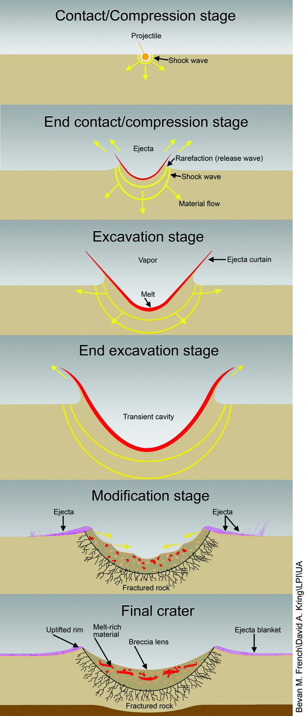
When impact occurs, a shock wave spreads through the Earth.
Notes:
When the meteoroid strikes the Earth, a shockwave is sent through the ground.
Diagram from NASA Lunar Science Institute Cratering Lab:
http://www.lpi.usra.edu/nlsi/education/hsResearch/crateringLab/lab/part1/background/

Slide 41
Most often, the impactor is completely destroyed.
Some material will be thrown into the air and then fall back to the surface.
Notes:
This shockwave is so powerful that it actually melts the rock and it acts like a liquid! The explosion and excavation of materials at the impacted site created piles of rock (called ejecta) around the circular hole as well as bright streaks of target material (called rays) thrown for great distances. The meteoroid itself is mostly vaporized.
Diagram from NASA Lunar Science Institute Cratering Lab:
http://www.lpi.usra.edu/nlsi/education/hsResearch/crateringLab/lab/part1/background/

Slide 42
Ejected material is called ejecta, and forms an
ejecta blanket.
Notes:
This is what some impact craters will look like, and this process can take a few seconds to several hours to complete, depending on the size of impact. In the bowl of the crater is a mix of melt-rich material and breccia (looks like concrete), and fractured rock beneath that. There is an uplifted rim, and ejecta outside the bowl of the crater. Sometimes there is a central uplift or peak in the middle, and rings around the rim of the crater --- these occur in larger craters.
Students should copy this diagram down, including terms, in their worksheet.
Diagram from NASA Lunar Science Institute Cratering Lab:
http://www.lpi.usra.edu/nlsi/education/hsResearch/crateringLab/lab/part1/background/

Slide 43
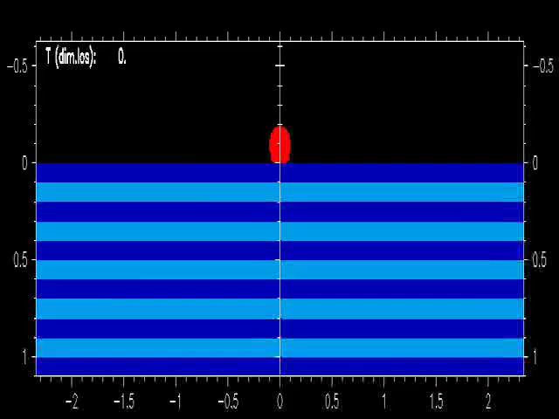

Slide 44

Notes:
This is the introduction from NOVA’s documentary, Meteor Strike (2013), about the fireball and shockwave that occurred in Chelyabinsk, Russia on Feb. 15, 2013. The meteoroid was about 17m in diameter, and exploded in an air burst at a height of about 23km. The loud shock wave occurred about 3 minutes after the fireball was visible. Many buildings were damaged, and about 1000 people were injured. If the meteoroid had come in at a steeper angle (more vertical) it would have done a lot more damage.

Slide 45
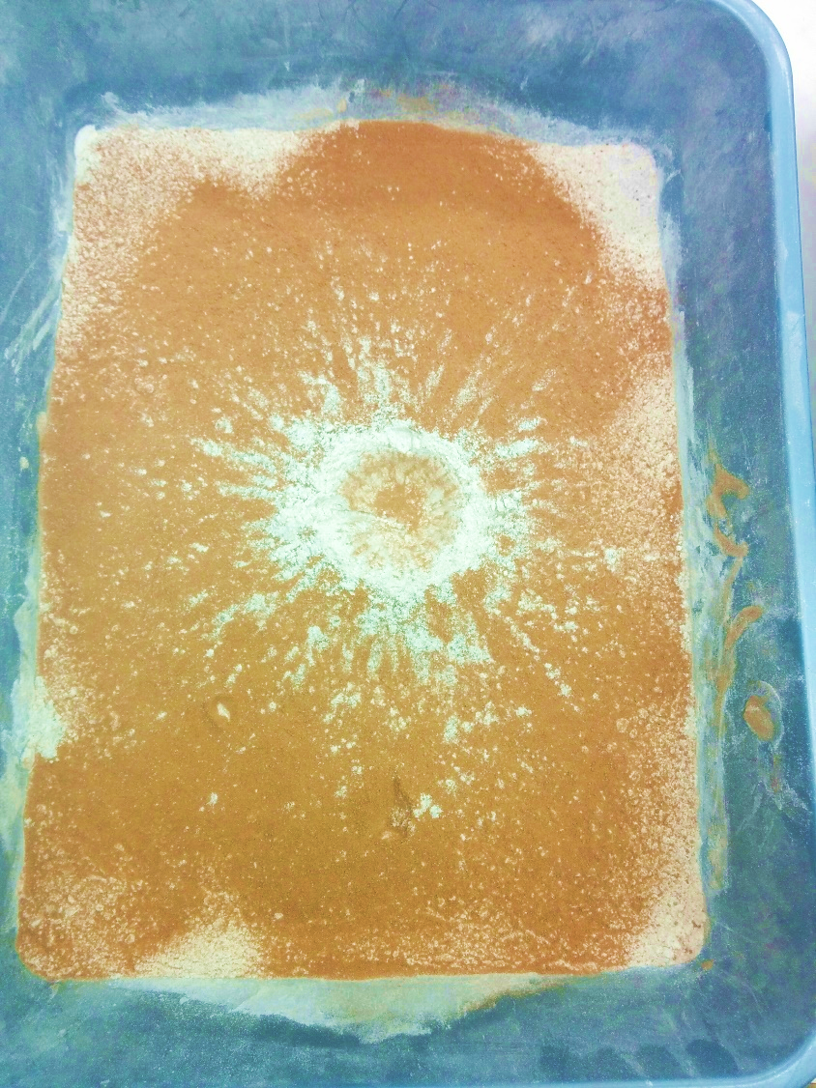
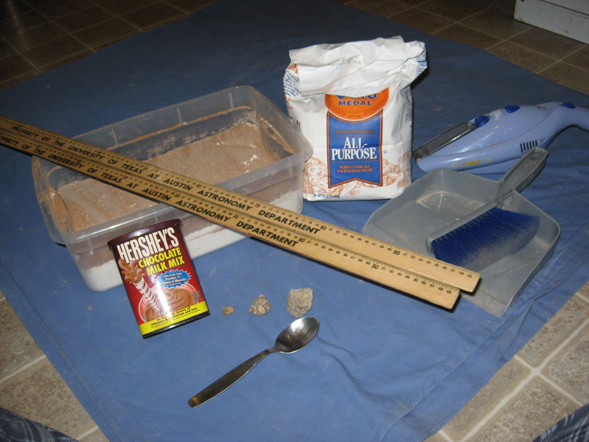
Demo & Lab
Notes:
Give the Classroom Demonstration.

Slide 46
After lab Review
Notes:
Ask students How is our model of an impact crater different than real craters?

Slide 47
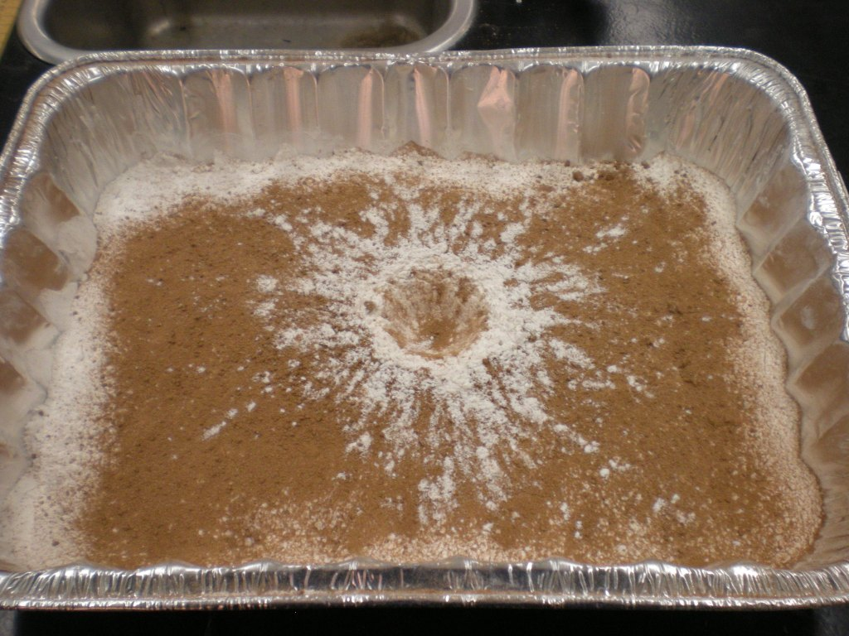
How is our model of an impact crater different than real craters?
Velocity of impactor
  (real life = hypervelocity , faster than 10 km/second!!!!!)
Size of impactor
Target Material
  For real craters, target material is solid rock
Notes:
Ask students How is our model of an impact crater different than real craters?– see how many they are able to come up with

Slide 48
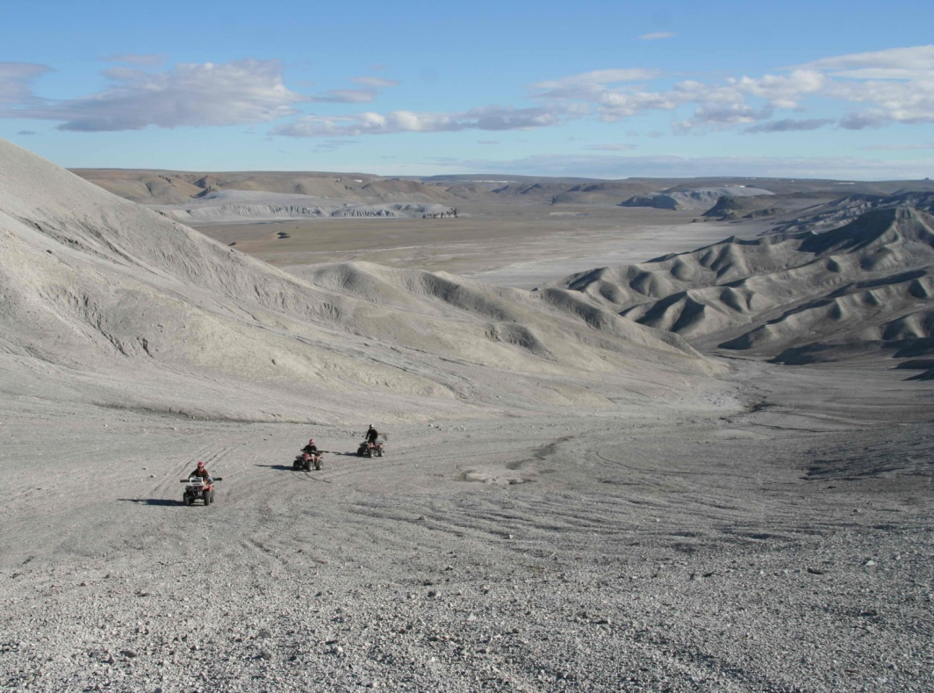
Why do we study craters?
Notes:
Ask students why they think studying craters is important.

Slide 49
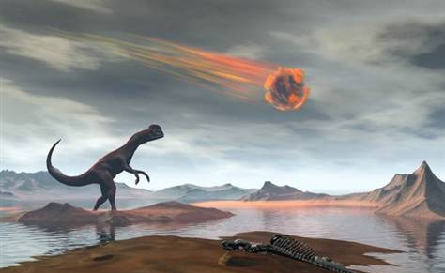
Why study craters?
Need to know how often they hit EARTH!!!! (especially the BIG ones!)
Notes:
First – we’d like to know how often meteroids are hitting Earth (especially BIG ones, such as the impact that destroyed the dinosaurs ~65 million years ago).
Image credit: stockxpert

Slide 50
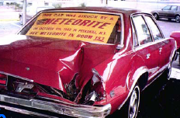
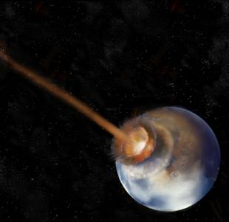
How frequent?
Small impacts (greater than 20 cm)
Very frequent (100’s per year!!)
Moderate impacts (greater than several meters)
Frequent (1 per year!!)
Large impacts (>10 km scale)
Very rare (every 100 million years!)
Notes:
Ask students how frequent they think rocks from space hit Earth?

Slide 51
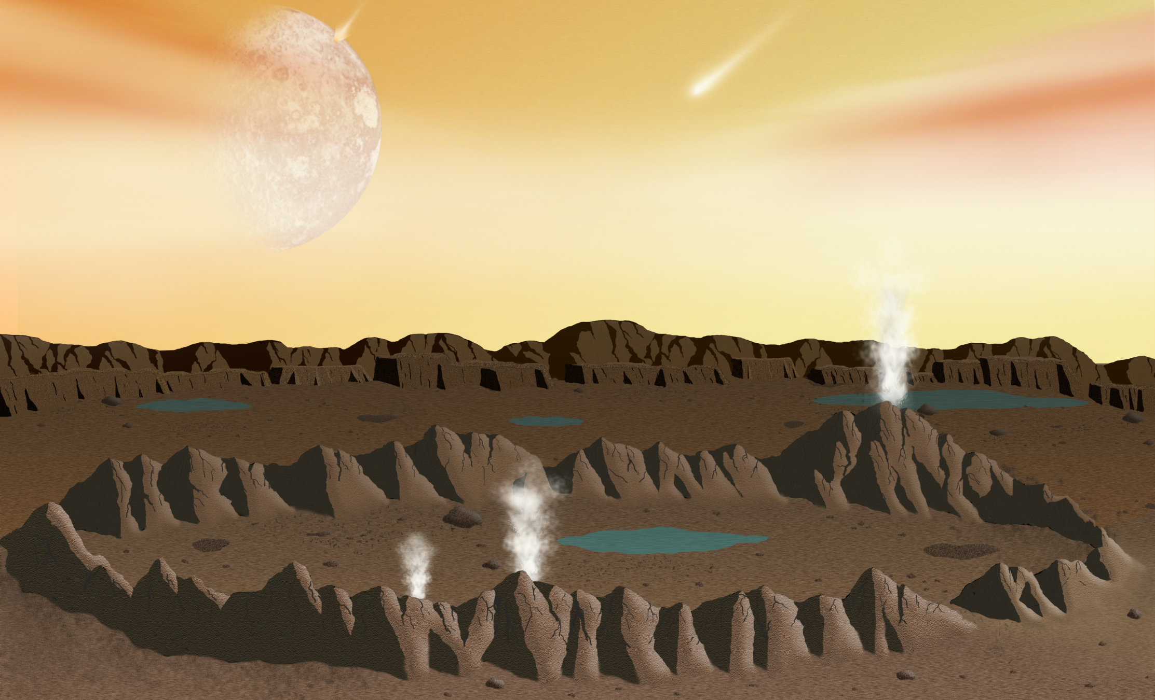
Why study craters?
Help to understand how life may have started on EARTH
Hydrothermal Systems
Notes:
Early Earth was ravaged by impact cratering events. During this time, impact events generated vast subsurface hydrothermal systems that may have been crucibles for pre-biotic chemistry and possible habitats for the early evolution of life.
Image Credit: LPI (David A. Kring and Leanne Woolley).
For further details see: http://www.lpi.usra.edu/nlsi/training/illustrations/

Slide 52
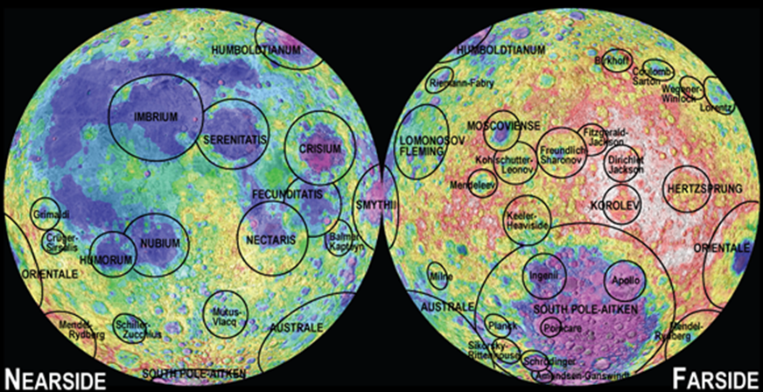
Why study craters?
3) Determine age of planets and moons
Moon
Notes:
We can determine the relative age of planets by how many craters are on the surface.
Different colours of lunar surface relate to topography (elevation).
Image credit: LPI (Paul D. Spudis and David A. Kring)
Source: http://www.lpi.usra.edu/nlsi/training/illustrations/

Slide 53
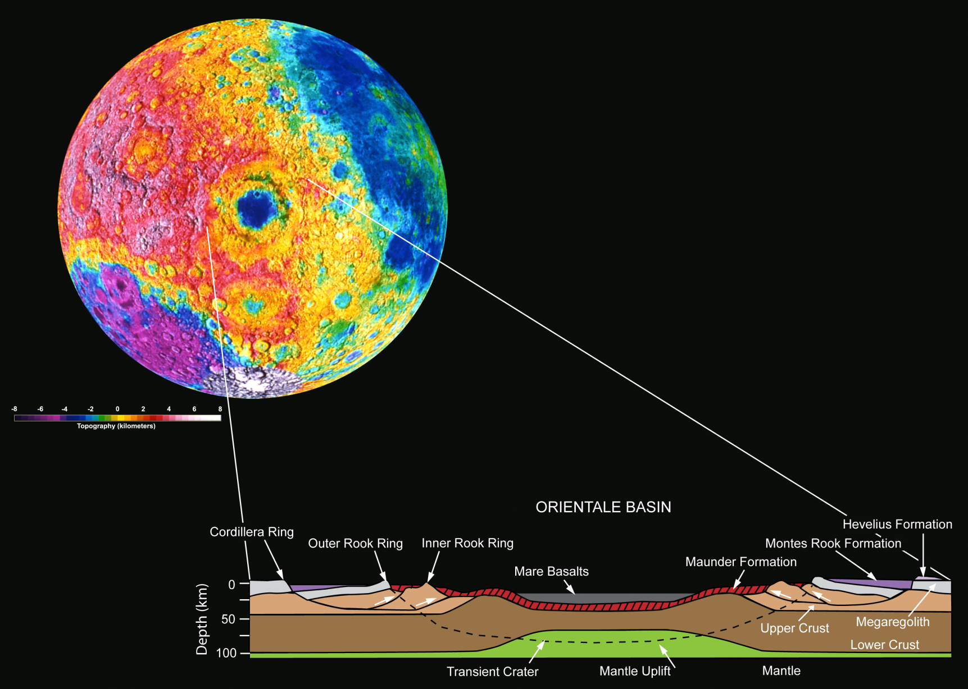
Why study craters?
4) We can use craters to study beneath the surface (without drilling!)
Moon
Notes:
Craters allow geologists to see below the surface of a planet – help us determine the geology of a planet, and also help us exploit materials that are typically burried deep beneath Earth’s surface
Image credit: Cross section of Orientale Basin, Moon. LPI (after Head et al. 1993). Different colours of lunar surface relate to topography (elevation).
Source: http://www.lpi.usra.edu/nlsi/training/illustrations/

Slide 54
Thank you!
Questions?
@westernuCPSX
cpsx.uwo.ca/outreach
Facebook.com/westernuCPSX

