Slide 1

The Earth, Moon, and Sun System
Prepared by: Alexandra Pontefract, Bhairavi Shankar, Heather Henry and Laura Thomson
Updated by: Jennifer Newman
@westernuCPSX
cpsx.uwo.ca/outreach
Facebook.com/westernuCPSX

Slide 2
Scale of the Earth/Moon/Sun System
Notes:
Get the students to draw the relative sizes of the Earth and Moon, and also draw the distance between them.
Then, using a volunteer’s head as the size of the Earth, ask students how large the Moon should be (you can give them choices using different size balls).
One of the larger styrofoam balls in the Moon kit would be the approximate size of the Moon when compared to your head (Head ~ 25cm, Moon ~ 7cm)
Ask the students how far the Moon should be away from the Earth (your head). It should be about 7.5m away (easy way to remember this is it’s distance is about 100 times the Moon’s diameter).

Slide 3
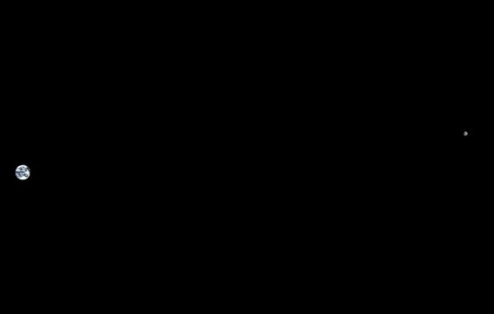
Earth and Moon to Scale
Earth
Moon
Notes:
This is a scale photo of the Earth and Moon.
Ask the students how large and far away the Sun would be in our model.
In this model, the Sun would be about 2.9 km away and be about 27m across! It’s about 100 times the diameter of Earth!

Slide 4
Motion of the Earth, Moon and Sun
Notes:
Now let’s talk about how the Sun, Earth, and Moon move in relation to one another.

Slide 5
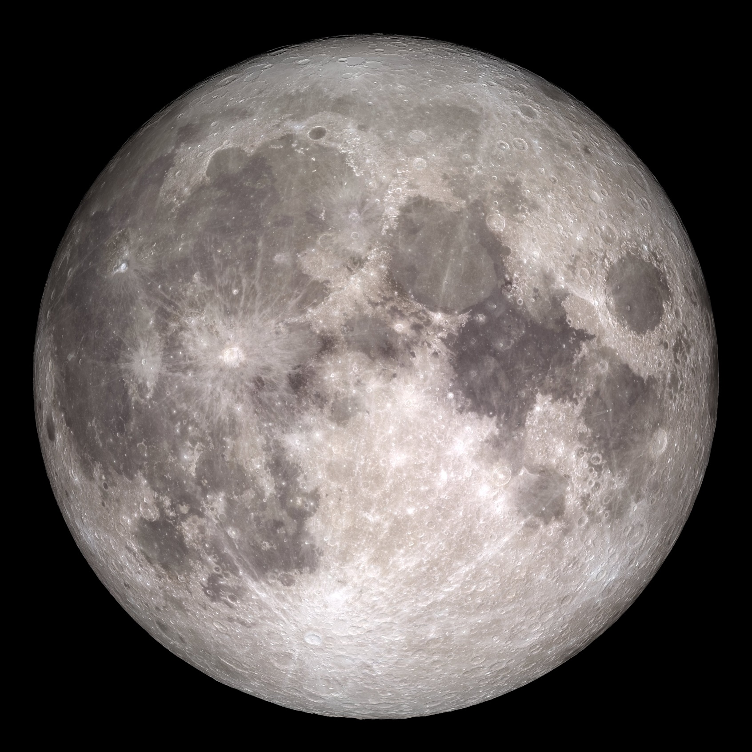
Moon Phases
Notes:
This should be a familiar image to everyone. A full moon is the most complete view we have of the moon from Earth, but as the moon revolves around Earth the portion of the moon illuminated moon we can see changes. These are the moon phases and the following slides will show how they occur.
http://www.nasa.gov/feature/goddard/rare-full-moon-on-christmas-day

Slide 6
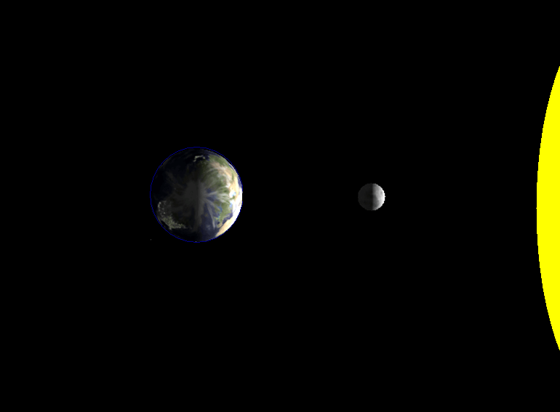

Notes:
ST:
Let’s look at this picture and you can help me point out a few things. First of all it is important that you recognize and understand a few things.
This is a view looking down on to the Earth from the North Pole
The Earth, is spinning counter clockwise.
The Earth is NOT it’s own light source, it only reflects the light that
Q:
What are the people on THIS (point to the half of the Earth closest to the sun) side experiencing?
AR:
Day Time
Q:
How much of the Earth is lit up?
AR:
Half

Slide 7
Notes:
ST:
Now that we add the moon into this picture and we see that the same thing happens. Only half of the moon is lit and notice that it is the half that is facing the sun.
Q:
If the people on Earth during the day were to look up, would they see the moon? Why or Why not?
NOTE: If students comment about the possibility of an eclipse tell them we will talk about it later.

Slide 8

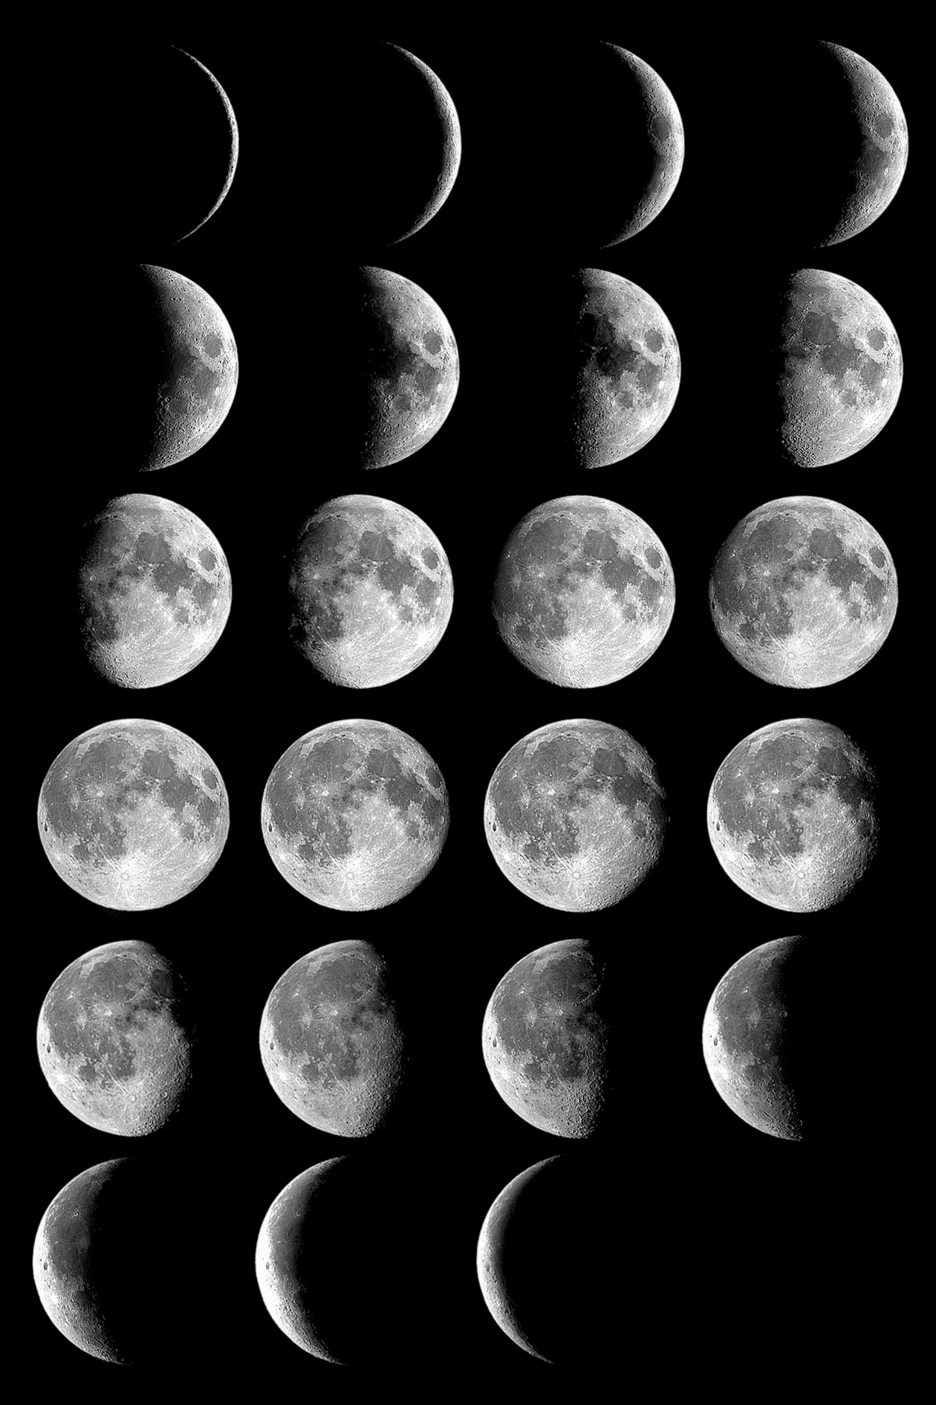
New
Moon

Slide 9
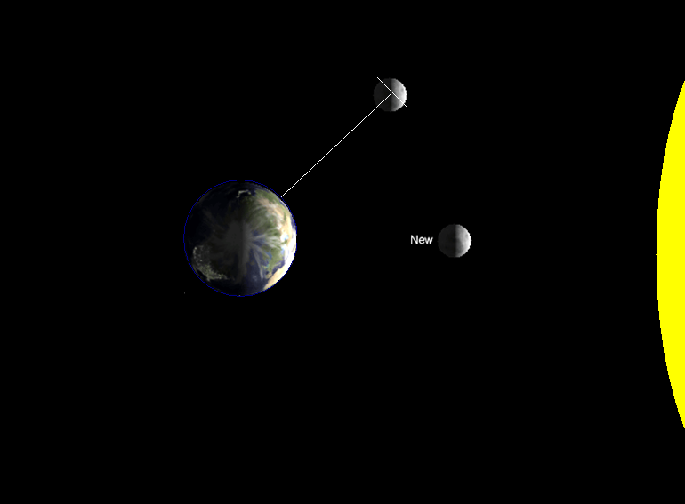
Waxing
Crescent
Notes:
ST:
Here we can see that after a few days (~4) some of the moon that IS reflecting the sun’s lights. We will explain the term “Waxing” in a moment, but for now, you should know what a crescent is… think ‘croissant’.

Slide 10
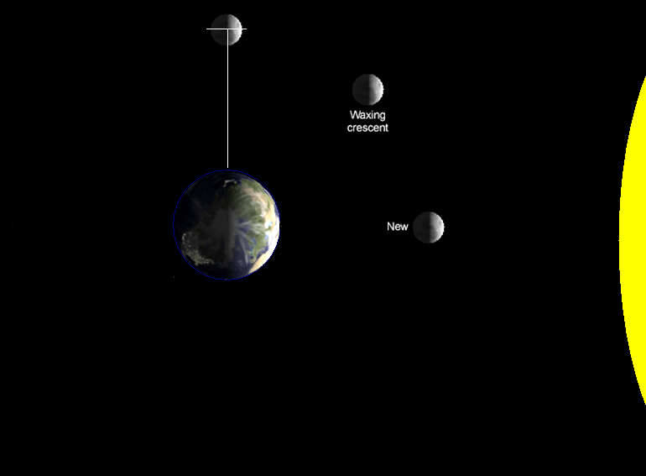
First
Quarter
Notes:
ST:
Science likes to be tricky… This term is a bit confusing because it is called the first quarter. Despite that, STILL only half the moon is really lit up and from the perspective of an Earth observer, half the moon appears bright.

Slide 11
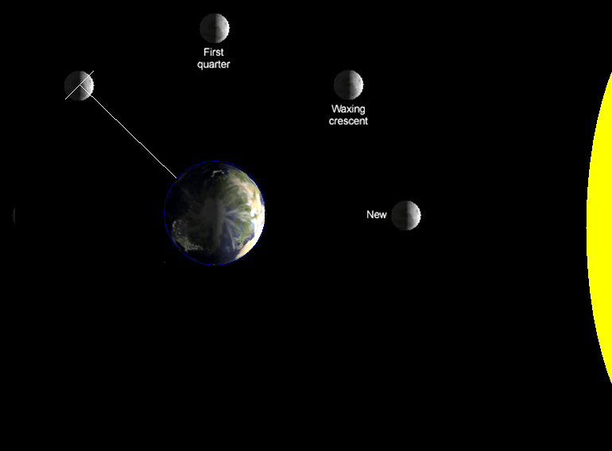
Waxing
Gibbous
Notes:
ST:
So we are suppose to get back to the term waxing… Since it is not 100 years ago I doubt if any of you would have made your own candles. If you had let us imagine what would happen. If you dip a candle in wax and pull it out, let it cool and the repeat this process what is happening to the size of the candle? This Growing effect is called waxing because with each layer of wax the candle grows. Similarly, When the moon rotates around the Earth on this size it is termed ‘waxing’.
Gibbous is a funnier term. Gibbous means to be ‘humped’ or ‘hump-backed’. You can think of this because there is an additional hump on the quarter moon before.

Slide 12
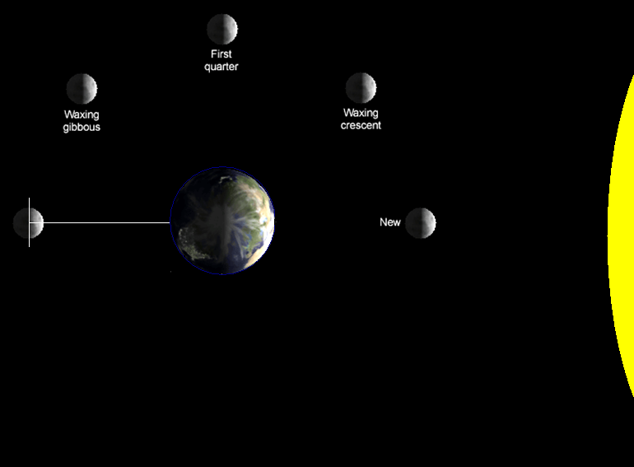
Full
Moon

Slide 13
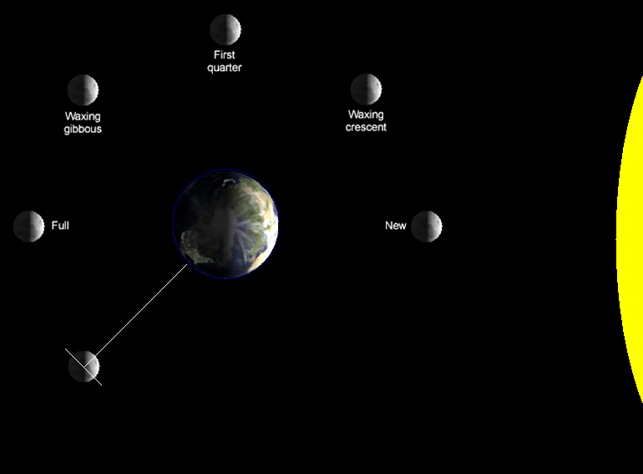
Waning
Gibbous
Notes:
ST:
Here we have a different term, Waning. Waning means to simply get smaller. On this side of the rotation, the amount of light we see from Earth reflected by the moon is decreasing. Remember though, the moon still and always only has about 50% of its surface illuminated.

Slide 14
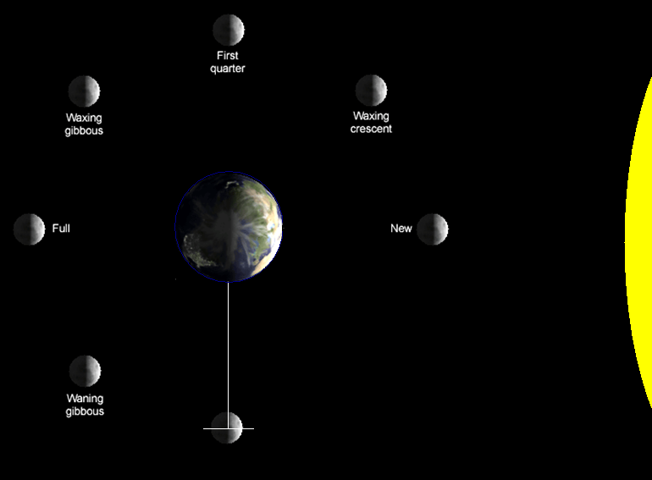
Third
Quarter

Slide 15
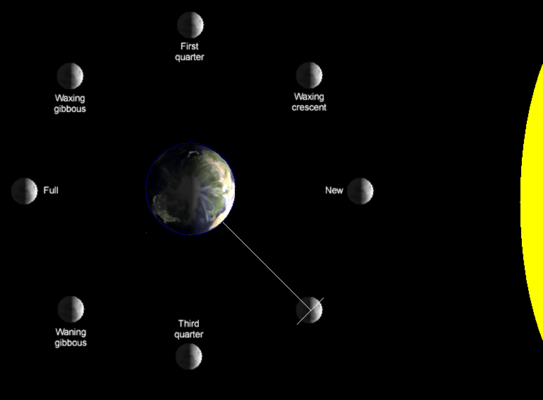
Waning
Crescent

Slide 16
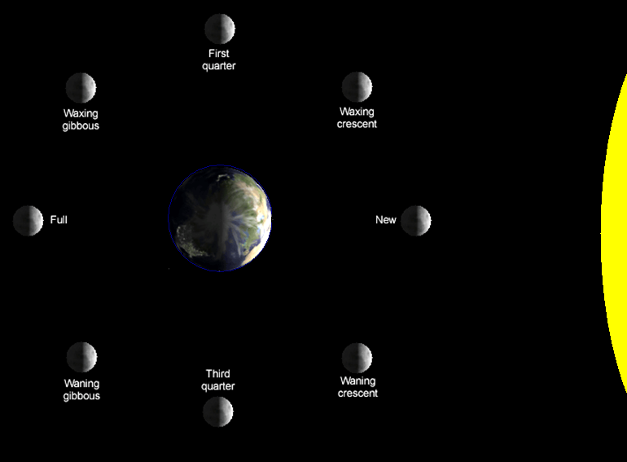
Notes:
ACT: (see activity sheet)
Now we are going to do an activity:
Each student (or pair of students) will take a Styrofoam ball on a wooden stick and hold it up to a lamp in the room. The ball of Styrofoam is the moon and the head of the student holding the stick is the Earth. Students rotate in place keeping the ‘moon’ directly infront of them and the light source stationary. As the students rotate they will be able to see the ‘moon’ light up in a similar way to the phases of the moon.
Note that students who’s heads (or Earth) get in the way are experiencing and eclipse. Have them raise their moon to see the effects of the phases.

Slide 17
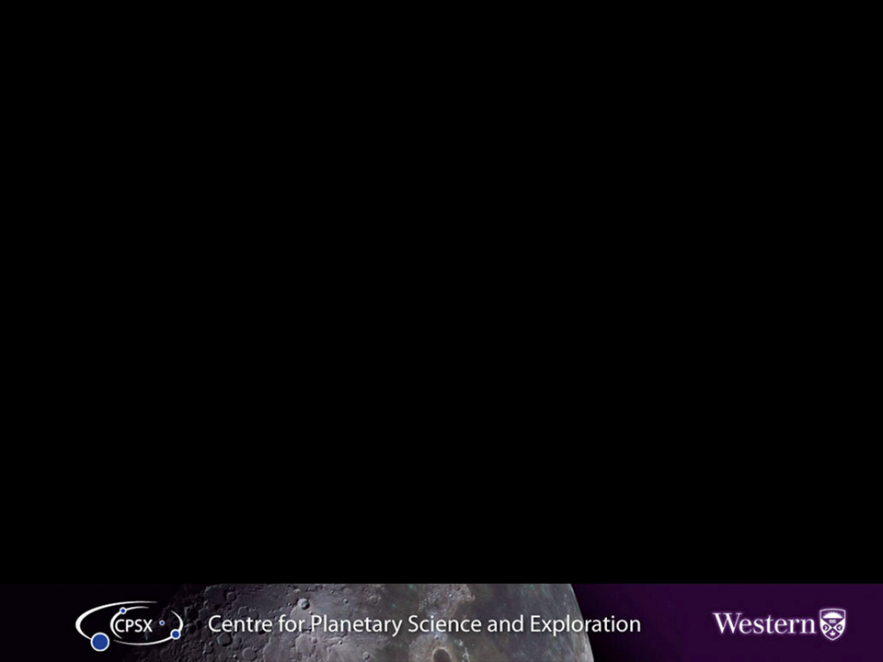
Waxing Gibbous
First Quarter
Waxing Crescent
Full Moon
New Moon
Waning Gibbous
Third Quarter
Waning Crescent
Notes:
Here are all the phases together. The moon always has half of its surface illuminated, it just depends where the moon is in its orbit around Earth as to how much of the lunar surface we can see.

Slide 18
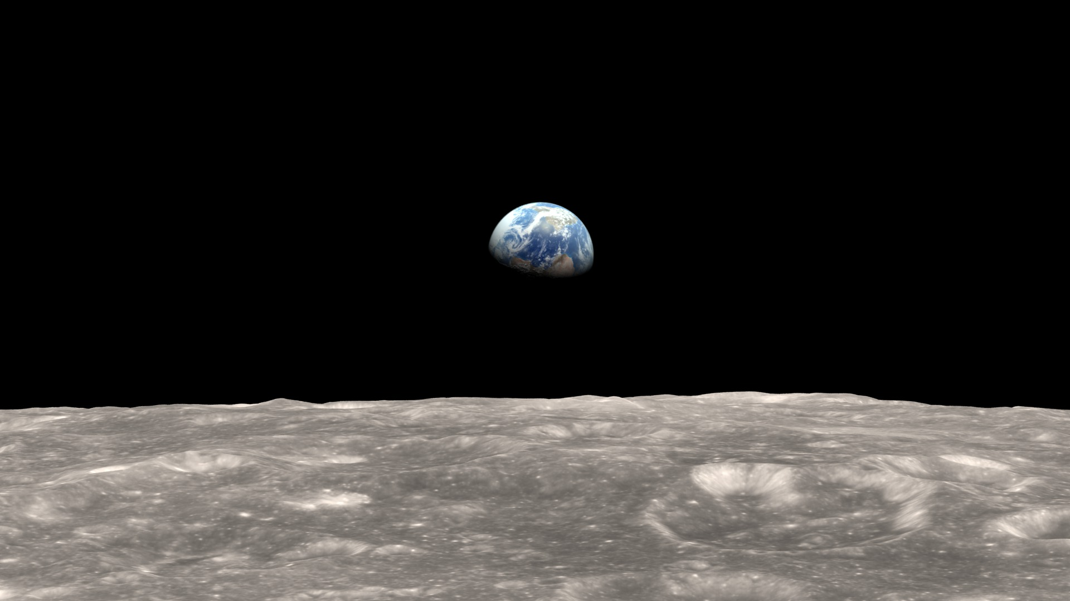
Earth has phases too!
Notes:
This is a view from Apollo 8 of Earth as it orbits the Moon, Dec 1968. If we were on the moon looking back at Earth, over the course of a month we would be able to see the same phases on Earth as we do the moon. Every month there would be a “New Earth” and a “Full Earth”.
https://svs.gsfc.nasa.gov/cgi-bin/details.cgi?aid=4129

Slide 19
What happens when the Earth, Moon and Sun become aligned?

Slide 20
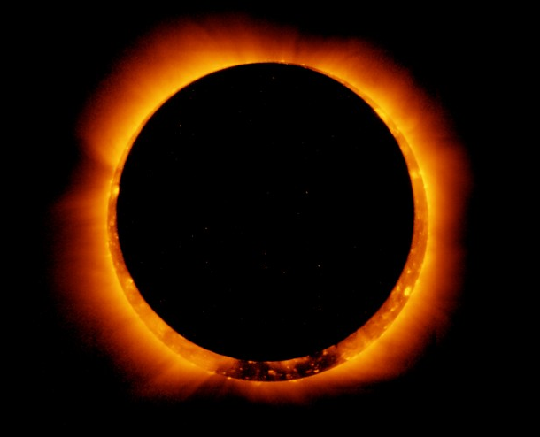
Eclipses

Slide 21
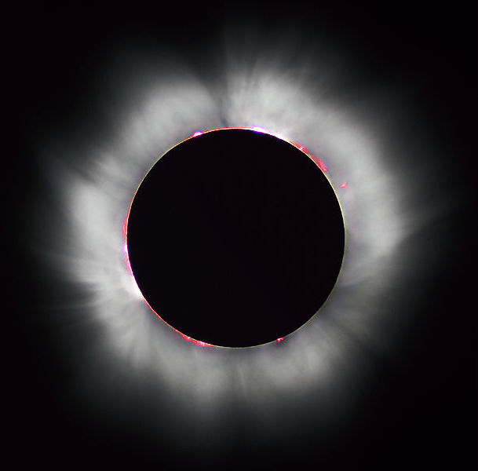
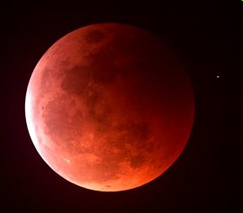
What kind of eclipses can occur?
Solar
Lunar
Notes:
What kinds of eclipses are there? Wait for student responses
Solar and Lunar.
The white halo we see around the Sun is called the Corona, which is only visible during a solar eclipse. The corona is made up of a substance called plasma and is extremely hot – over 2 million degrees celsius!! The corona is not very dense though, and so produces a lot less light, which is why we only see it during an eclipse.

Slide 22
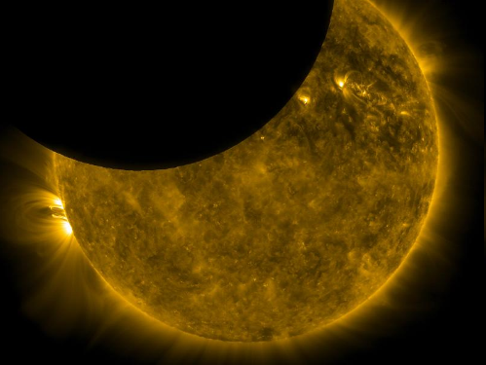
Solar Eclipse Types
Total Eclipse - Umbral
Annular Eclipse - Antumbral
Partial Eclipse - Penumbral
Notes:
There are three types of solar eclipses, depending both on your position on Earth when the eclipse begins, as well as how close the Moon is to the Earth (the Moon has an elliptical orbit, with a variation in distance to the Earth of 13%).
Total Eclipse – the Earth is within the Moon’s umbra
Annular Eclipse – the Earth is in the Antumbra of the Moon
Partial Eclipse – the Earth is in the Penumbra – this can also occurs during a Total Eclipse

Slide 23
Why are there different types of solar eclipses?
The orbits of Earth and the Moon are not perfect
It just depends how Earth aligns with the Moon’s shadow from the Sun
Notes:
The orbits of the Earth, Moon and Sun are not all in the exact same plane so a slight deviation in their positions relative to each other results in a missed eclipse opportunity. Since we do not have a lunar and solar eclipse every month, the alignment of Earth, Moon and Sun must be precise in order to occur.

Slide 24

Location of Earth determines eclipse
Total
Sun
Moon
Partial
Annular
Not to scale!!
Notes:
The location of Earth with respect to the shadow created by the Moon determines what type of solar eclipse will be observed.
(Image created by Jen Newman)
The umbra, in which the moon completely covers the sun (more precisely, its photosphere) = TOTAL Eclipse
The antumbra, extending beyond the tip of the umbra, in which the moon is completely in front of the sun but too small to completely cover it = ANNULAR eclipse
The penumbra, in which the moon is only partially in front of the sun. = PARTIAL Eclipse

Slide 25
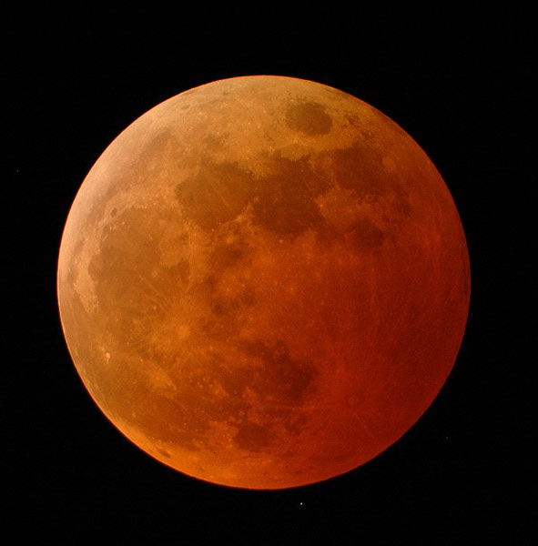
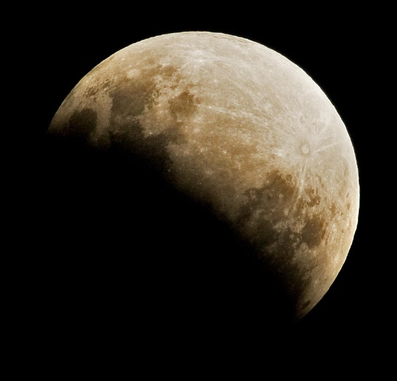
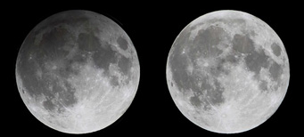
Lunar Eclipse Types
Total Eclipse - Umbral
Partial Eclipse - Umbral
Penumbral Eclipse
Max eclipse
No eclipse
Notes:
The most recognizable type of lunar eclipse is a total eclipse, with its eerie red colour.
A partial eclipse is a darkening of the moon’s surface, without turning red (as happens during a total eclipse). Can look very similar to moon phases, but unlike the phases that take days to change the amount of lunar surface that is illuminated, partial lunar eclipses occur over a matter of hours then return to being a fully illuminated full moon.
Penumbral eclipses are very subtle and usually go unnoticed. There is only a slight darkening of the lunar surface.
Total lunar: http://science1.nasa.gov/science-news/science-at-nasa/2007/12feb_lunareclipse/
Partial lunar: http://wvxu.org/post/guide-experience-partial-lunar-eclipse-saturday#stream/0
Penumbral: http://www.skyandtelescope.com/observing/harvest-moon-penumbral-eclipse/

Slide 26
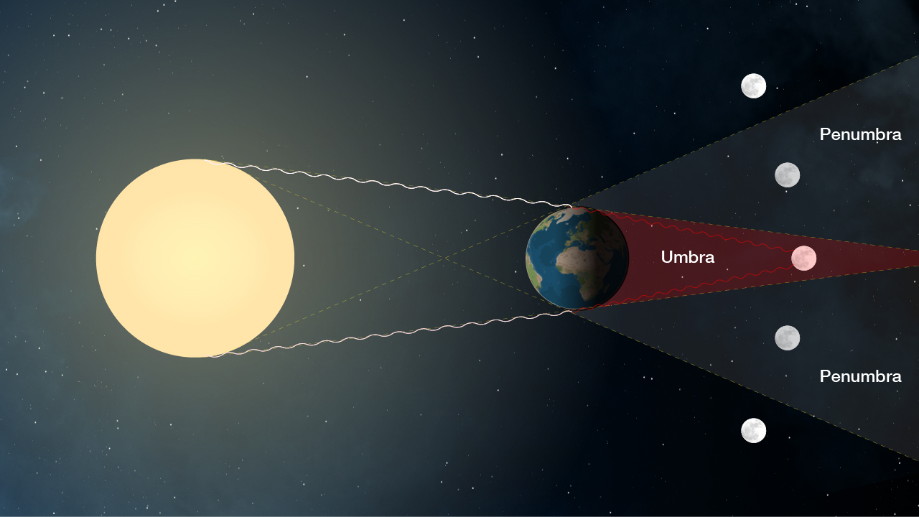
Location of Moon determines eclipse
Notes:
Total lunar eclipse- moon is completely within the umbra
Partial lunar eclipse- moon does not fully enter the umbra
Penumbral eclipse- Earth blocks only a portion of the sun’s light, but not all, like what happens during a total lunar eclipse
http://mars.nasa.gov/allaboutmars/nightsky/total-lunar-eclipse/

Slide 27
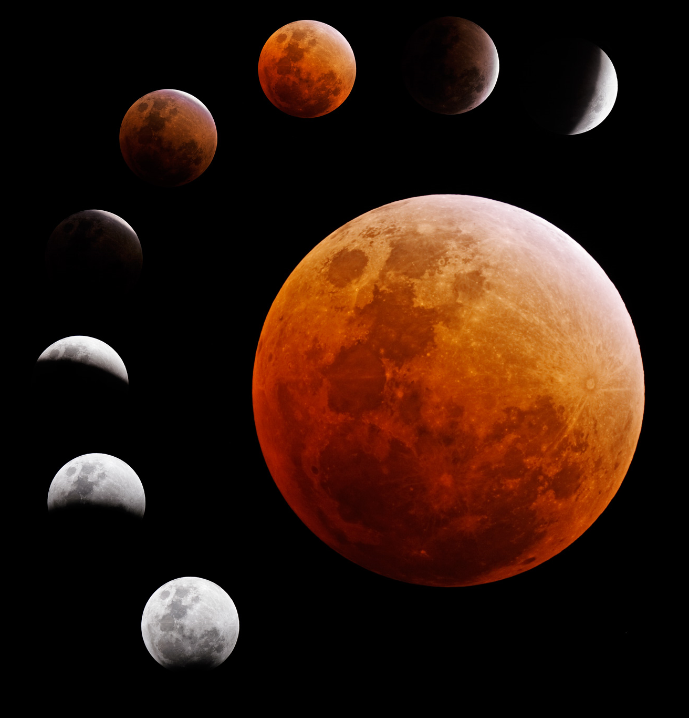
Lunar Eclipse
Why does the moon look red?
Notes:
Why does the moon look red?
Answer: Because of Earth’s atmosphere. Sunlight refracted through the Earth’s atmosphere intersects the umbra and still provides faint illumination.

Slide 28
How often do eclipses happen?
Solar Eclipses: 2-5 a year are possible
Eclipse type | Date | Visible in North America?
Annular | 26 Feb 2017 | No
Total | 21 Aug 2017 | Yes!!
Partial | 15 Feb 2018 | No
Partial | 13 Jul 2018 | No
Partial | 11 Aug 2018 | No
Partial | 5 Jan 2019 | No
Total | 2 Jul 2019 | No
Annular | 26 Dec 2019 | No
Notes:
See https://www.timeanddate.com/eclipse/list.html for yearly updates
Solar eclipses can technically only happen twice a year, this is because the moon’s orbit around the Earth is inclined at 5 degrees to the ecliptic, so most of the time the Moon’s shadow misses us. This is why we don’t have an eclipse on every new moon. Twice a year, however, the orbits line up and it is possible to have a solar eclipse.
Similarly, Lunar eclipses can only occur on the full moon, but because of the tilt in the Moon’s orbit, the Moon is not eclipsed every month. Lunar eclipses can be visible from entire hemispheres, this is because the umbra of the Earth is much larger than the umbra of the Moon.

Slide 29
How often do eclipses happen?
Lunar eclipses: 0-3 total eclipses per year
Eclipse type | Date | Visible in North America?
Penumbral | 10 Feb 2017 | Yes
Partial | 7 Aug 2017 | No
Total | 31 Jan 2018 | Yes - only a portion visible
Total | 27 Jul 2018 | No
Total | 20 Jan 2019 | Yes
Partial | 16 Jul 2019 | No
Penumbral | 10 Jan 2020 | No
Penumbral | 5 Jun 2020 | No
Notes:
See https://www.timeanddate.com/eclipse/list.html for yearly updates
Solar eclipses can technically only happen twice a year, this is because the moon’s orbit around the Earth is inclined at 5 degrees to the ecliptic, so most of the time the Moon’s shadow misses us. This is why we don’t have an eclipse on every new moon. Twice a year, however, the orbits line up and it is possible to have a solar eclipse.
Similarly, Lunar eclipses can only occur on the full moon, but because of the tilt in the Moon’s orbit, the Moon is not eclipsed every month. Lunar eclipses can be visible from entire hemispheres, this is because the umbra of the Earth is much larger than the umbra of the Moon.

Slide 30

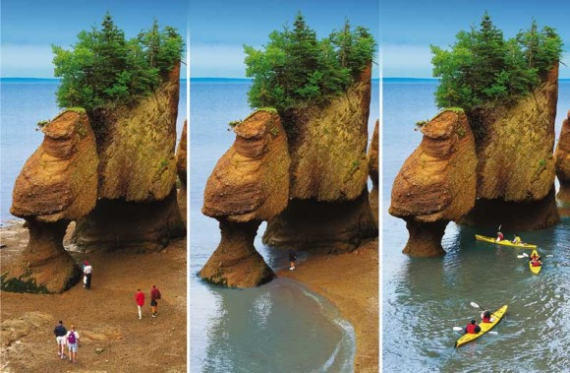
Tides
How are tides related to the Moon??
Bay of Fundy, Nova Scotia
Notes:
Now we’re going on to tides – can anyone tell me what I mean by “tides”? (students should mention something about the oceans rising and falling, and might also know it’s due to gravitational interactions from the Moon (and Sun))
The Bay of Fundy in Nova Scotia experiences the largest tide change in the world (about 16m or 53 feet)!

Slide 31
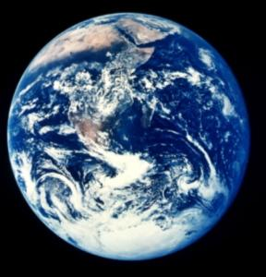
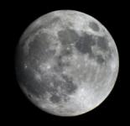
Where are the tides?
High Tide
High Tide

Slide 32
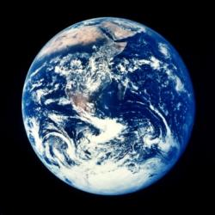
Cause of High Tide
Moon over head
Moon under foot
Notes:
ST:
High Tides are caused by the Tides are cause primarily by the moon. It acts on the Earths water system via gravity pulling the water towards it when it is closest. Imagine that we are the star and the moon is above us…
This isn’t the whole story though because the moon doesn’t just pull the water…

Slide 33
High Tides: Making things more complicated
Every ~24hrs
2 high tides
2 low tides
Notes:
Q:
How often do we experience Tides?
AR:
In most places tides cycle through 2x per day. That means we experience 2 high tides and 2 low tides in approximately 24 hours.
ST:
Because the Earth makes a revolution every 24 hours we cycle through 2 high tides and 2 low tides. Why is it approximate? Since the moon is also rotating around the Earth, it doesn’t stay put while we rotate. Remember that the reason we see the phases of the moon is because the moon is not in exact same position after 24 hours. It actually takes around 24 hours and 50 minutes for the moon to be back in the same relative position.
Other complications.
The moon does not rotate in an exact circle but rather in the shape of an ellipse (oval). This means that sometimes the tides are higher than other times.
There is a delay and so high tide is not always when the moon is ‘directly’ over head and underfoot.

Slide 34

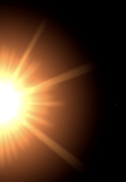

The Sun and Tides
Spring Tides
Neap Tides
2 spring tides every ~28 days
  New Moon
  Full Moon
2 neap tides every ~28 days
  First Quarter Moon
  Third Quarter Moon
Notes:
Q:
The sun is a massive body. What kind of an effect do you think the sun would have on the tides?

Slide 35
Thank you!
Questions?
@westernuCPSX
cpsx.uwo.ca/outreach
Facebook.com/westernuCPSX

Slide 37
EXTRA SLIDES
Extra Slides

Slide 38
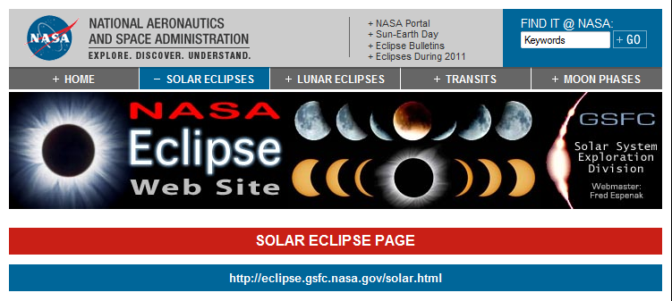
Want more info?
Notes:
Solar eclipses can technically only happen twice a year, this is because the moon’s orbit around the Earth is inclined at 5 degrees to the ecliptic, so most of the time the Moon’s shadow misses us. This is why we don’t have an eclipse on every new moon. Twice a year, however, the orbits line up and it is possible to have a solar eclipse.
Similarly, Lunar eclipses can only occur on the full moon, but because of the tilt in the Moon’s orbit, the Moon is not eclipsed every month. Lunar eclipses can be visible from entire hemispheres, this is because the umbra of the Earth is much larger than the umbra of the Moon.

Slide 39
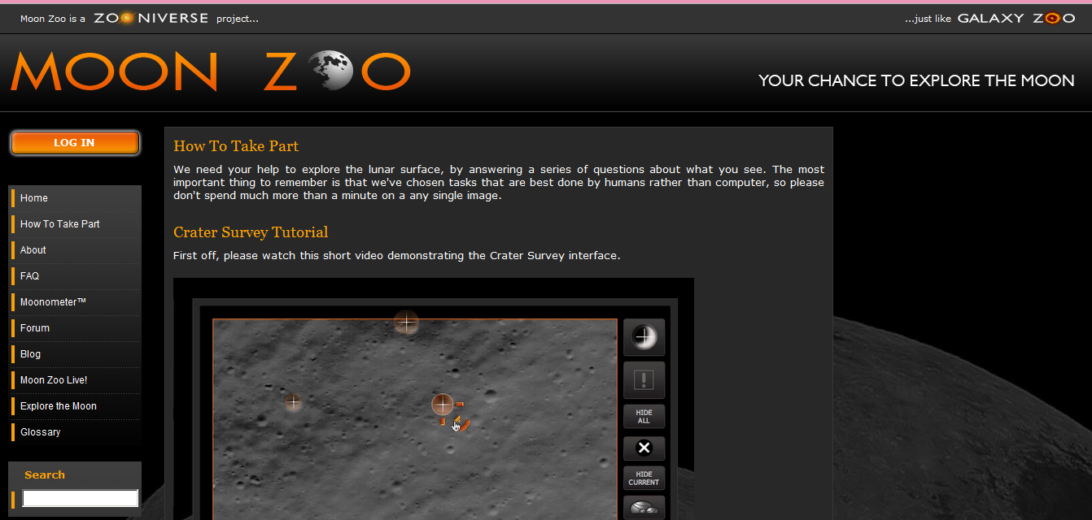
Moon Zoo (www.moonzoo.org)
Notes:
Moonzoo.org
What do we want to know?
The aim of Moon Zoo is to provide detailed crater counts for as much of the Moon's surface as possible. Unlike here on Earth where weather quickly erodes any signs of all but the most recent impacts, craters on the lunar surface stay almost until eternity. That means that the number of craters on a particular piece of the surface tells us how old it is. This technique is used all over the Solar System, but the Moon is particularly important because we have ground truth — samples brought back by the Apollo missions — which allow us to calibrate our estimates. Planetary scientists have always carried out this kind of analysis on large scales, but with your help and the fabulous LRO images then we should be able to uncover the finer details of the Moon's history.
Craters can tell us more than just the history of the lunar surface though. In particular, you're asked in Moon Zoo to look for craters with boulders around the rim. Boulders are a sign that the impact was powerful enough that it excavated rock from beneath the regolith (the lunar 'soil') and so by keeping an eye out for these we can begin to map the depth of the regolith across the surface of the Moon.
39

Slide 40
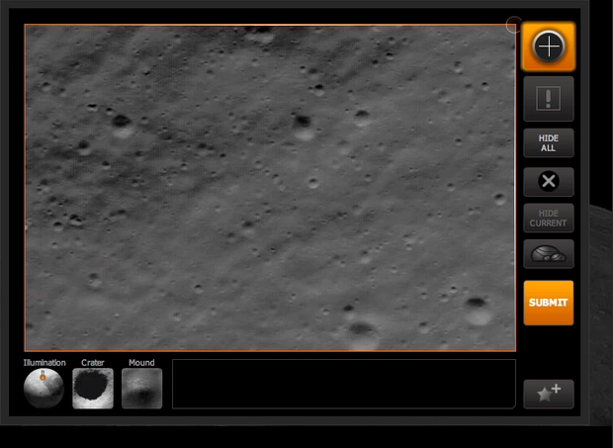
Notes:
40

Slide 41
Earth, Sun, Moon: Sizes
Earth Radius: 6,378 km Diameter: 12,756 km
Moon Radius: 1,737 km Diameter: 3,474 km
Sun Radius: 695,500 km Diameter: 1,391,000 km
It would take ~109 Earths to cross the surface of the Sun; and 3.5 moons would cross the surface of the Earth at the equator

Slide 42
Earth, Sun, Moon: Distances
Earth – Moon: 384,403 km
Earth – Sun: 149,597,870 km

Slide 43
Earth, Sun, Moon: Rotations and Revolutions
Rotation of the Earth: Counter-clockwise, 24 hours
Rotation of the Moon: Counter-clockwise, 28 days
Rotation of the Sun: Counter-clockwise, 24 days
Revolution of the Earth around the Sun:
Counter-clockwise, 365.25 days
Revolution of the Moon around the Earth:
Counter-clockwise, 28 days

Slide 44
Earth, Sun, Moon: Model
If your head (~25cm diameter) represents Earth, the moon would be a 7 cm diameter ball.
At this scale (50,000,000x smaller) the Earth-Moon distance would be 7.5 metres, and the Earth-Sun distance would be 2.9 km.

Slide 45
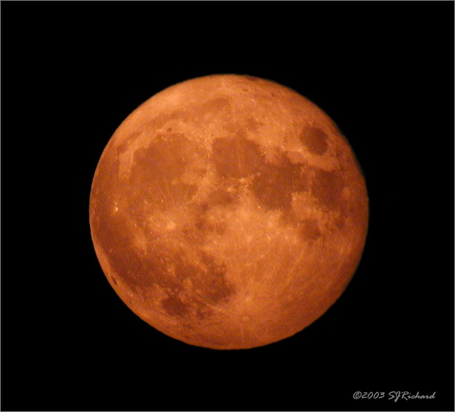
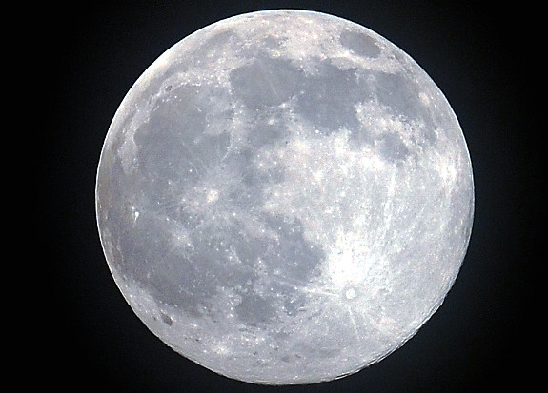
Blue Moon
Harvest Moon
Notes:
Harvest Moon – First full moon after autumnal equinox
Often, the harvest moon seems to be bigger or brighter or more colorful than other full moons. The warm color of the moon shortly after it rises is caused by light from the moon passing through a greater amount of atmospheric particles than when the moon is overhead. The atmosphere scatters the bluish component of moonlight (which is really reflected white light from the sun), but allows the reddish component of the light to travel a straighter path to one's eyes. [source Wikipedia]
Blue moon: When you have a second full moon in one month. Most years have twelve full moons that occur approximately monthly. In addition to those twelve full lunar cycles, each solar calendar year contains roughly eleven days more than the lunar year of 12 lunations. The extra days accumulate, so every two or three years (7 times in the 19-year Metonic cycle), there is an extra full moon. [source Wikipedia]

Slide 46
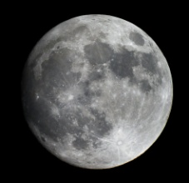
Surface of the Moon

Slide 47
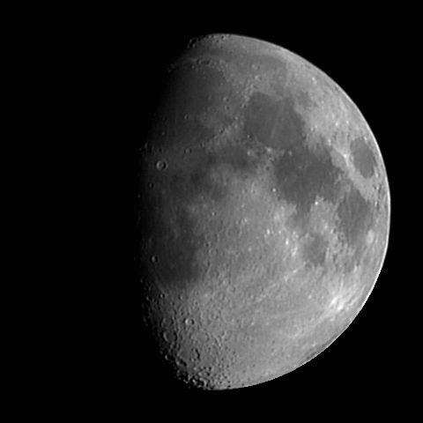
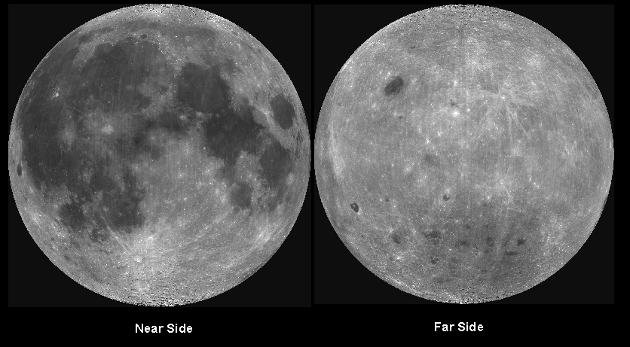
On the Lunar Surface
terminator
mare
highland
Notes:
Near Side: What do we see? *Wait for student response*
Round features are impact craters; range from ~1m to few 100km’s!!
Dark areas are “mare”: filled with volcanic materials (rich in Fe)
Highland areas have less Fe content than mare.
Show samples of basalt and highland like samples
Terminator: imaginary line that separates illuminated and dark parts of the moon. The location of the terminator line varies by time of day due to the rotation of the Moon on its axis as well as the revolution of the Moon around the Earth.
With far side and near side views: What is the difference??? **Wait for student response*
Near side has more mare areas unlike far side
Location of South Pole – Aitken basin (the second largest in the solar system)

Slide 48
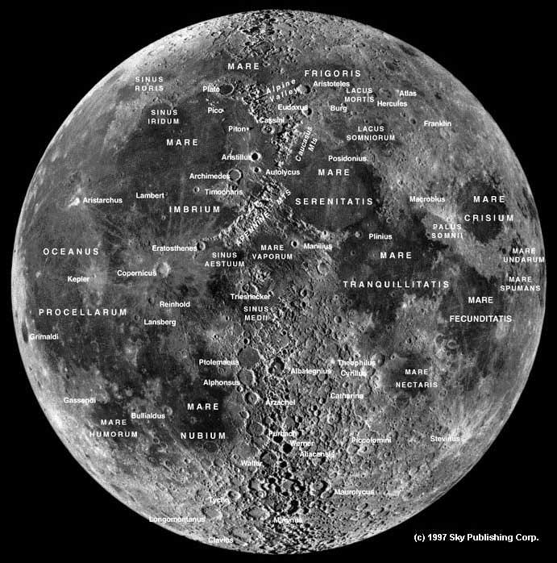
Craters
Mountains
Valleys
Frozen water at poles??
Notes:
Features are named after famous scientists, scholars, artists and explorers
Surface features give us a clue of the lunar history and about the planet’s interior

Slide 49
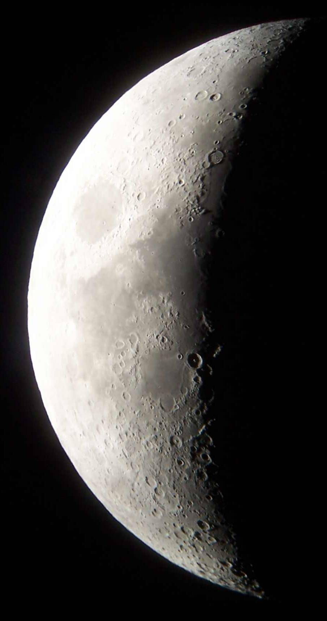
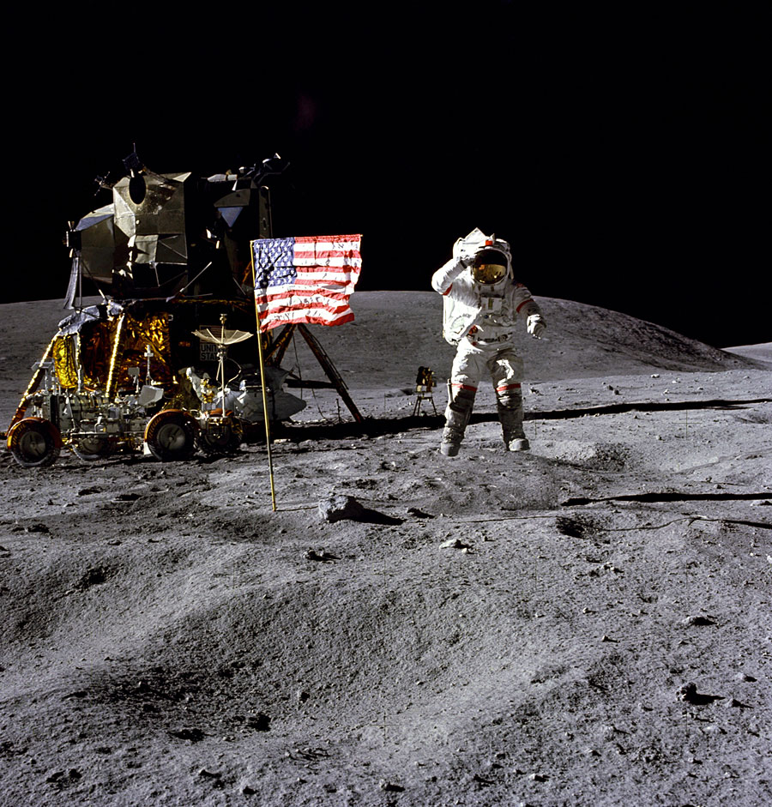
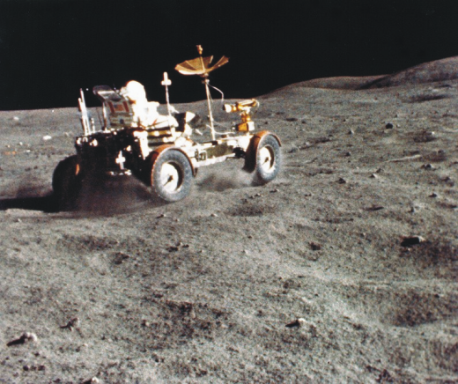
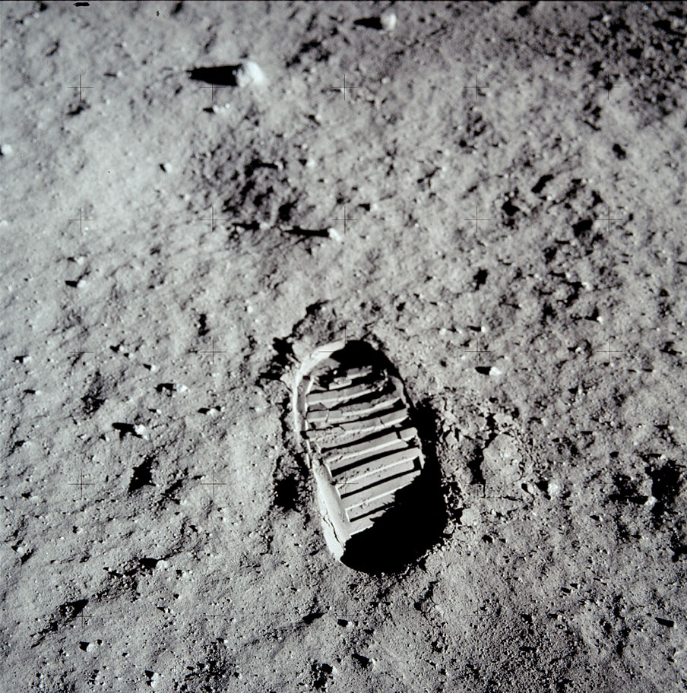
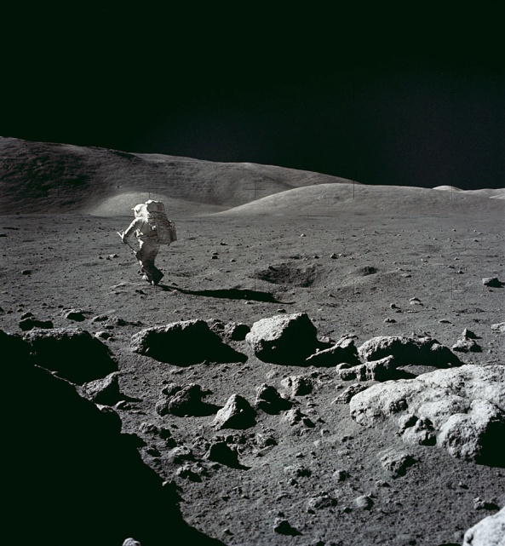
Moon’s Surface: Apollo
Images from NASA
Notes:
*Question to the students – so how do we study the lunar surface??*
A lot of what we know about the moon’s surface is from the Apollo missions during the 1960s…..
Rocks collected have given us clues of surface ages
Seismometers left behind have been used to detect moonquakes that occur below surface

Slide 50
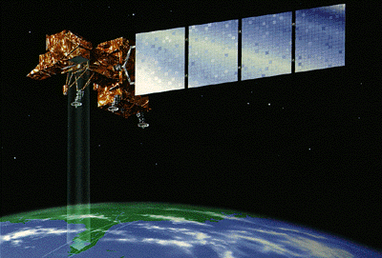
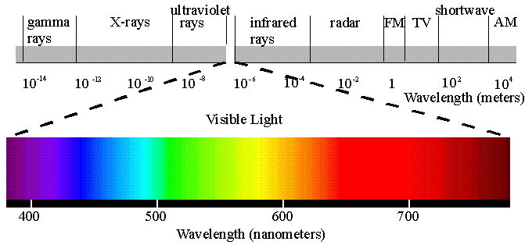
How do we study the Lunar surface?
Notes:
- Use Reflectance spectroscopy
- Spectrometers on spacecrafts
- Compare to known Earth and Apollo samples
- Make maps of the mineral and chemical composition of the surface
50

Slide 51
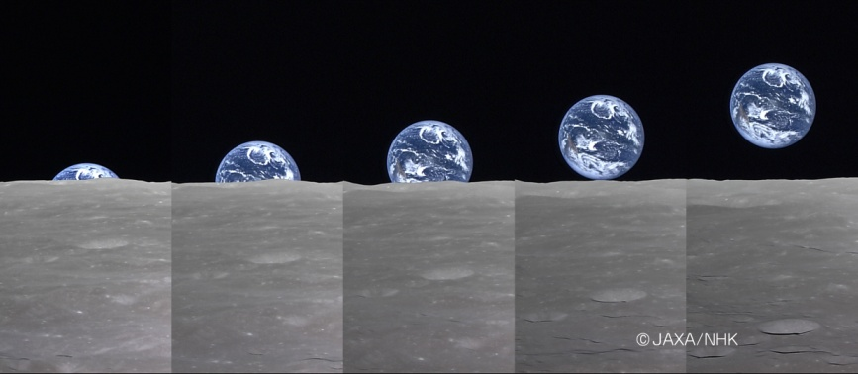
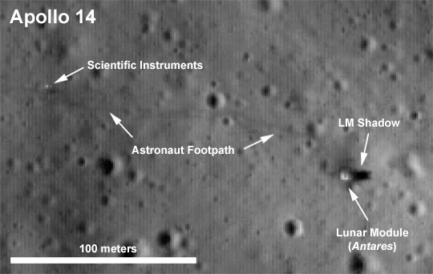
High Tech Instruments on Missions
Lunar Reconnaissance Orbiter
Kaguya – JAXA

